Slide 1

Navigating the Future of Education
Mike Sharples
Institute of Educational Technology
The Open University, UK

Slide 2
Education system in 10 years time?
Radical change
Technology
led
Society
led
Pedagogy
led
Little change

Slide 3
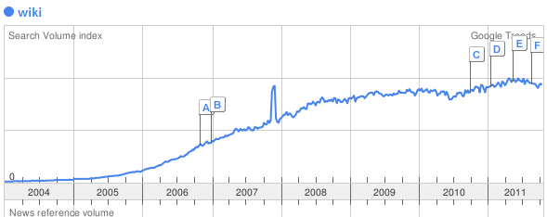
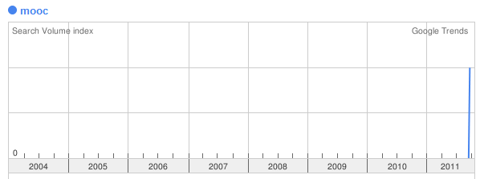
Wiki
Blog
Twitter
Podcast
Social media
Second Life
Mobile learning
Cloud computing
MOOC (Massive open online course)
Wiki
MOOC
Any more?

Slide 4
How can education respond to continual innovation in technology?

Slide 5
How can education respond to continual innovation in technology? ...
... is the wrong question to ask
  because it misunderstands the relation between technology and education

Slide 6
Influence of Technology on Education
“Books will soon be obsolete in the schools. . . . It is possible to teach every branch of human knowledge with the tablet computer. Our school system will be completely changed in ten years”
Do you agree or not? Why?

Slide 7
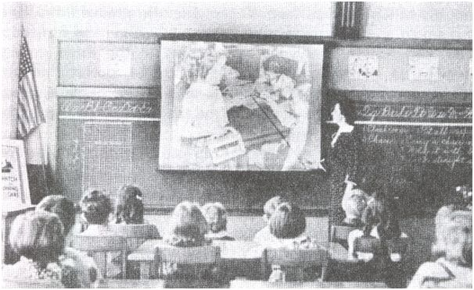
Influence of Technology on Education
“Books will soon be obsolete in the schools. . . . It is possible to teach every branch of human knowledge with the motion picture. Our school system will be completely changed in ten years”
Thomas Edison, 1913

Slide 8

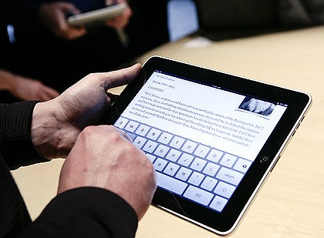
What is the difference between these tablet devices?

Slide 9
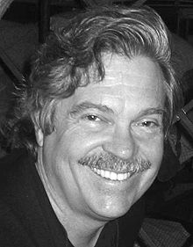
Answer: 35 years!
Dynabook 1974
Alan Kay
iPad 2010
“A personal dynamic medium for children of all ages”
Learning Research Group, Xerox PARC

Slide 10
The education system is resistant to change from a single technology
For innovative technology there is normally a long gap from vision to successful implementation
Moral: Don’t try to respond immediately to the latest technology innovations

Slide 11
The right question to ask is:
How can we navigate and design the future of education?

Slide 12
Any questions or responses so far?

Slide 13
How can we navigate and design the future of education?
Distinguish hype from reality, ephemeral from valuable
  Learning sciences
Indentify ‘weak signals’ of systemic change
  Education futures
Support design-based research studies
  Educational technology
Scale best practice
  Educational policy

Slide 14
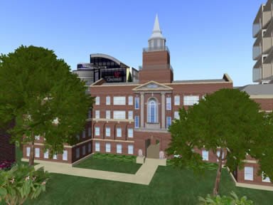
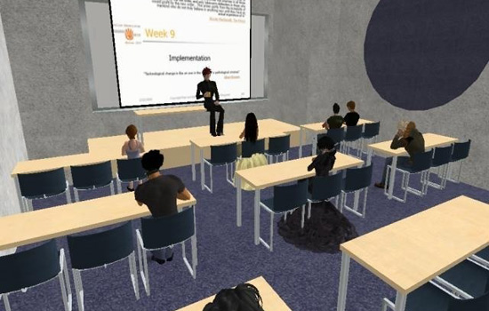
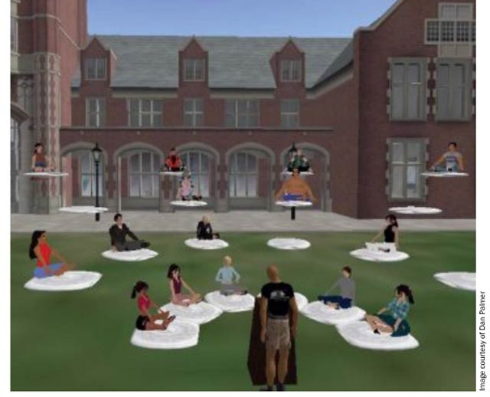
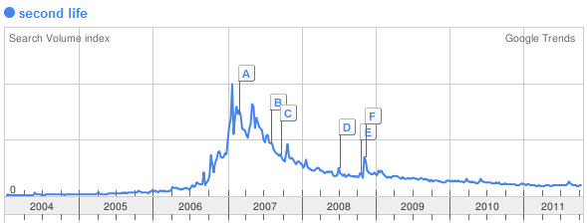
Hype or value: Virtual Worlds?
MOOC

Slide 15
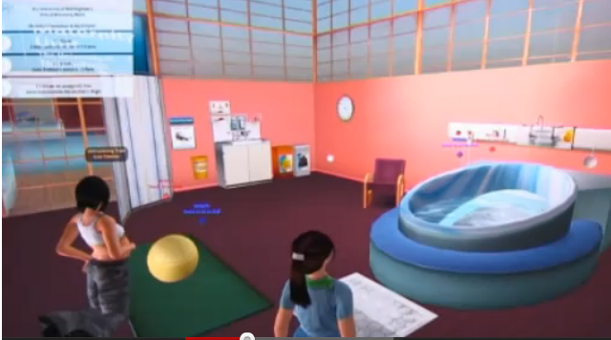
Nottingham University midwifery training
http://www.youtube.com/watch?v=UvUEdI-imhs#t=02m00s

Slide 16
Hype or value: Blended learning?
US meta-study of comparisons of online and face to face teaching in higher education
On average, students in online learning conditions performed better than those receiving face-to-face instruction
Bigger effect in studies that blended online and face-to-face
Blended conditions often included additional learning time and instructional elements not received by students in control conditions
B. Means et al. (2009) Evaluation of Evidence-Based Practices in Online Learning: A Meta-Analysis and Review of Online Learning Studies. US Department of Education

Slide 17
Hype or value?
Personalised learning
Open learning
Remote tutoring
Mobile learning
Assessment for learning
Massively open online courses
How can we evaluate these?

Slide 18
Weak signals
“If only we knew 10 years ago that students would be carrying powerful mobile devices around with then we’d have been able to plan our IT budgets and teaching methods”
ALT-C delegate

Slide 19
Weak signals
“If only we knew 10 years ago that students would be carrying powerful mobile devices around with then we’d have been able to plan our IT budgets and teaching methods”
ALT-C delegate
We did know that 10 years ago!

Slide 20
Weak Signals
A UK survey in January 2001 by the NOP Research Group [4] found that 48% of children aged 7-16 owned a mobile phone and that on average they sent 2.5 text messages per day.
Learners can command an increasing range of mobile technologies that have the potential to support learning anytime anywhere, but also to disrupt the carefully managed environment of the classroom. (Sharples, 2002) ‘Disruptive devices: mobile technology for conversational learning’

Slide 21
Weak Signals
We knew what was coming it’s just that most practitioners and policy makers didn’t see the broad consequences.
We need to distinguish between new technologies and systemic changes

Slide 22
Systemic changes
E-learning in the 1990s | Technology- enhanced learning in the 2000s
Constructivist learning | Social-constructivist learning
Online learning | Blended learning
VLEs and MLEs | Personal Learning Environments
Media-equipped teaching rooms | Flexible learning spaces
Desktop computer rooms | Support for students with multiple personal technologies
Creating re-usable learning objects | Open learning and student-created media
Collaborative learning | Open social learning
Evaluation of learning gains | Evaluation of learning transformations

Slide 23
Where is your institution?
(Discuss in text chat)
E-learning in the 1990s | Technology- enhanced learning in the 2000s
Constructivist learning | Social-constructivist learning
Online learning | Blended learning
VLEs and MLEs | Personal Learning Environments
Media-equipped teaching rooms | Flexible learning spaces
Desktop computer rooms | Support for students with multiple personal technologies
Creating re-usable learning objects | Open learning and student-created media
Collaborative learning | Open social learning
Evaluation of learning gains | Evaluation of learning transformations
A: Left column?
C: Right column?
B: In transition?

Slide 24

What are the signals for the next 10 years?
Near future (12 months)
  Interactive e-books
  Personal and mobile learning
  Open social learning
  Assessment for learning
Medium future (2-3 years)
  Augmented reality
  Game-based learning
  Learning design and orchestration
Longer term (4-5 years)
  Gesture based computing
  Learning analytics
  Learning toolkits
  Intelligent tutoring?
Educause Horizon Report 2011
http://net.educause.edu/ir/library/pdf/HR2011.pdf

Slide 25
From strategic priorities ...
Socially and personally inclusive education
Blended learning within and beyond the institution
Technology for teaching difficult topics and subjects
Creation of sharable and re-usable resources
Assessment for learning in the 21st century
Support environments for professional practitioners

Slide 26
... to systemic changes
Learning
  Inquiry-based learning; Networked learning
Mediation
  Digital mediation of text, voice, images, video, (sculpture? dance?)
Context
  Connecting learning in formal and non-formal settings
  Location-based guides, environmental simulations, social networks
Setting: wide-area education
  Open education; MOOCs
Agents: globalisation of education
  Outsourcing of teaching
  Multinational educational institutions

Slide 27
A tool for navigating and designing the future of education
Developed as part of research for Becta ‘Harnessing Technology’ strategy
Can be used to analyse or generate educational innovations

Slide 28
 | Learning |  | Context |  | Mediation |  | Agents
 | Delivered |  | Location Classroom Home Workplace Field ... |  | Communication Synchronous Asynchronous |  | Students
 | Reflective |  |  |  |  |  | Peers
 | Collaborative |  |  |  |  |  | Teachers
 | Simulation |  |  |  | Setting Single Co-located Distributed Virtual |  | Avatars
 | Construction |  | Process Teacher led Self-managed Peer Teamwork
 | Inquiry-driven
 | Problem-solving
 | Case-based
 | Cross-context |  |  |  | Technology Room Desktop Tablet Laptop Phone ... Representations Texts Images Virtual worlds Annotations ...
 | Game-based
 | Assessing
 | Performative |  | Subject Geography Geology Tourism History...
 | Conversational
 | Networked
 | Browsing
 | Embodied

Slide 29
Lecture
 | Learning |  | Context |  | Mediation |  | Agents
 | Delivered |  | Location Classroom Home Workplace Field ... |  | Communication Synchronous Asynchronous |  | Students
 | Reflective ? |  |  |  |  |  | Peers
 | Collaborative |  |  |  |  |  | Teachers
 | Simulation |  |  |  | Setting Single Co-located Distributed Virtual |  | Avatars
 | Construction |  | Process Teacher led Self-managed Peer Teamwork
 | Inquiry-driven
 | Problem-solving
 | Case-based
 | Cross-context |  |  |  | Technology Room Desktop Tablet Laptop Phone ... Representations Texts Images Virtual worlds Annotations ...
 | Game-based
 | Assessing
 | Performative |  | Subject Geography Geology Tourism History...
 | Conversational
 | Networked
 | Browsing
 | Embodied

Slide 30
MOOC
 | Learning |  | Context |  | Mediation |  | Agents
 | Delivered |  | Location Classroom Home Workplace Field ... |  | Communication Synchronous Asynchronous |  | Students
 | Reflective |  |  |  |  |  | Peers
 | Collaborative |  |  |  |  |  | Teachers
 | Simulation |  |  |  | Setting Single Co-located Distributed Virtual |  | Avatars
 | Construction |  | Process Teacher led Self-managed Peer Teamwork
 | Inquiry-driven
 | Problem-solving
 | Case-based
 | Cross-context |  |  |  | Technology Room Desktop Tablet Laptop Phone ... Representations Texts Images Virtual worlds Annotations ...
 | Game-based
 | Assessing
 | Performative |  | Subject Geography Geology Tourism History...
 | Conversational
 | Networked
 | Browsing
 | Embodied

Slide 31
Use the tool to:
  analyse an educational innovation
  propose and examine new types of learning (e.g. case-based, performative, assessing, with virtual worlds and avatars)

Slide 32
Changing landscape for education
Learning with personal technologies
  Personalised learning
Shift from content delivery to learning support
  Open learning, online tutoring and support, assessment for learning
Connecting learning in formal and non-formal settings
  Blended learning, mobile and contextual learning, workplace learning
Global engagement
  Transnational education, massively social learning

Slide 33
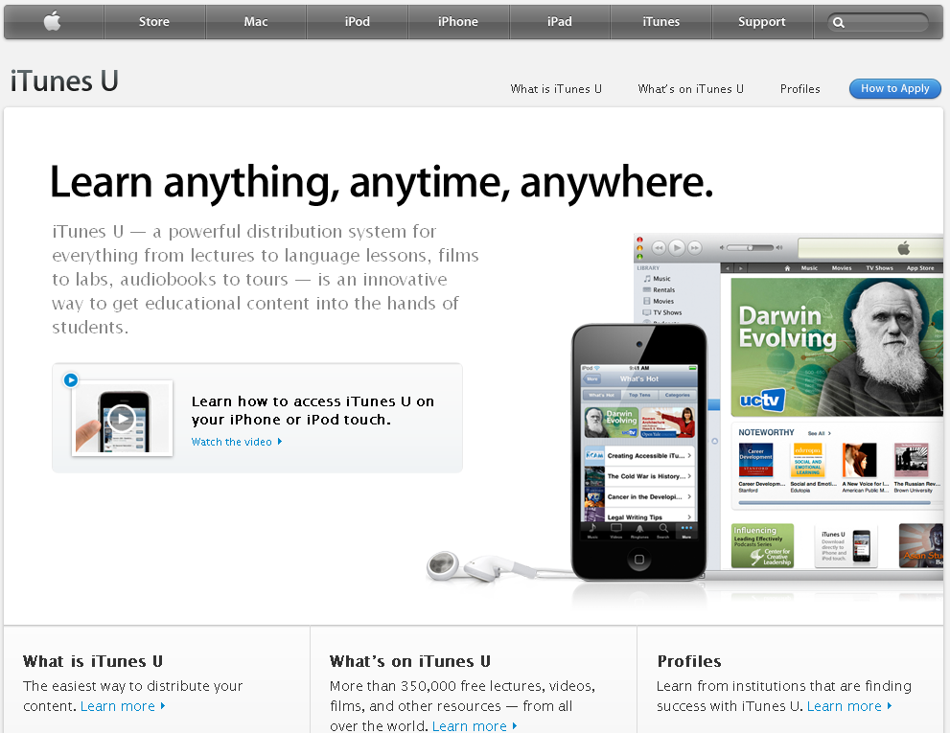
From Distribution: Open Learning

Slide 34
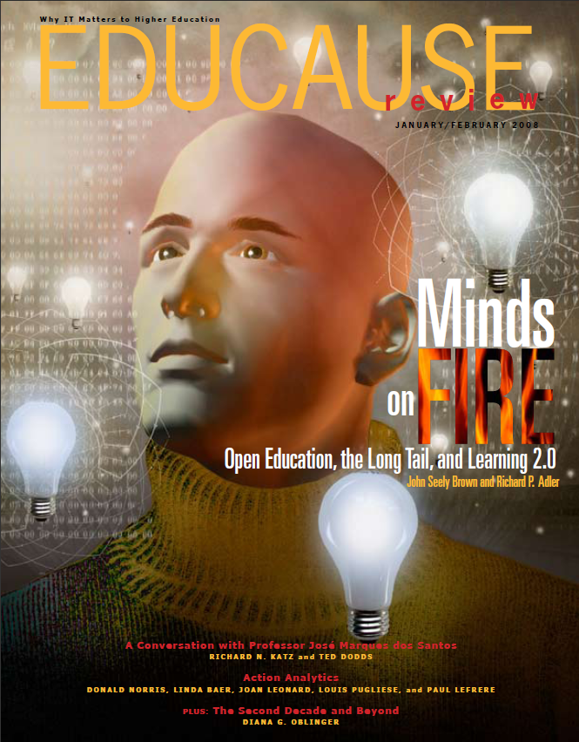
To Co-construction: Open Social Learning
Large scale social construction of knowledge
Open education practices
Social apprenticeship
Learning through construction, sharing and critique
Collaborative design
Open toolkits

Slide 35
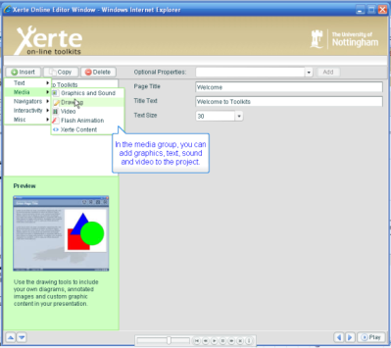
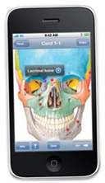
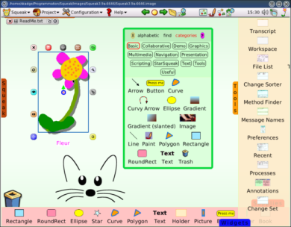
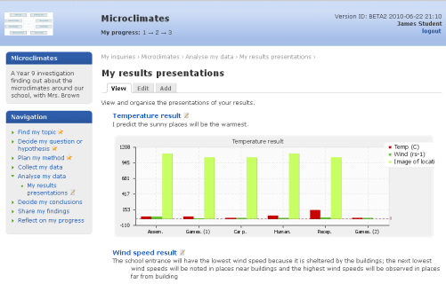
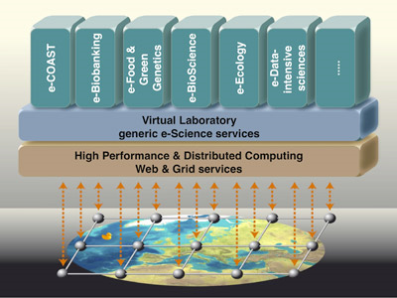
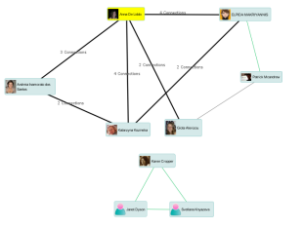
Create
Open learning toolkits
Access
Open Educational
Resources
Web 2.0/3.0
E-humanities
E-science
Open construction ecosystem
Share
Adapted from John Seeley Brown & Richard Adler, Minds on Fire, Educause, Jan-Feb, 2008

Slide 36

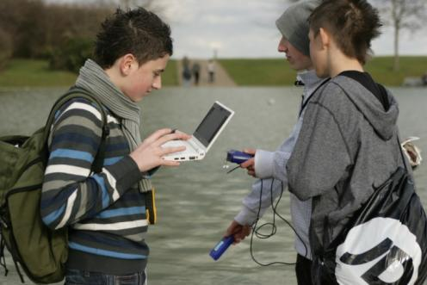
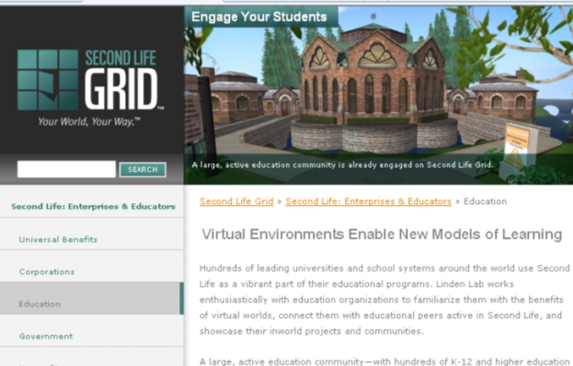
Navigating the future of education
Don’t evaluate how technology makes traditional learning slightly more efficient
Design effective forms of learning that can be enhanced by technology

Slide 37
Education system in 10 years time?
Radical change
Technology
led
Society
led
Pedagogy
led
Little change
Notes:
Optional – if time

