Slide 1
Amigos
Creating Independent Learning through Social Media.

Slide 2
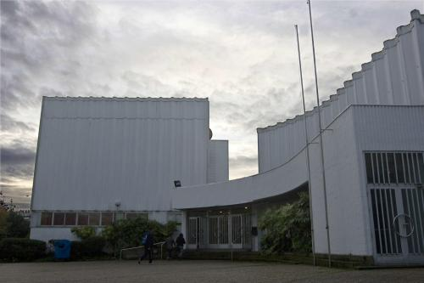
The pilot Project
Middlesbrough Community Learning Service.
La escuela de Idiomas A CORUÑA Spain

Slide 3
The Pilot Project
In the summer of 2011, 4 learners from Spain and 4 learners from Middlesbrough were identified .
Assessments and material were uploaded to the Amigos
class page on the Teeslearn / Moodle VLE.
Learners contacted each other through Skype and arranged to complete their assignments at a time convenient to both parties.
Learners uploaded their assignments for Tutor feedback.

Slide 4
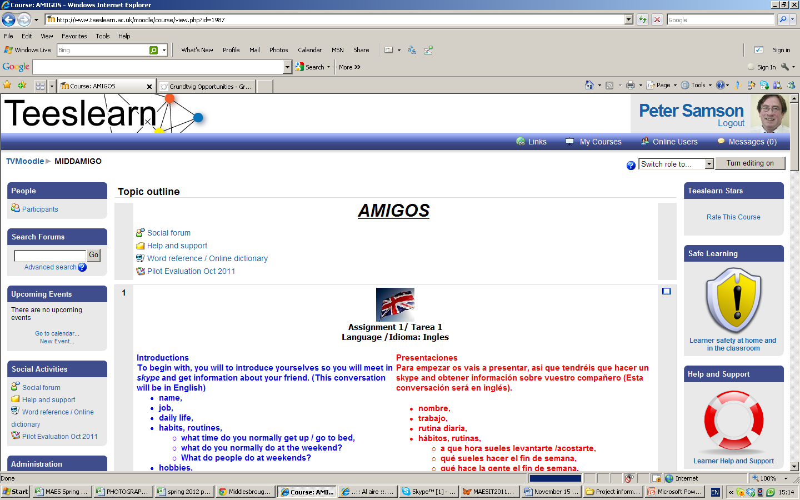

Slide 5
The next stage
An evaluation of the pilot project was devised and actions were put into place.
For example the assessments were too long. SMART targets were to be devised.
Skype details were added to the Moodle page, giving the learner the opportunity to contact other ‘Amigos’.
Further partners were contacted in France to extend the project.

Slide 6
SMART Targets
SMART stands for:
S - Specific - the target must say exactly what needs to be learned or done
M - Measurable- It must say exactly how this can be measured
A - Achievable - The target must not be too hard or too large, better to have several small targets leading to a larger goal.
R - Realistic - It must be possible to get access to any training, books or help needed to meet the target.
T - Timed - There should be a set time limit for achieving the target.
Read more: http://usefulwiki.com/page/SMART_targets#ixzz1dmiGGqBM

Slide 7
Amigos en France
L’institut Municipal d’Education Permanante / Bourges / France
Learners in France who are studying English now have the opportunity to contact their Amigos in England and learners who are studying Spanish can contact their Amigos in Spain.
Under construction
A partner in Guadeloupe is discussing possibilities for learners to make contact with their Amigos in England.

Slide 8
And next?
GRUNDTVIG EUROPEAN FUNDING OPPORTUNITY
Work is under way to find partners in Germany, Italy and possibly Russia and ??

Slide 9
Discussion
I would like to discuss in an open forum, possible;
Problems or Advantages
Learner skills? /Connectivity? / Safeguarding issues? / technical problems ? / Copyright? / Skype limitations -re Online conference / Possible use of recordings as evidence for RARPA- accredited evidence / Recording tools- software / recordings used as a resource./
+ ?

