Slide 1
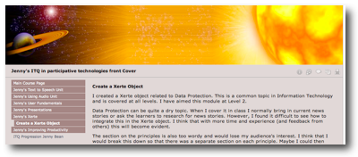
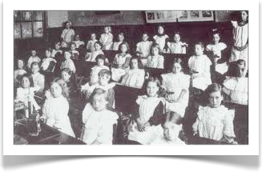
Completing a Mapped course by a Reflective process
Geoff Rebbeck
grebbeck@me.com
Geoff Rebbeck
JISC On-line Conference Nov 2011
Notes:
This presentation will shows how qualifications that are essentially mapped to outcomes can be delivered through a reflective process and Personal Learning Space. Reflection is a process related to a manner of thinking that leads to progress through insight. It is arguable that this method of learning is capable of delivering a deeper understanding of the subject matter as well is enjoying other spinoff attractions relating to the efficiency of the administration of learning and development of study skills that lead to self management of the learning journey on a life wide lifelong basis. An e-portfolio is a component part of a personal learning space and we have used PebblePad as the tool of choice for the personal learning space. What makes this difference from a portfolio is that the latter is simply a collection and indexing of assets used to demonstrate a point or purpose. It is the reflective thinking and sharing for critical consideration that broadens the new portfolio purpose into the grander personal learning space. Much of what FE colleges provide our courses and qualifications that are strictly mapped out come set by awarding bodies. The purpose of this presentation is to explain how those needs can still be met yet the learning journey can be richer and improve the quality of the learning and understanding.
Personal as opposed to group learning is not a new concept in itself but the availability of personal learning space, it's self made possible by the refining and improvement to technology provides an accommodation or stage on which personal learning can take place. It is arguable that in the dominant advancement of the BLE over the last seven years may now finally be checked as the technology for the many gives way to the technology for the one.
thoruout the presentatin I will be demonstrating an ITQ in participative leaving deviesed by JISC TechDis and validated by City & Guilds that we ran at Thanet College to exploiore the possibility of delivering a mapped qualification through a reflective porcess and whether it could be doen beond the reach of the VLE (Moodle in this instance).

Slide 2
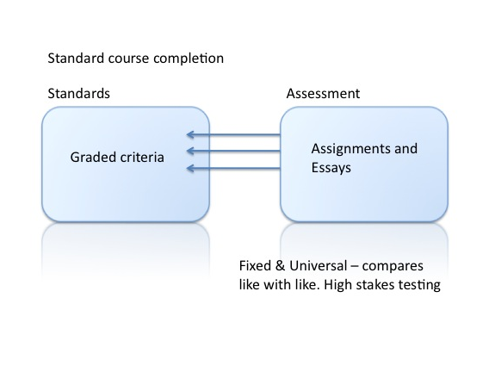
The orthodox model
Geoff Rebbeck
JISC On-line Conference Nov 2011
Notes:
Learning can be a very simple process. It may rely simply on the student providing evidence of a graded standard of attainment in matching a series of outcomes that define the qualification. This method is particularly useful where the curriculum is basic and is part of a general foundation of learning. It is also an efficient model in taking a group of learners together on a common journey where the start, finish and pacing of the course is reasonably fixed for all. The teacher describes the position and height of the learning hurdles that students need to jump and declares when student has cleared them.
The outcome is a fixed and universal standard in that students can be compared on a like-for-like basis across institutions. This has been the traditional model of education.

Slide 3
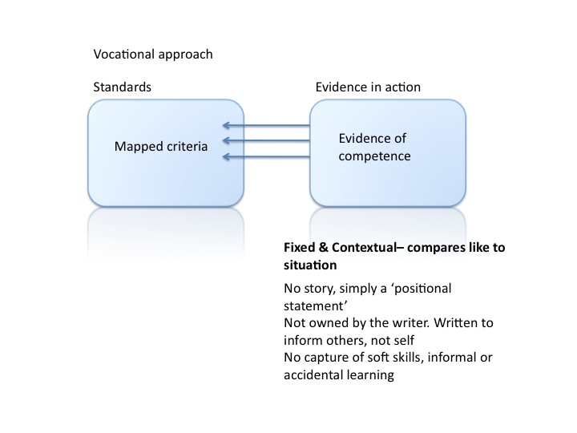
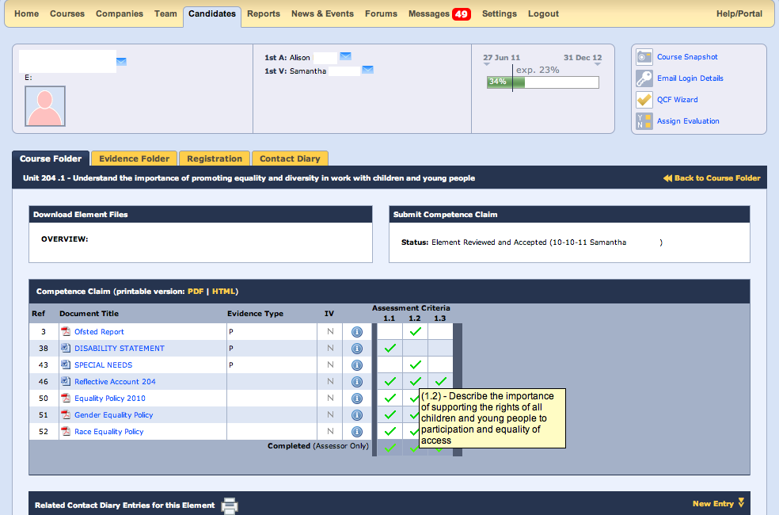
The NVQ model
Geoff Rebbeck
JISC On-line Conference Nov 2011
Notes:
Mapping portfolios represent a transitional model between the Orthodox position and the new personal learning space.They are a good example of a portfolio rather than a personal learning space because there is no prominence given to reflective thought, critical friendships, critical writing, capture of soft skills, and ability to demonstrate high-level thinking. The student merely in maps evidence onto the learning outcome hooks and once the evidence has been matched the qualification is achieved. It has the administrative convenience over a paper-based system but lacks the refinement of a personal learning space. The NVQ process is thoroughly understood and the behaviour of candidates, assessors, and verifiers are easily reduced into the software processes giving a high probability of alignment of software to purpose. The very rigidity of mapping portfolios is one of its strengths in that it supports the administration of learning.
But technology can do better than this. For students who want to manage their learning journey more would find the software processes and mapping portfolio to constricted and it very clearly and quickly would come to be seen as nothing more than a sophisticated indexing system.

Slide 4
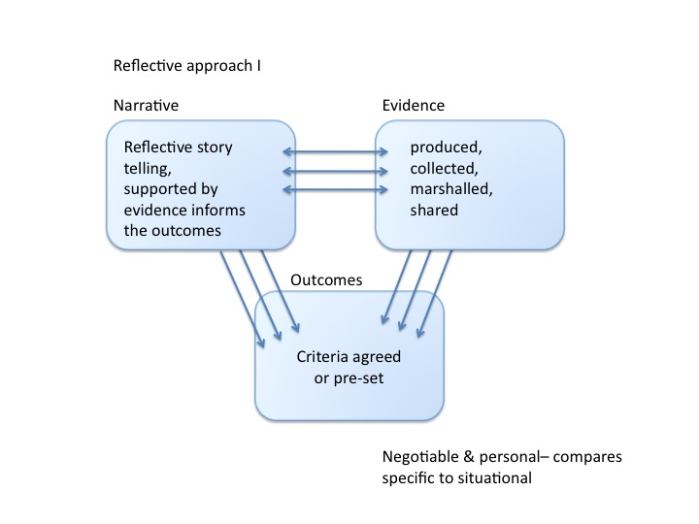
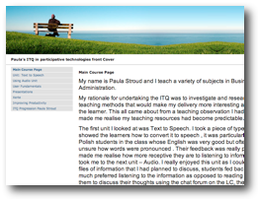
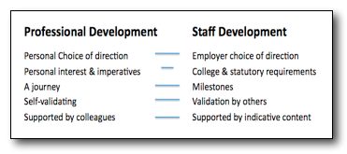
Completing a Mapped course by a Reflective process
The student decides the context of learning, provides unique evidence and checks the work off
Geoff Rebbeck
JISC On-line Conference Nov 2011
Notes:
The critical change in using personal learning space is that the student has two transcends the learning outcomes and the collection of evidence by the rating the story of the learning and the context, personal to the author, that shows how learning maps to the outcomes and the world in which the learner lives. The adding of the narration immediately changes the dynamics of learning. Students aren’t able to simply provide evidence that they have to show how their experiences and learning needs the outcome. In short it becomes necessary to justify or validate the learning undertaken to themselves first before anyone else sees it.
The disadvantage of this method is that the management of learning now sits closer to the student and many find this uncomfortable, wishing to remain relatively passive in the administration of the learning, relying on the teacher and the college to decide what is to be done when what hurdles to be jumped and to validate the clearance of those hurdles in the race to the finish.
It could be argued that the narration brings to life the rather anodyne process of finding and mapping evidence. It allows students to explain as a virtue that something had not worked well for them or why they may have had difficulties in particular areas of learning. Narration allows the student to demonstrate some of the softer skills that are becoming so important; the ability to respond positively to criticism, to think creatively and to be able to synthesise ideas, to work well under pressure, to demonstrate values and beliefs commensurate with the professional behaviour in the narration. Not least it allows the learning and learning journey of each individual student to be as unique and is peculiar as the student themselves. This is achieved either in the narration or through the use of tags or specific pages of writing.

Slide 5
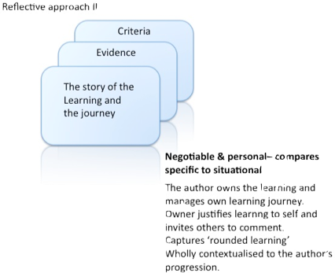
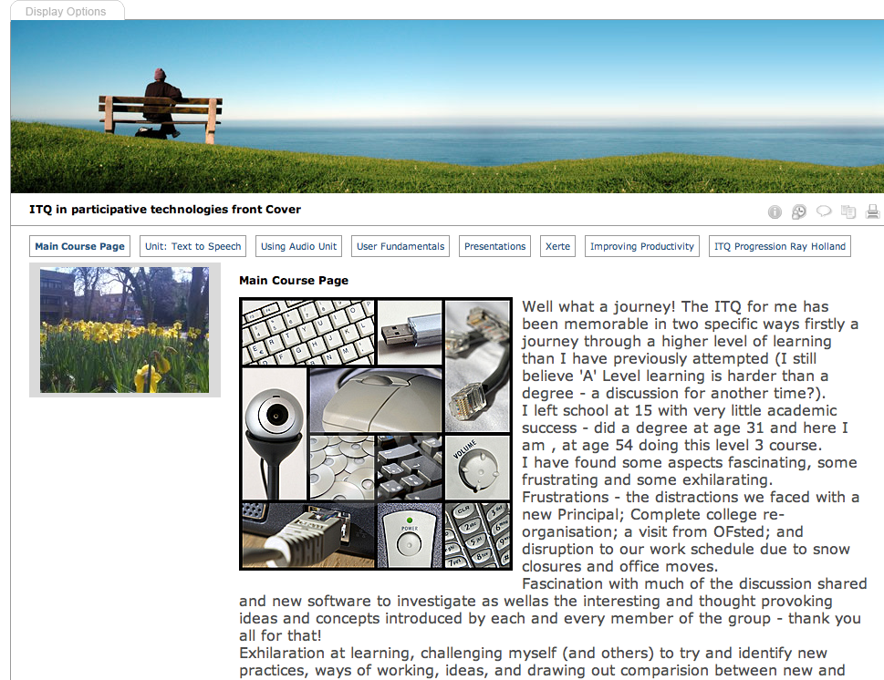
Completing a Mapped course by a Reflective process
Mapped to the agreed outcomes.
Pointing to the evidence against any assertion
The story of the learning journey
Geoff Rebbeck
JISC On-line Conference Nov 2011
Notes:
The use of narration and personal learning space allows students to collaborate through critical friendships and co-mentoring with each other as long as the student can show how their understanding has been improved by this process. The whole thing becomes so much more dynamic.

Slide 6
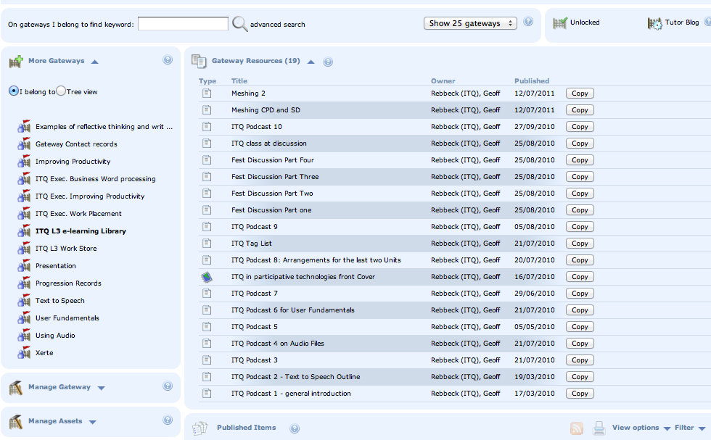
Gateways for the social enterprise
Geoff Rebbeck
JISC On-line Conference Nov 2011
Notes:
Central space or libraries can still be made available for students to reference, download and publish their own portfolio content. Other than the requirement for a class online forum for notices and discussion it is arguable that personal learning space has helped find the boundaries of what has been up to now seen the March of the ubiquitous VLE.
This ITQ qualification was completed by the staff entirely without the support of the College VLE or any other technology that supports the administration of learning. This page shows one of the library shelves it also demonstrates the importance of pod casting in the absence of a forum or regular class meetings.

Slide 7
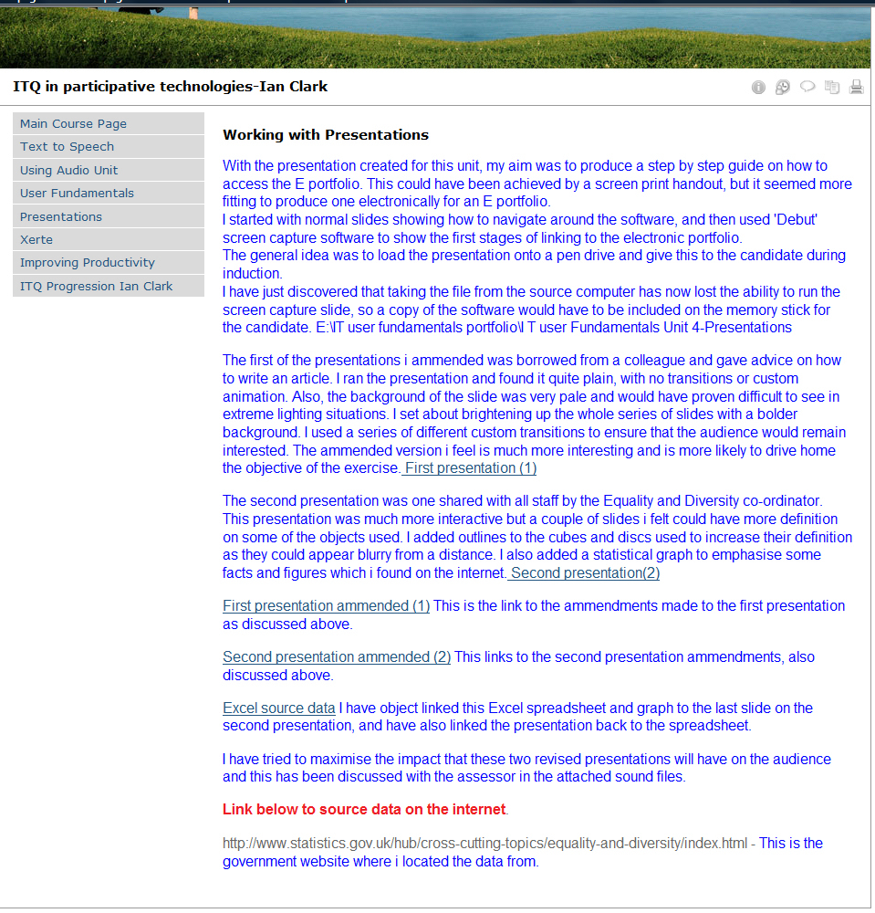
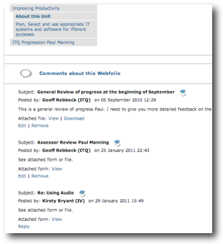
Assessment
Geoff Rebbeck
JISC On-line Conference Nov 2011
Notes:
On this portfolio page you can see the opening screen of a video produced by the learner where he is able to introduce his portfolio and his learning in his own words, describing what he learnt in what he intends to do next is the result. To meet the needs of the awarding body assessment and verification forms were written in and attached to the Web folio. The slideshows are two types of assessment: the awarding assessment and the personal assessment.

Slide 8
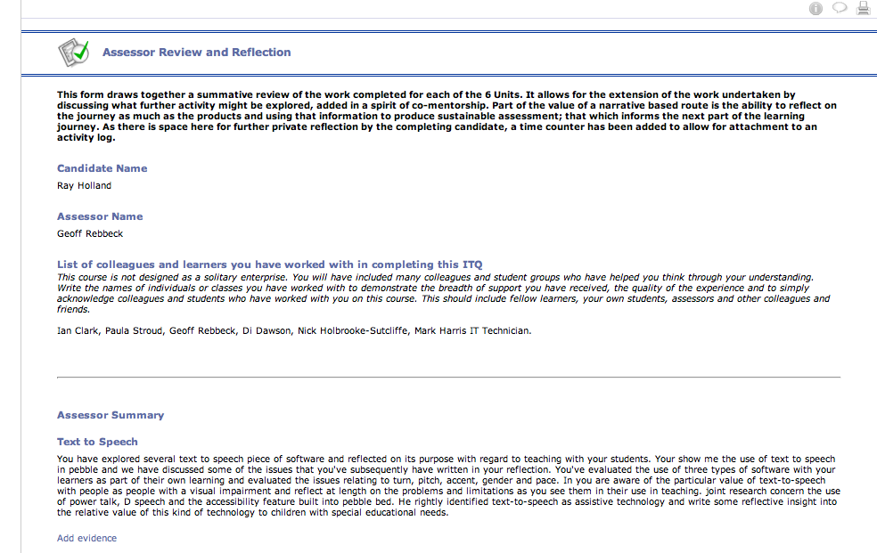
Ticking the boxes
Geoff Rebbeck
JISC On-line Conference Nov 2011
Notes:
Formative assessment is available continuously to learners and as students and their work is a members are immediately available to teaching staff through central gateway. Consequently a check on progress can be maintained and feedback can be provided at any stage.

Slide 9
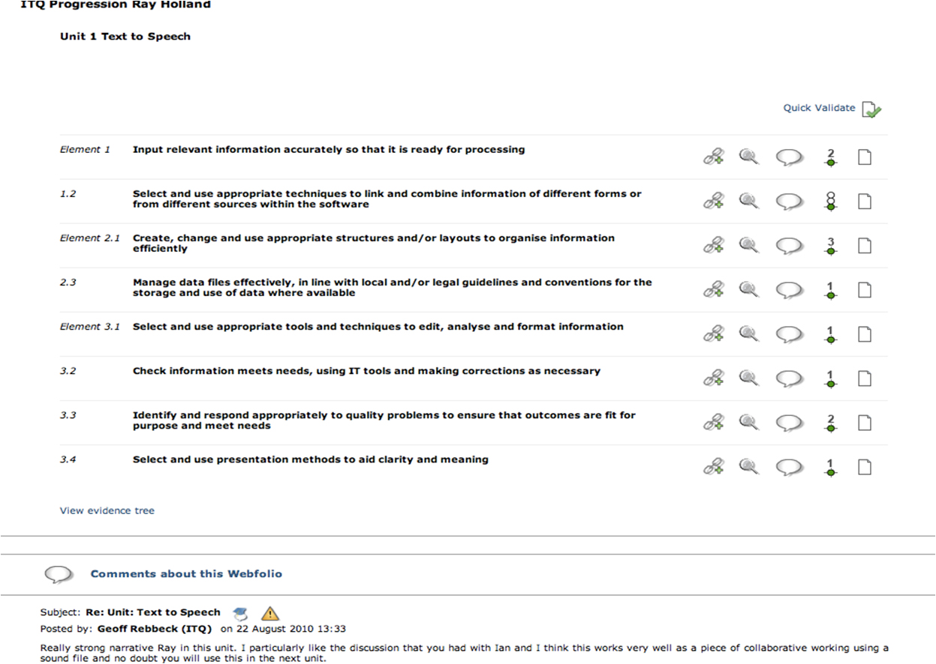
Ticking the boxes
Geoff Rebbeck
JISC On-line Conference Nov 2011
Notes:
Narration alone doesn’t meet the current regulations from ITT so the 80 learning outcomes were written into the six sections of the qualification allowing the evidence items to be that. This whole mapping process hides behind the narration and is neither readily available nor part of the finished folio of learning will stop however the two are inextricably linked through hyperlinking from the narration to the satisfaction of city and Guilds in this instance.

Slide 10
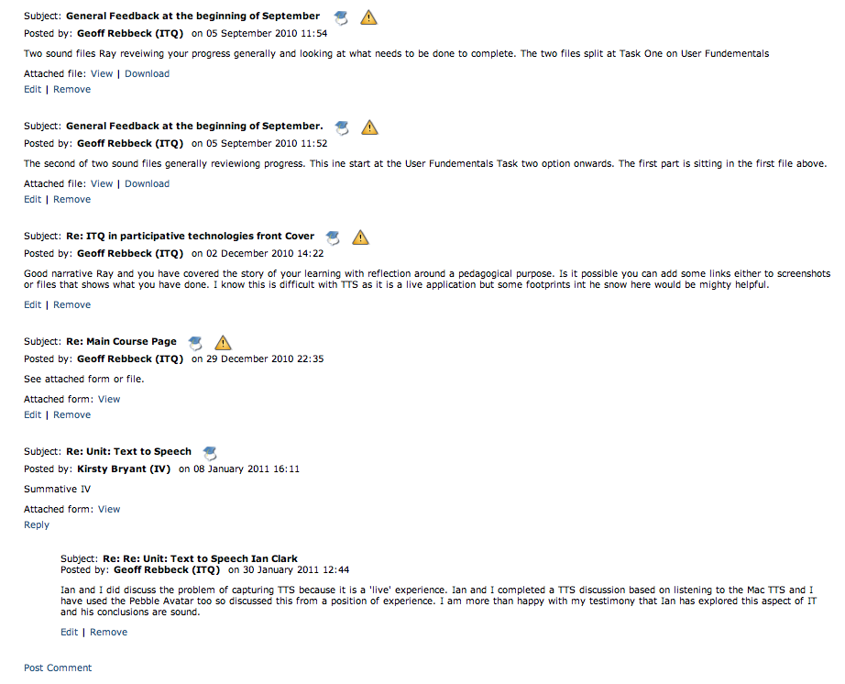
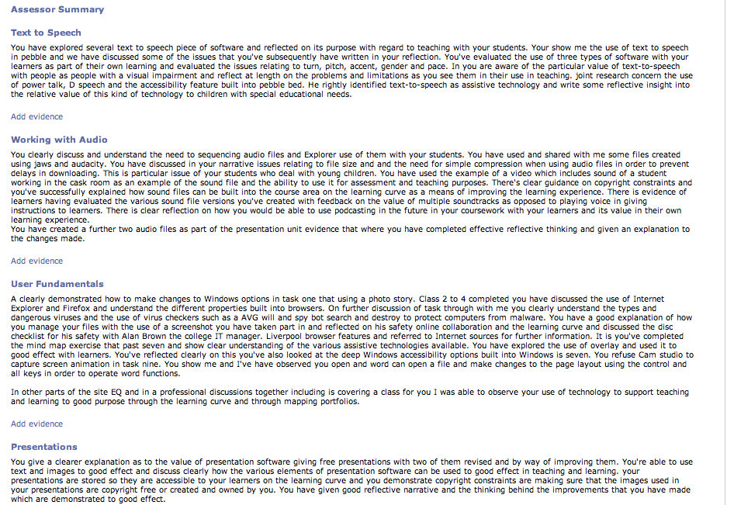
Ticking the boxes
Geoff Rebbeck
JISC On-line Conference Nov 2011
Notes:
To speed things up formative assessment was completed using speech to text software.

Slide 11
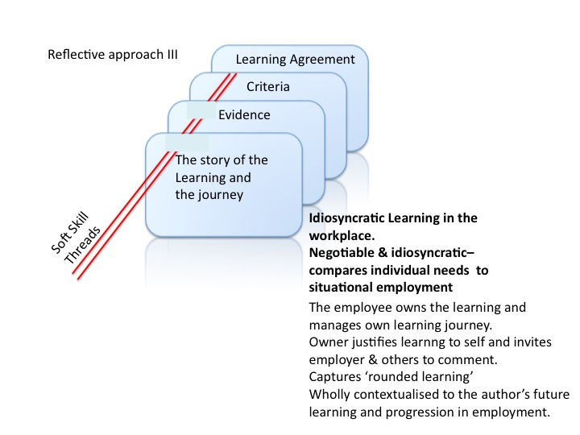
Idiosyncratic learning agreements
Geoff Rebbeck
JISC On-line Conference Nov 2011
Notes:
As technology becomes more refined and reliable we are able to move from the personal to the idiosyncratic learning style. It is possible to use this model of learning to underwrite loan agreements with individual employees in a given company as part of the colleges workplace learning provision. Learning outcomes can be unique to the employee and their position within the company. Once the story of learning has been written, hyperlinked to require evidence then linked to agreed outcomes, this can be presented by the employee to the employer and on receipt the college can generate its invoice.
In the future it is possible that hybrid courses will be established where some units will be completed using the VLE and certainly used in support of the social enterprise of learning. Yet other parts will be completed away from the social noise of learning in reflective narratives.

Slide 12
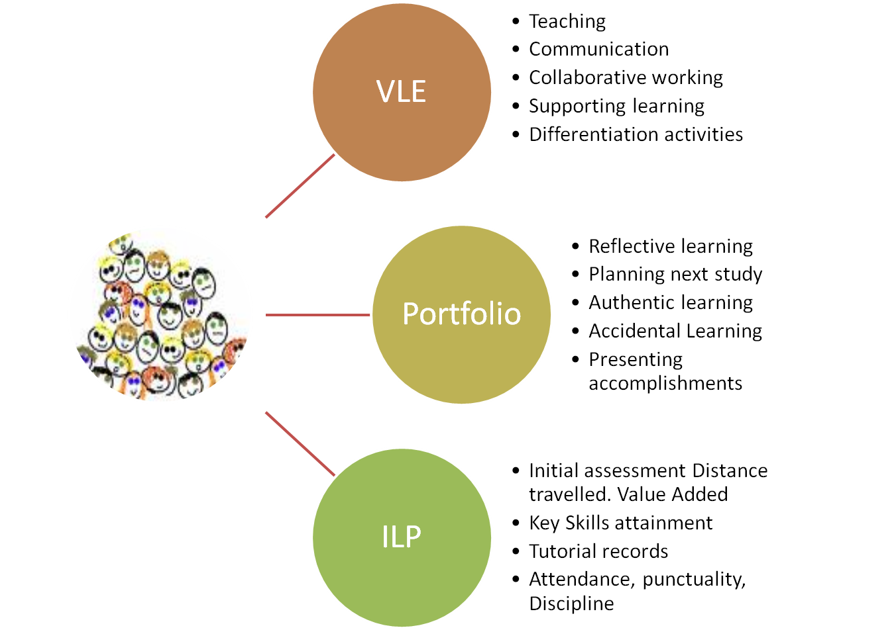
Hybrid courses?
Geoff Rebbeck
JISC On-line Conference Nov 2011

Slide 13
The College
The parties &
their jobs
Invoices against publication
Learning Agreement
The Employer
List of Outcomes
taught
The narrative
Personal details
& Summary
The published Web folio
The work-base learner agreement
Geoff Rebbeck
JISC On-line Conference Nov 2011

Slide 14
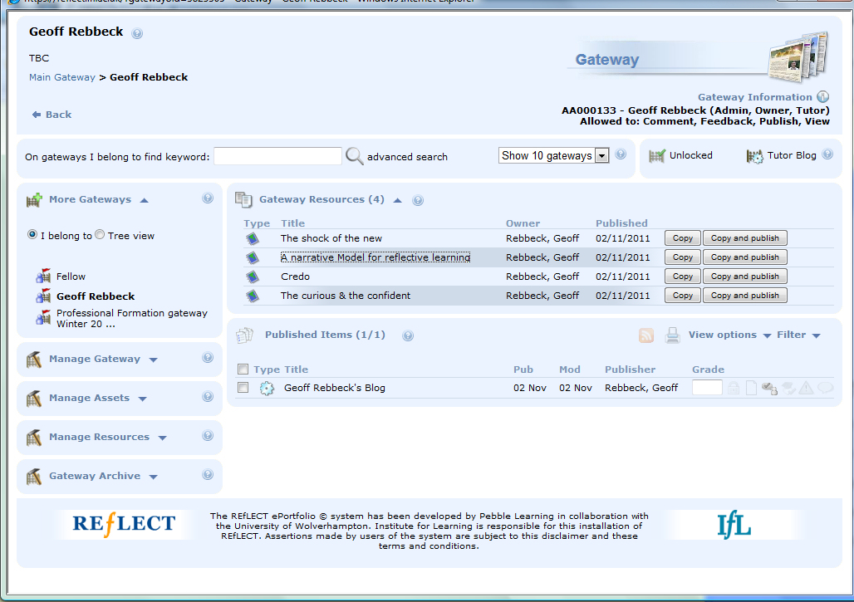
Completing a Mapped course by a Reflective process
Geoff Rebbeck
grebbeck@me.com
You can view the Web folio at https://reflect.ifl.ac.uk/webfolio.aspx?webfolioid=3766751
Geoff Rebbeck
JISC On-line Conference Nov 2011

