Slide 1

Tensions in collaboration in a changing landscape
Bill Rammell
Deputy Vice-Chancellor, Plymouth University

Slide 2

Icebreaker
In terms of introducing technology to the curriculum, what has been the source of your most innovative ideas?
A. Students
B. Colleagues
C. JISC/Publications
D. Another University
Notes:
Get you involved
This session will work best if it is interactive

Slide 3
The Issue
The potential in technology to forge cross-sector collaboration through which further and higher education institutions, learners and employers can work together to shape a more forward-looking curriculum

Slide 4
Outline
What can the sector do to address these challenges?
How to facilitate collaboration and change?
What are the challenges?
Notes:
Outline of what I am going to be presenting to you

Slide 5

Students at the Heart of the System
reforming funding
delivering a better student experience
increasing social mobility
reducing regulation and barriers for new providers to enter the market
Notes:
This is the stating point – major shakeup in Education – has a big impact now and in the future.
Is this really about student choice with
Care Margin

Slide 6
Challenges
Pressures on budgets
Greater competition: International and commercial
Student Expectations
Contestability
Notes:
The UK education sector is changing rapidly and is facing a range of challenges which include pressures on budgets, competition from commercial and overseas providers and responding to and acting upon student expectations.
1/6 places untestable

Slide 7
Context
  Cuts - substantial reduction in teaching grant
  Fees tripled
  Challenge of private sector providers and FEC’s
  1 in 4 places to be contestable in 2012. Growing trend
  Fees/government direction - forcing universities to improve quality of student experience
  Move to REF/greater concentration of funding
  End of AimHigher
  OFFA Agreements - more demanding
  Even with fees at £9k - financial challenges remain

Slide 8
Challenges: Changing markets
Current UK Higher Education Institution (HEI) student domicile
  UK: 84%
  EU: 5%
  Overseas: 11%
13 UK HEIs have an international branch campus
Over 100,000 students on Foundation Degrees
50% of Foundation Degree students progressing to an HEI
Institutions offering Foundation Degrees
  Pre 92 HEI = 24
  Post 92 HEI = 70
  Further Education College (FEC) = 275
Notes:
Showing there is churn in the sector
HEIs having a presence in other countries
Post 92s offering FDs (3 times more than Pre 92 HEIs)
Further Education colleges have majority of FD market – what happens when they expand?

Slide 9

Challenges: Changing markets
Visa changes
Increased activity of providers such as:
  Pearson
  LLP
  Navitas (8 UK centres)
  INTO (11 UK centres)
Notes:
Threats from visa changes
Impact of commercial feeder colleges that have an on campus presence/partnership agreement
Not all challenges are threats – highlight Plymouths strong relationship with Navitas
Threat or Opportunity?

Slide 10
Challenges: Pressures on budgets
 | 2009-2010 | 2010-2011 | 2011-2012
Teaching | £4,782 million* | £4,727 million ** | £4,339 million***
Research | £1,572 million | £1,603 million | £1,558 million
Business and the community | £134 million | £150 million
Knowledge exchange (HEIF) |  |  | £150 million
Moderation funding |  |  | £30 million
Transitional allocations | £36 million
Special funding | £316 million | £294 million | £207 million
Earmarked capital funding | £1,154 million | £562 million | £223 million
Total | £7,994 million | £7,356 million | £6,507 million
 | *£143 million for widening participation and £269 million for teaching enhancement and student success | **£144 million for widening participation and £269 million for teaching enhancement and student success | *** £142 million for widening participation and £264 million for teaching enhancement and student success
Data from http://www.hefce.ac.uk
Notes:
Need to show the budget reduction.
Reinforce the loss of WP
Note that JISC is funded from the ‘Special funding’
60% Reduction

Slide 11
Challenges: Greater competition -
International and commercial
Overseas Institutions attractive to UK students?
Courses delivered in English in several European Institutions
Commercial organisations already having programmes validated e.g. Pearson and UoFL College
FECs moving towards their own validation of Foundation degrees, with a possibility of full degree awarding powers
A private equity firm or private higher education provider will buy a UK university in whole or part "within the next six months” - Glynne Stanfield, Eversheds
Notes:
With full fees now in place it may be attractive for students to travel elsewhere in EU / worldwide as this may be a cheaper option

Slide 12

Challenges: Student expectations
Tuition fees = Graduate contribution
Notes:
Recap on the fees changes
Show the video to put the fees into context
3k – 9k
£15k - £21k
Less per month post grad than present system
Much bigger controversy this time
Studs will expect more
Uni’s have to market/communicate their offer
Play video

Slide 13
Challenges: Student expectations
Need to ensure
Value for Money
Meets employability agenda
Students have access to Information, Advice, Guidance
Increased Graduate contribution
Likelihood of increase in complaints / dissatisfaction
Notes:
All happening at once

Slide 14
Students as Partners
Consumers?
Customers?
Partners
Principle that the most ‘powerful’ decisions are made in partnership between student and university.
Taking account of the student voice – “right voice, right time, right place”
Making the ‘student experience’ part of all staff job descriptions, and students ‘adopting’ staff members
Funding to drive the student experience
Notes:
Plymouth University has in recent years been working to develop and define the concept of "Students as Partners" with a view to realigning its activities - whether academic, social or pastoral - to support a culture that involves students studying "with Plymouth University" rather than “at Plymouth University.”

Slide 15
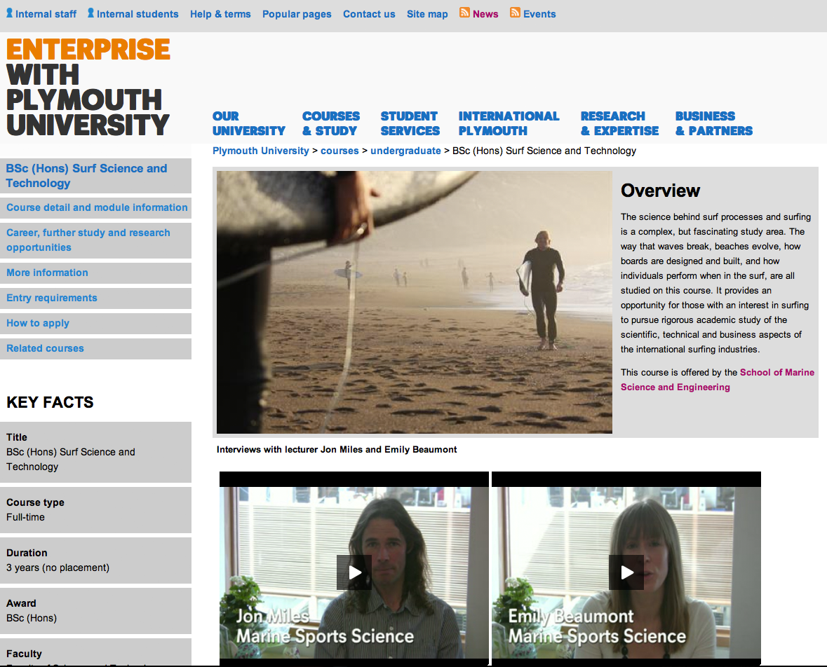
Our students are informed
Institutional
Notes:
All HEIs have their own website, which we all spend a lot of time discussing, worrying about and comparing with each others. BUT where do students (and their parents) get their information from? The official website is only one source of information

Slide 16

Our students are informed
League Tables
UniStats
Social Media
Independent / commercial sites
  Student Room “Plymouth vs Hertfordshire vs Nottingham Trent”
  Our students are using information from multiple sources to inform their choice
Notes:
Show the discussion on Student room - http://www.thestudentroom.co.uk/showthread.php?t=1817143&utm_source=twitter&utm_medium=tweetbutton&utm_campaign=thread
(all 3 Universities come out of well, Plymouth slightly better)

Slide 17
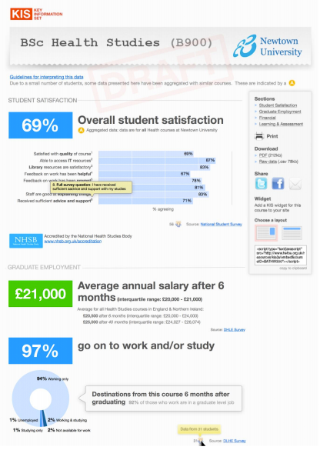
Getting our students better informed
The Key Information Set (KIS) will contain areas of information that students have identified as useful. These areas are:
  student satisfaction
  course information
  employment and salary data
  accommodation costs
  financial information, such as fees
  students' union information.
Notes:
The KIS is an area the entire sector is looking at
Should mention the image is a generic template
How contextualised?

Slide 18
Addressing expectations through Open Data
The KIS data is not just limited to HEFCE and Universities.
Once we open the data we open the market
Comparethemarket.ac.uk?
ImConfused.com?
Does the sector want a preferred independent provider of information on quality?
Notes:
Sharing of our data allows it to be used in a variety of ways.
Nor only will this have a direct impact on the various league tables, it may lead to university/course comparison sites, either “owned” by the sector or commercial sites.
Martin Lewis – Independent/preferred fees campaign
Independent – Influence?

Slide 19
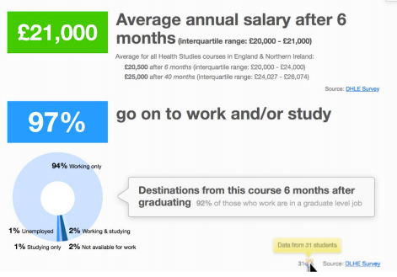
Expectations and Employability
Employability very high on the expectation agenda
To meet these student expectations to need to ensure institutions, learners and employers can work together to shape a more forward-looking curriculum
Notes:
Employability is very important to our students
We are seeing a cultural shift from education for Personal Development, where people studied a subject because it interested them, to one of Professional development, where students are embarking on programmes that will benefit their career immediately after graduation. – Whether we like it or not
To ensure our programmes are fit for purpose in this new era we need to ensure that institutions, learners and employers can work together to shape a more forward-looking curriculum

Slide 20
Challenges
Pressures on budgets
Greater competition: International and commercial
Student Expectations
Contestability
Notes:
Recap on the significant challenges

Slide 21
Activity 1
Select the area you consider to be the most significant challenge:
A. Pressures on budgets
B. Greater competition: International and commercial
C. Changing markets
D. Student Expectations
Notes:
Use the polling tool to see what the audience think is the greatest challenge

Slide 22
Activity 2
What other challenges do you think we are facing?
  Please use the text chat area. The additional challenges you identify will be collated and reported on at the end of the session.
Notes:
Use the text area to get the audience to post any other challenges

Slide 23
Any questions so far?
Notes:
General Q & A session – invite contributors from the text chat and those willing to broadcast the questions via voice/video.

Slide 24
Addressing the challenges
Addressing the challenges
Shared Services/ Cloud/ Commercial Providers
Responding to user needs
The Digital Organisation
Meeting Expectations

Slide 25

Meeting expectations: Equality of Service
The profile of our students is changing
Institutions may need to support remote students and remote staff
Technology needs to be inclusive
All students and staff receiving the same experience, independent of their location
Notes:
With a move to remote campuses, shared curricula, distance learning etc. we must ensure that all students have access to the same level of resources and support
There is a recognition that off campus students need support and and sector is moving in this direction, learning from the recommendations from the Online Learning Task Force report
The Online Learning Task force report is an example of the sector sharing practice, using the experience from different institutions to inform future ways of working
The Online Learning Task Force (OLTF) published its final report 'Collaborate to compete: Seizing the opportunity of online learning for UK higher education' in January 2011.
It concluded that online learning – however blended with on- or off-campus interactions, whether delivered in the UK or overseas – provides real opportunity for UK institutions to develop responsive, engaging and interactive provision which, if offered at scale, can deliver quality and cost-effectiveness while meeting student demands for flexible learning.
The report showcases the work of 16 university and consortia courses in the UK including partnerships between HE institutions and the private sector.

Slide 26

Meeting expectations: Digital Inclusion
‘Networked Nation’ aims to get every working person in the UK online by 2015*.
90 per cent of all new jobs require basic internet skills.
The specific role of further and higher education in supporting digital inclusion has yet to be clearly articulated
It can be inferred that a much higher than 90% proportion of graduate jobs require internet skills, and that graduates will play a leading role in cascading digital practices to other members of society
*http://raceonline2012.org/manifesto
Notes:
- 1997

Slide 27
Sector Response: Responding to user needs
Student Voice
NSS
Local
National
SPQ
PTES
NSS: National Student Survey
PTES: Postgraduate Taught Experience Survey
SPQ: Plymouth’s Student Perception Questionnaire
Notes:
Data is available from a variety of sources
NSS – National Student Satisfaction
SPQ – Student Perception Questionnaire
PTES – Postgraduate Taught Experience Survey
Local sources such as Student/Staff Liaison, Module Review, Programme Review
National feedback from the NUS etc.
All of this is valuable, and needs to be addressed.

Slide 28
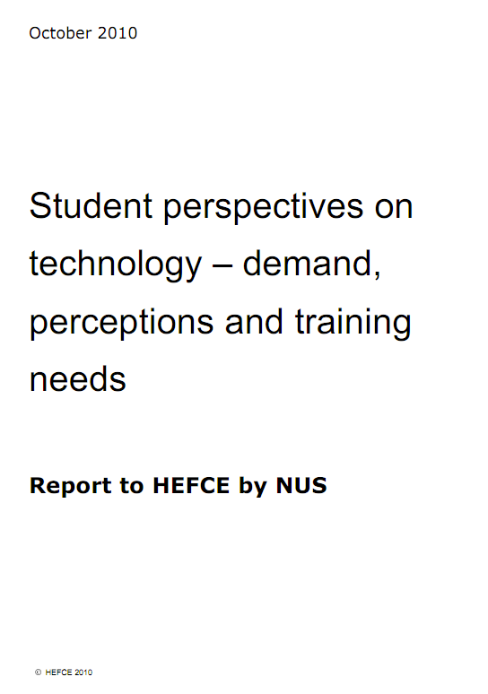
Responding to user needs: Listening to stakeholders
Involvement of students in
  Decision making
  Needs analysis
  Research
  Evaluation
Both in formal and informal ways
Close the loop by feeding back on changes brought about by student involvement
Notes:
JISC are leading the way in student involvement in projects.
There is no point is just asking for their opinion – it has to be considered and responded to, even if it is to say ‘No’, but a justification on the decision has to be given

Slide 29
Responding to user needs: Listening to stakeholders
A Plymouth example – ‘Mobile with Plymouth University’
2,000+ responses from a student technology survey (part of a JISC Building Capacity project)
This data directly informed our CampusM deployment to create ‘Mobile with Plymouth University’ as the data told us not just to develop an iPhone App, but to ensure data can be consumed by any mobile device
Notes:
Students prioritised services they would like to be delivered via mobile services, plus requested others

Slide 30
Responding to user needs:
Respondents asked to rank the usefulness of a range of mobile device accessible services :
View course information.
View exam and course timetables.
View library Receive alerts relating to IT services, library, course info
Check PC availability in Open Access Labs.
Search the University Directory Campus Maps & Locations using GPS
Access to the Virtual Learning Environment
Subscribe to various University News & Events e.g. public lectures
Friend Locator – find friends are on the campus and contact them

Slide 31

Responding to user needs:
Mobile with Plymouth University based on user needs
Students’ Union now planning own area on App
Feedback process includes invitation to join focus groups
Students requesting additional features to support Teaching and Learning

Slide 32

Sector Response: Shared Services
Shared services are nothing new. The sector has been collaborating to deliver services for mutual benefit for a very long time. Some of those services, such as JISC and the JANET network, are the envy of the world. Others, such as the system of inter-library loans, tend to be types of collaboration that are taken for granted and have never been branded 'shared services' as such
JISC Infokit on Shared Services
http://www.jiscinfonet.ac.uk/infokits/shared-services
Notes:
This is another way to respond to the users needs

Slide 33
Sector Response: Shared Services
Shared Services are powerful and cost effective
We already use them:
  JANET
  UK Access Management Federation
Shared Services can be local / cross sector or interest based
If we want to carry on using these services, we may have to think about additional costs
Notes:
With the current JISC review there may be a subscription model for JISC shared services. This will cause institutions to question the value they are getting, BUT some of these services may be so deeply integrated into practice that withdrawal is not an option

Slide 34
Sector Response: Cloud solutions
Plymouth, like many others, has moved its student email to a cloud provider – live@edu
Instant benefits
  Increase in student email capacity from 100MB to 10GB
  25GB file storage
  The ability for students to share and collaborate
  Cost savings, freeing up storage for other uses
  Institutional experience of implementing a Cloud solution
Notes:
Direct benefit for student
Efficiency saving for the University
Plymouth now has experience in implementing a cloud solution and can build on this

Slide 35
Sector Response: Use of commercial providers
Budgets reducing
Solutions required
User expectations increasing
?
Notes:
In recent years there has been a need to align the University to initiatives such as ePortfolio/PDP, Online Assessment, Mobile Delivery etc.
There are a number of commercial products for all these areas, it is vital that the community share its experience and opinions about the us and efficacy of suitable solutions, something the JISC community does extremely well.
We need to look at implementing service models that are both efficient and user friendly and making appropriate use of shared services, cloud solutions and commercial providers. Our students will expect equality of service across an institution and, where this enhances the student experience, partnerships between institutions

Slide 36
Sector Response: The Digital Organisation
Student
digital
literacy
Institutional
digital
literacy
Staff
digital
literacy
Notes:
To meet the previous requirements , to satisfy user needs and to able to good practice for the adoption of new technologies we need to think about the digital organisation
Competitive/capability
Older staff
Student offices
Not a crime

Slide 37

The Digital Organisation: Digital Literacy
Virtually all non IT & Telecoms positions (92%) advertised by UK recruiters during the final quarter of 2008 were thought to require at least some level of IT user skills
Almost one third (29%) of employers thought the level of applicant skills in this area were generally below that required by the firm
77% of UK jobs involve some form of ICT competence, requiring skills to be updated as technology changes
Notes:
With Technology skills required in the workplace, we need to see how we are going to support students in their use of choice of technology

Slide 38
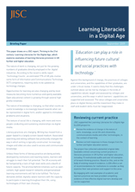
The Digital Organisation: Digital Literacy
The nature of work is changing
Opportunities for learning are changing
The nature of knowledge is changing
The texture of social life is changing
Universities are changing
http://www.jisc.ac.uk/publications/briefingpapers/2009/learningliteraciesbp.aspx
Notes:
The Learning Literacies in a Digital Age (LLIDA) study makes some pertinent observations, perhaps we need to add ‘Universities are changing’

Slide 39
The Digital Organisation: Digital Literacy
Literacy practices are changing
Writing has moved from a paper-based to a largely screen-based medium.
Associated searching and editing software has profoundly changed the way in which writing is typically constructed.
Increasingly images and video are also used to access and communicate knowledge
Unless these forms of literacy practice are being actively developed by institutions and teaching teams, learners will struggle to reach their full potential
Notes:
It’s not just about the technology, it’s about changes in practice and how Universities can support their students, but this will mean having digitally literate staff.
Scary

Slide 40
The Digital Organisation: Digital Literacy
The UK economy will be hampered by a lack of high-level skills and a dearth of future capacity.
The promise behind initiatives such as open content, high speed research networks and personalised learning environments will fail to be fulfilled.
The future demands skilled, digitally-aware learners with the capacity to participate in learning throughout their life, using technologies of their own choosing.
Notes:
The LLIDA study also made these statements about the future

Slide 41
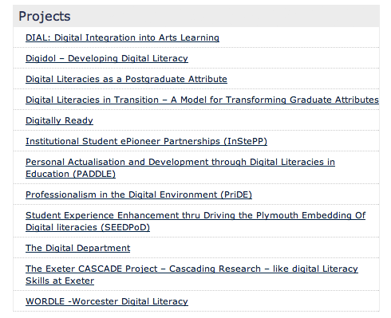
The Digital Organisation: Digital Literacy
Student Digital Literacy
  Knowing how to choose and use the right technology
  Needs to be supported by staff across the institution
  Need to be informed and build upon the JISC’s Developing digital literacies programme
Notes:
There is a large body of work being undertaken by JISC in this area – the Developing digital literacies programme, including the SEEDPD project at Plymouth

Slide 42
Activity 3
How many institutions have a Digital Literacy strategy?

Slide 43
Any questions so far?
Notes:
General Q & A session – invite contributors from the text chat and those willing to broadcast the questions via voice/video.

Slide 44
How to facilitate collaboration and change?
Sharing Approaches and Experience
Define Problems and Identify Solutions
Build Capacity
Community Building and Partnership

Slide 45
Sharing approaches and experiences
Respond to user needs
Agile responses in a changing environment
Build on the relationships we already have
Review, use and share the outputs, experience and artifacts we have in the sector
But, we have to maintain this approach through the pressures of competition

Slide 46
Community building and partnerships
JISC is a big community
JISC is made up of many communities
Other communities have disappeared (HE Academy subject centres) – does JISC have a role replacing these communities?

Slide 47

Define the shared problems then identify suitable solutions
Collective knowledge is an excellent attribute
Using the JISC outputs: the JISC Infonet Infokits are a valuable resource

Slide 48
Building capacity using existing resources and artifacts
Community is vital
Use the collective experience
Use the outputs, findings and assets we have
Building Capacity and building communities is essential
Links students, employers and institutions together
Notes:
The two essential areas here are the embedding of collaborative working and dialogue with students in conjunction with the Business Community engagement work already underway by JISC
Suggest Bill mentions some of the great Plymouth initiatives - Change Academy, BCE project with Research and Innovation,

Slide 49
Conclusions
Challenges
Sector Solutions
How to facilitate collaboration and change?
Partnerships with students
Partnerships with sector
Partnerships across sector
Notes:
Brief recap on the 3 areas:
1. Challenges facing sector
2. Sector based Solutions
3. Approaches to facilitating collaboration and change.
The underlying theme is that of Partnerships and communication
With students
With parts of the sector
.Across the sector

Slide 50
Thank you
Questions and Discussion

