Slide 1


Digital literacy - panel session
Helen Beetham, Alex Bols, Andrew Eynon, David White,
Alison Mackenzie, Matt Benka,
chaired by Derfel Owen and facilitated by Frances Bell

Slide 2




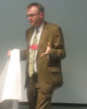



Presenters
Helen Beetham is an independent consultant, researcher and author in the field of e-learning.
Alex Bols is Assistant Director (Research) & Head of Higher Education at the National Union of Students.
Andrew Eynon is Library and Learning Technology Manager at Coleg Llandrillo.
David White co-manages Technology-Assisted Lifelong Learning (TALL), an award winning elearning research and development group in the University of Oxford.
Alison Mackenzie is Dean of Learning Services at Edge Hill University. She is currently Chair of North West Academic Libraries (NoWAL) and Chair of SCONUL Information Literacy Working Group.
Matt is Vice President Education, University of Bath Students Union.
Chair
Derfel Owen is Student Engagement and Participation Development Manager at the University of Exeter.
Facilitator
Frances Bell is a Senior Lecturer in Salford Business School, teaching, researching and running the programmes MSc IT, MSc Managing IT.

Slide 3
Session practice
Text-chatting
Elluminate layout
Audio
Whiteboard
Technical problems
Use the text-chat to engage with other delegates, presenter and moderators about the content of the session.
You can send private text-chat messages e.g. to moderators or to individuals.
You can change your Elluminate layout to “Wide layout” to make it easier to follow the text-chat (select “View … Layouts…Wide layout”).
If you are distracted by the text-chat, you can “unlock” the Elluminate layout to enable you to adjust the size and position of the text-chat sub-window (uncheck “View…Layouts …Layout locked”)
It is best to run the Audio Set-up Wizard to test your audio set-up each time you enter an Elluminate room (select “Tools…Audio… Audio setup wizard).
You must use a headset/microphone if you want to ask a question in audio.
Only use your microphone when guided by a moderator – click on the mic icon (bottom-left of screen) to turn it on and click on it again to turn it off.
Only draw on the whiteboard if guided by a moderator.
Send a private text-chat message to “moderators” and they will try to help.

Slide 4
Panel session on digital literacies

Slide 5
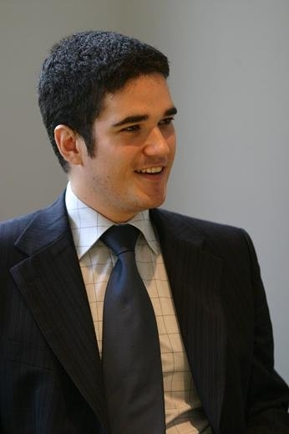
Digital Literacies panel session
Derfel Owen
Chair
Student Engagement and Participation Development Manager at the University of Exeter.
Frances Bell
Facilitator
Senior Lecturer in Salford Business School, teaching, researching and running the programmes MSc Information Technology, MSc Managing Information Technology

Slide 6

Session Structure
Welcome!
The panel:
5 minute overview from each
  “Barriers to students becoming effective learners in a digital world”
  “Ways of supporting learners in a digital world”
20 minutes for questions at the end
Please use the comment box throughout!
Notes:
Welcome to the session, thank Peter
Name each of the panel members – this is the order in which they will speak. They will explain their role/interest in DL when they speak
Each will give 5 minute talk (strictly!)
Explain that Frances will be gathering comments and themes throughout the discussion and will pose some questions based on these to the panel. SO PLEASE COMMENT and pose questions

Slide 7
Audience – who are you
A Academic
B ICT/e-learning/library support staff
C Student
D Member of agency staff (e.g. JISC)
E Other (type into text chat)
Notes:
We hope to be interactive, so will try to use show of hands and polls as we go through. Here’s one to warm us up

Slide 8
Helen Beetham,
independent consultant, researcher and author in the field of e-learning.

Slide 9
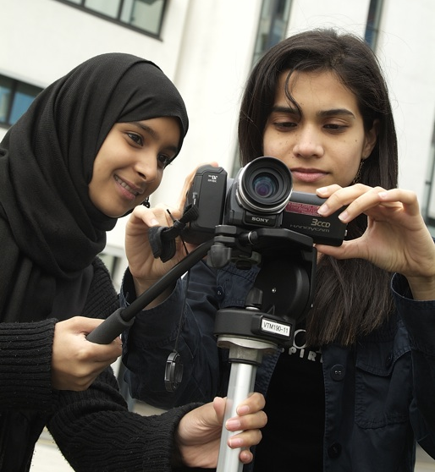
Digital Literacy
Challenges facing learners
Getting access to
learning opportunities
Integrating diverse
living/learning experiences with technology
Developing digital fluency across technologies and contexts
Knowing what I need to know, and how to express it
Becoming a participant in the digital knowledge community
Developing critical judgement
in relation to digital means and media
Developing academic/professional digital identity
Notes:
9
9
Digital technology can reduce some barriers to access but introduce others. New inequalities (though mainly just reinforcing the old in equalities i.e. access to cultural, material and digital capital)
The diversity of experiences that are mediated through technology does not in itself lead to development if learners don't have the opportunity to reflect on their meaning, consider their own goals, and create meaningful stories or pathways for themselves. Often, development work in Universities and Colleges is fragmented. It may be accessed only by those who are already well resourced, or alternatively only by those in crisis Students' development needs to be seen and supported coherently – even if different professionals are involved – and those professionals may not have good digital skills or awareness.
We know that people have difficulty transferring digital capability across contexts, such as learning, work and leisure, and also across boundaries. Technologies are used in specific contexts which support their use Negative or limited experiences with technology make it harder to acquire fluency i.e. the ability to use familiar technologies for unfamiliar ends, or to adopt unfamiliar technologies confidently.
.
.

Slide 10
Digital Literacy
Digital Literacy
Supporting learners effectively
Address the digital divide and use technology to enhance access for all
Provide coherent support for digital literacy across the learning experience
Create diverse authentic, technology-rich learning experiences
Explore how a range of media can support scholarly communication
Reward active, participative and public exchange of ideas
Model a critical approach to digital means and media
Offer co-curriculum activities such as networking, portfolio and CV building, reputation management
Notes:
10
10
But a positive experience of technology use in a range of contexts can support fluency or the ability to transpose skills, and to confidently take up new technologies by building on existing knowledge.

Slide 11
Matt Benka
Vice President Education, University of Bath Students Union.

Slide 12
Disconnect between use of technology in learning and in daily life
Use of technology for day-to-day interactions – shopping, social lives, entertainment.
Use of technology for education and studying – improving, but not quite there.

Slide 13
Great potential, misused?
Perception that the students (but especially “traditional” students) know how to use technology, just because they’re students.
Wasted potential on even simple things like PowerPoint – lectures being slides read off – students become disengaged, and don’t see the potential of effective ICT integration.
In my experience, students often don’t know what they want from ICT in learning because they don’t know what’s possible, and their only experience is a disappointing one.

Slide 14
Andrew Eynon
Library and Learning Technology Manager at Coleg Llandrillo

Slide 15


Barriers to FE students becoming
effective learners in a digital world
Access to ICT in the Workplace
Technology Bypass
Institutional Policies
ICT Confident
Not ICT Competent
Access to ICT in the Classroom
Creepy Treehouse
Wi Fi Access

Slide 16
Ways of supporting FE learners in a digital world
PADDLE
(Virtual Communities of Practice)
PEDL
(Peer
e-guides)

Slide 17
Alex Bols
Assistant Director (Research) & Head of Higher Education at the National Union of Students.

Slide 18

How do students use technology?
96% of students use the internet as part of their studies, 71% of this group using it every day.
56% of students are now submitting assignments electronically, compared with 52% in 2009
Usage of the Virtual Learning Environment (VLE) has also increased significantly from 71% to 78% from 2009. VLEs are also being used more frequently: 52% of the students using a VLE now use it daily, compared to 45% in 2009

Slide 19

What do students think?
Decreasing proportions students believe that ICT usage has enhanced their experience of studying from 46% in 2009 to 42% in 2010.
Half (50%) of the students disagreed that they gain more from teaching sessions when the tutor or lecturer integrates ICT with only 21% agreed.
75% disagreed that more teaching should be delivered online, with only a small minority (10%) agreed.

Slide 20
What do students want?
Only 57% of students say that they have been offered ICT training.

Slide 21
Alison Mackenzie
Dean of Learning Services at Edge Hill University. She is currently Chair of North West Academic Libraries (NoWAL) and Chair of SCONUL Information Literacy Working Group

Slide 22
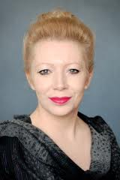

I’ve got......
so, why do I need a Library?...............
So why do I need a Library?.....

Slide 23
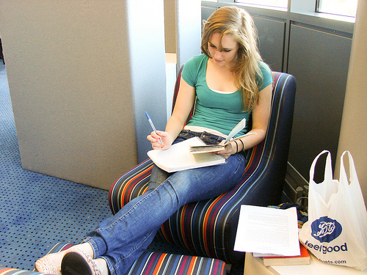
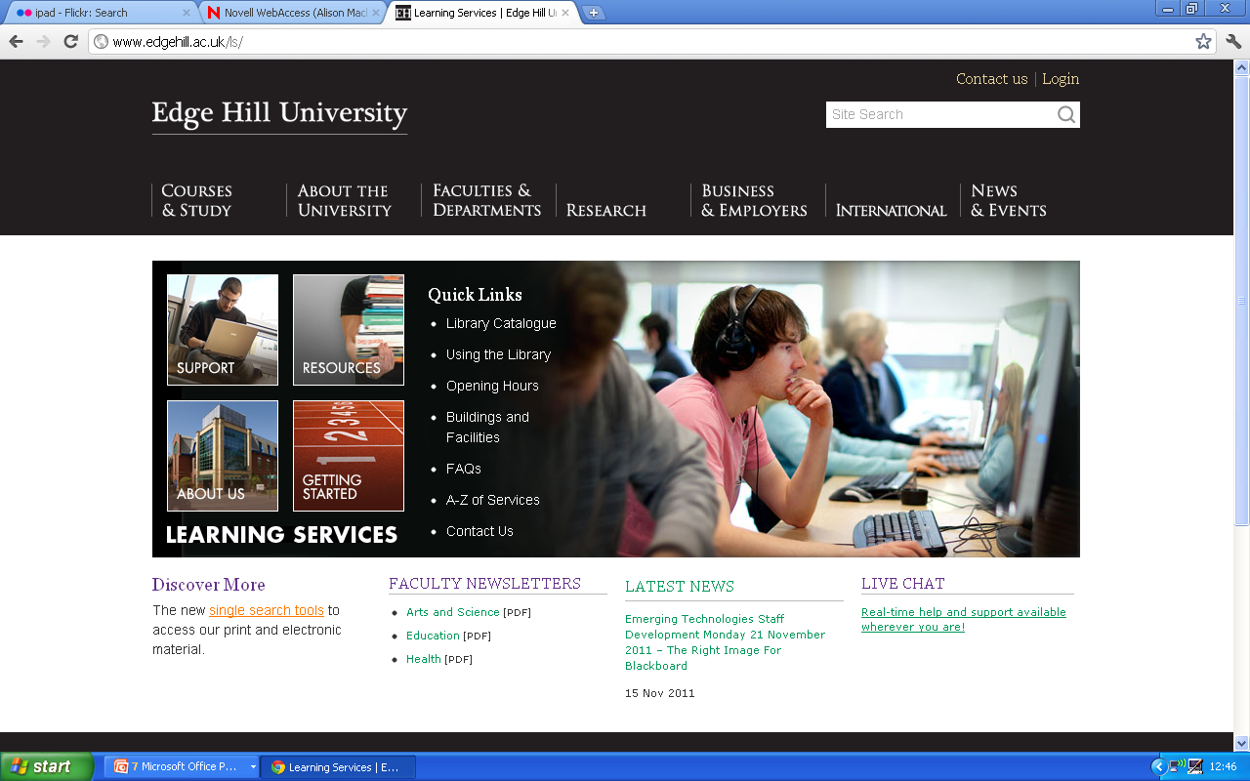
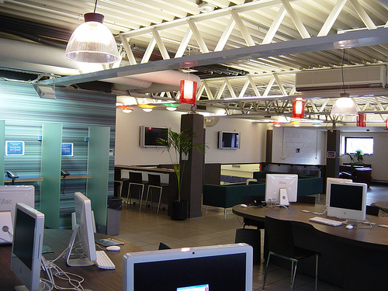
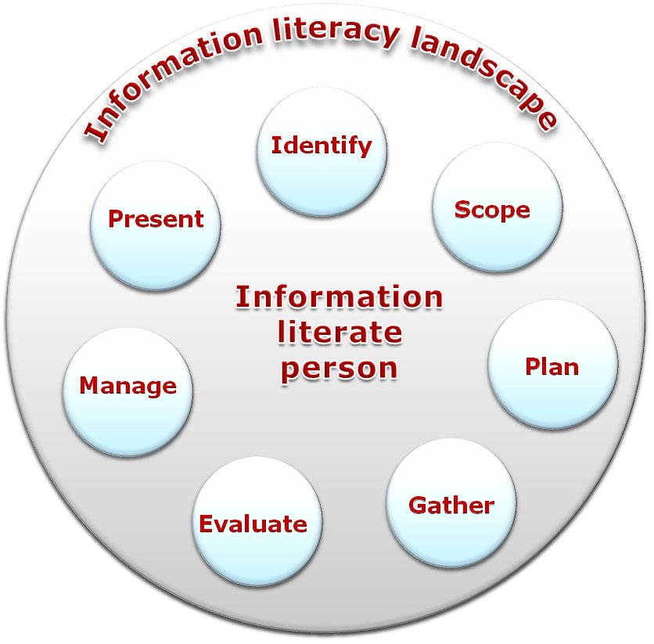
Expert advice
Peer support
----------------------------
Mobile Apps
QR codes
Podcasts
SMS

Slide 24
Dave White
co-manages Technology-Assisted Lifelong Learning (TALL), an award winning elearning research and development group in the University of Oxford.

Slide 25

Learning
Black
Market
Notes:
Will go to the internet first – disappointed if info is not there. Expediency

Slide 26
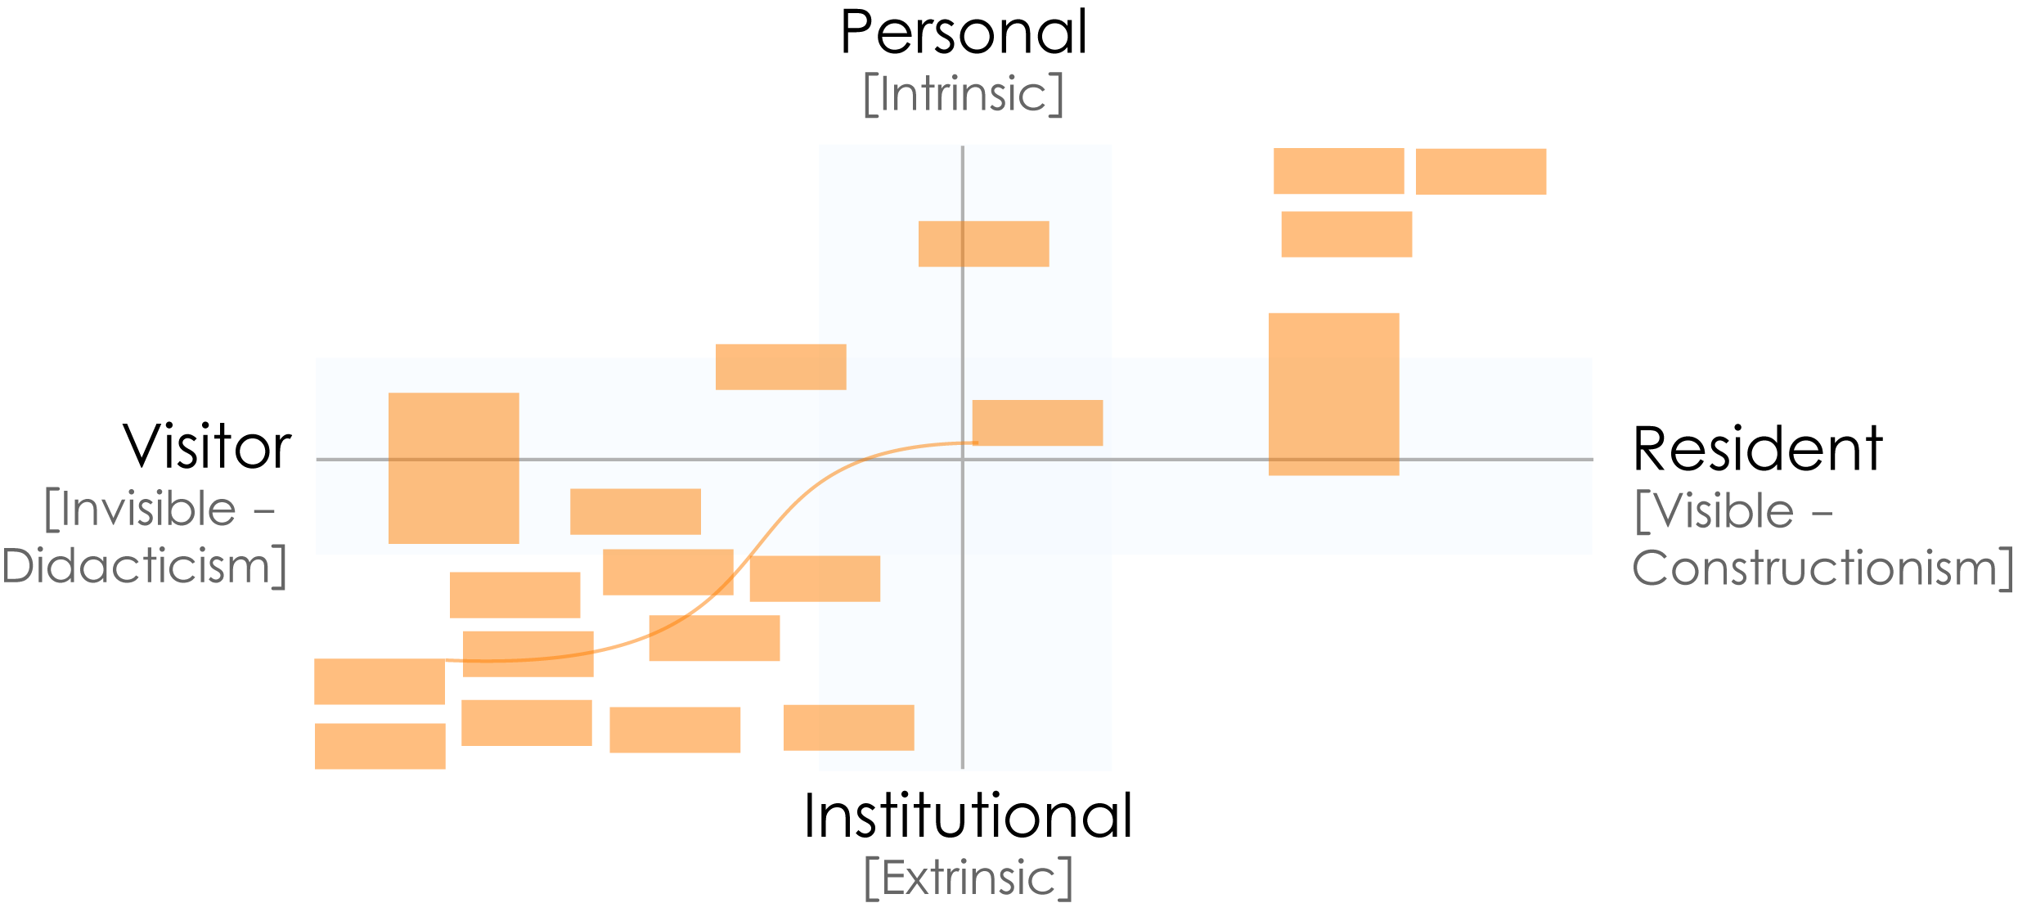
Engagement Map: UKU3
Notes:
Will go to the internet first – disappointed if info is not there. Expediency

Slide 27
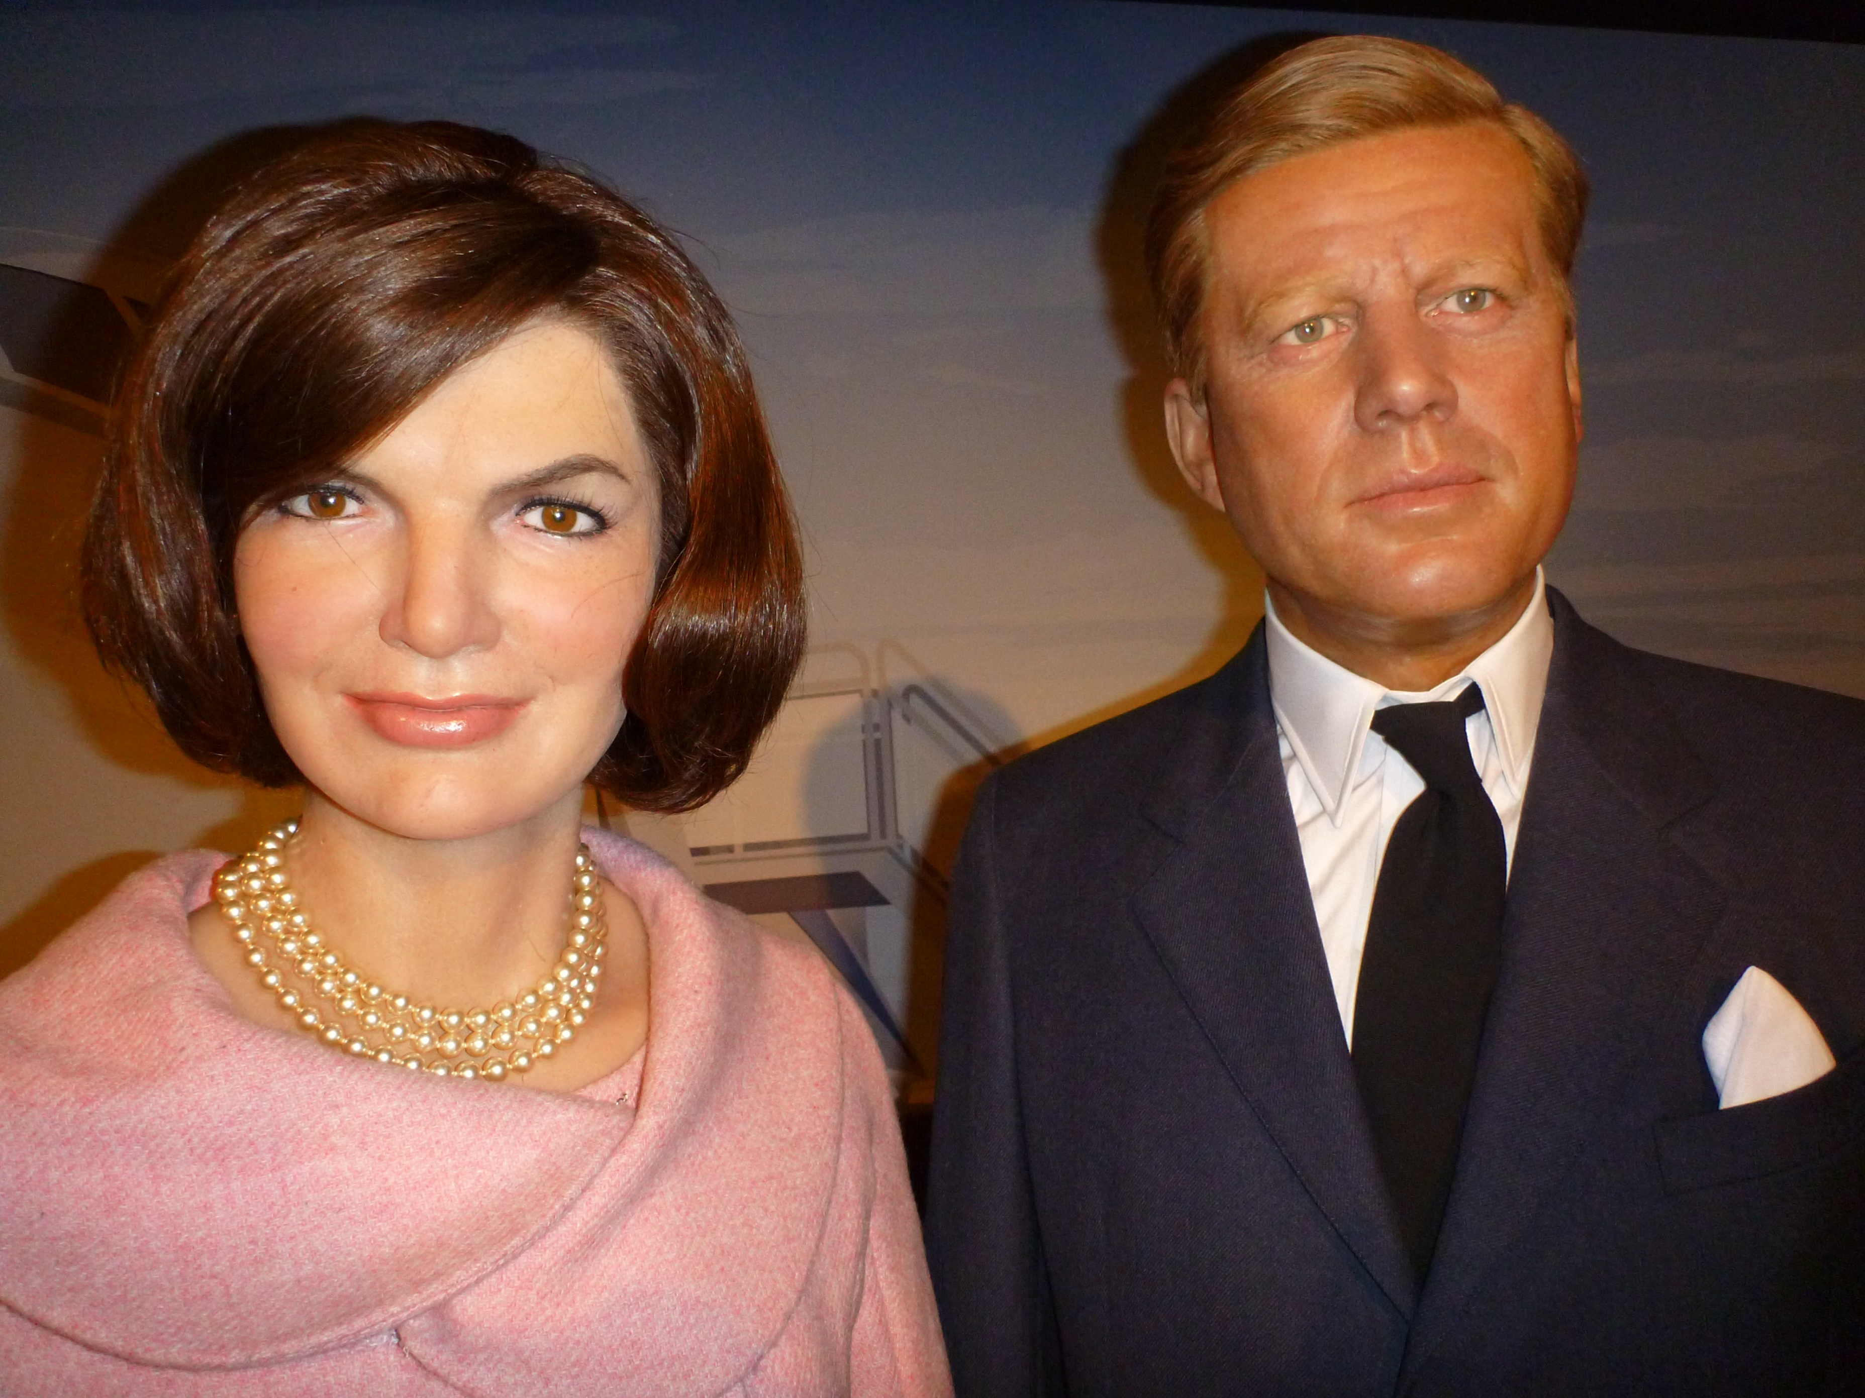
Authenticity
User owned
Literacies
Notes:
Will go to the internet first – disappointed if info is not there. Expediency

Slide 28
Q&A

Slide 29


Follow-on activities
Asynchronous discussions
You can continue the discussions in the asynchronous discussion area: http://www.online-conference.co.uk/WebX?230@@.eedd499
Thinking Space
Sally Graham and Joy Jarvis will chart the developing story of the conference, creating a virtual thinking space to visually present ideas, common themes, connections, views, issues and questions that arise from the conference.
You can access the online Thinking Space at http://bit.ly/tieV01.
As Sally and Joy develop the Thinking Space during each day of the conference, please contribute towards the Thinking Space by tweeting your ideas and feedback using the tag #jiscel11space.
Sally Graham
Joy Jarvis

