Slide 1
Digital Literacy Induction across a FE College
JISC RSC East Learning Resources Managers’ Forum
Ellen Lessner – e-Learning Coordinator
Abingdon and Witney College
Activity week
JISC Online Conference 2011
Ellen Lessner - e-Learning Coordinator
Abingdon and Witney College

Slide 2
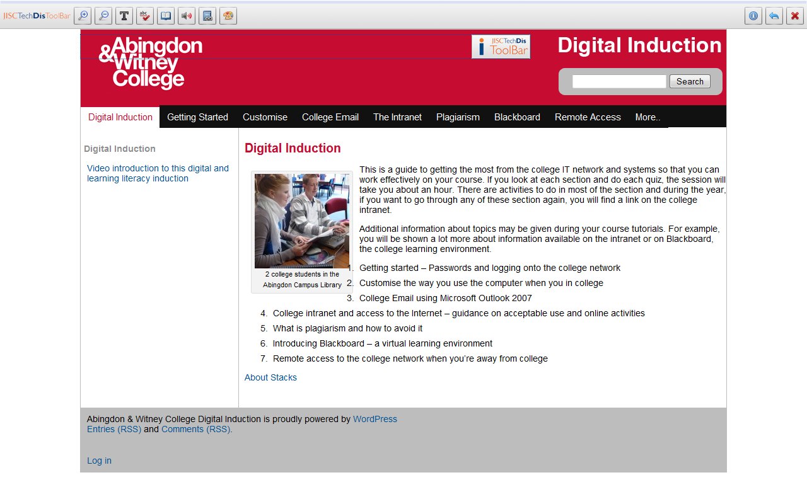
Text and video options

Slide 3
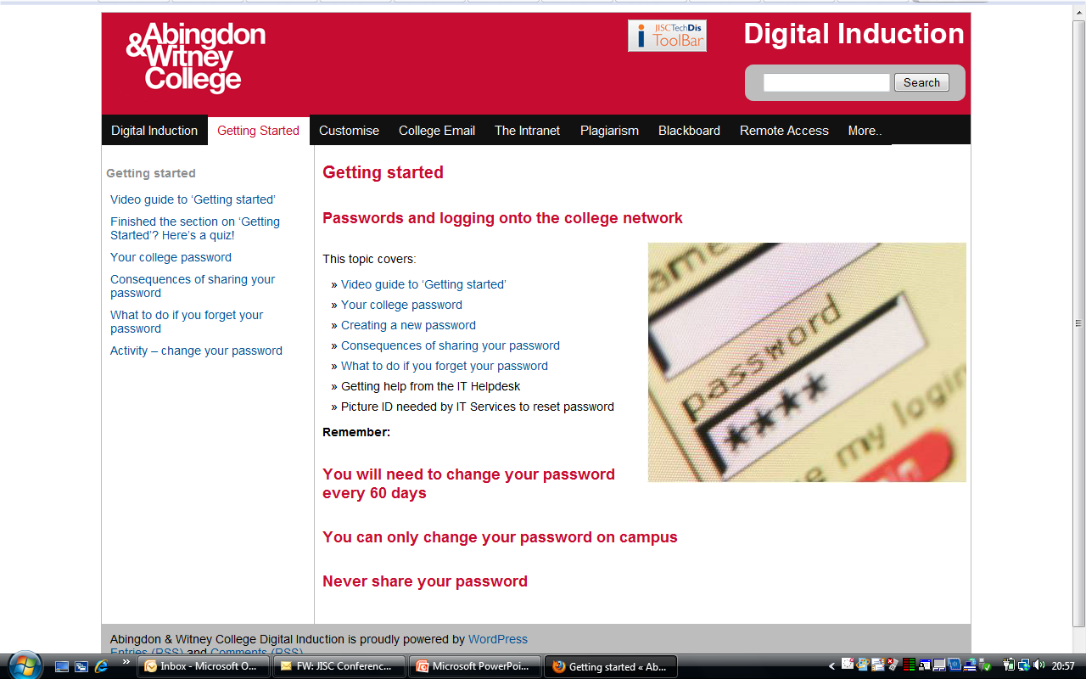

Slide 4
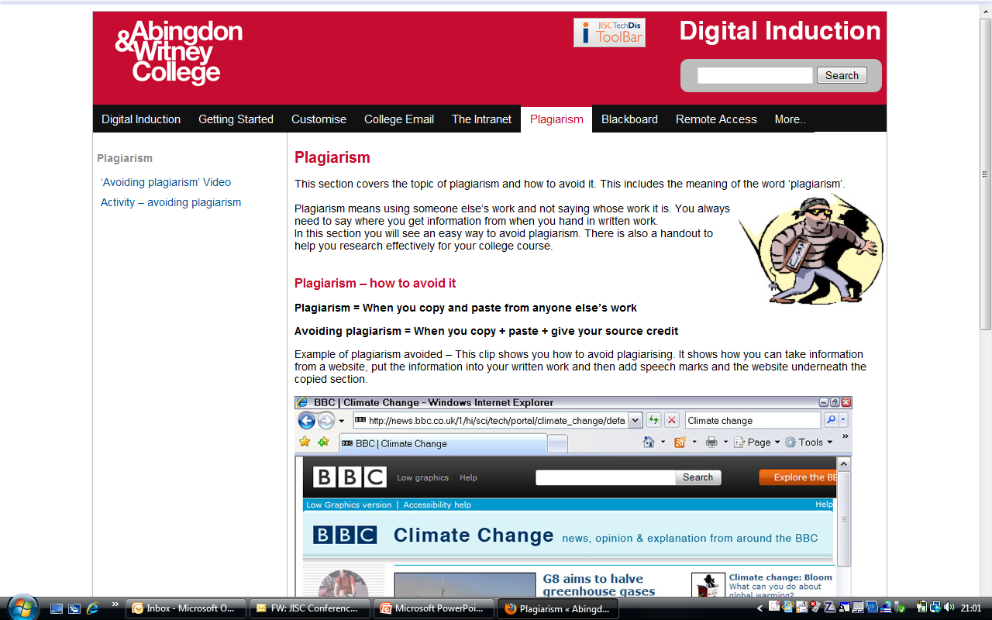

Slide 5
Digital literacy induction at Abingdon and Witney College
Our Digital Literacy Induction contains the following key points:
Mandatory for all full time students during induction
They receive a memory stick when the tutor has completed it with them
It is available all year and used with new staff

Slide 6
Quizzes in most sections and a final quiz for recording understanding
Video option for those with lower literacy skills
Jumping off point for tutors – it begins to highlight the basics of e-safety/plagiarism
Students are not dependant on their tutor’s own digital skills and knowledge to get the basic level of understanding of digital literacy skills

Slide 7
Listening to Learners = Digital Literacy
Learner experience of e-Learning Phase 2 http://bit.ly/9EPS0h
Learning literacies in a digital age http://bit.ly/dt8A78
Slida project - http://bit.ly/cfxa6W (JISC overview)
Slida case studies - http://bit.ly/b5djtd
Abingdon and Witney Digital Literacy Induction – http://www.abingdon-witney-digit.co.uk/
Good idea!
Notes:
The case studies demonstrate a range of ways of creating and enabling opportunities that promote the development of effective learning in a digital age. This includes:
focussing on induction support (Abingdon and Witney College)
meeting students expectations for using personal technology (Birkenhead Sixth Form College)
listening to student voices (University of Glamorgan)
developing learning spaces to meet learners’ needs (Edinburgh University)
supporting student enterprise (University of Surrey)
embedding learners into the curriculum (University of Salford)
developing graduate attributes through blended learning (University of Wolverhampton).
The ultimate aim is to promote strategies which support learners to develop the access, skills, strategies and attributes they need to learn effectively with technology.

Slide 8
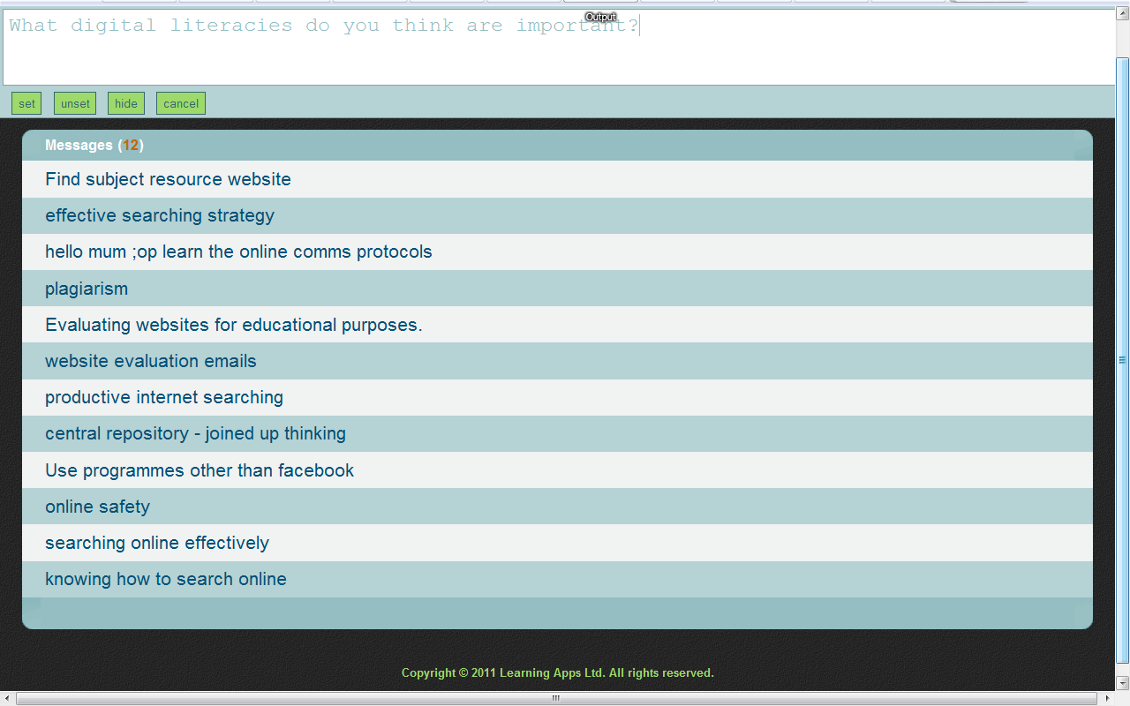
“Your thoughts about which digital literacies are important”
Text Wall - £30/year from Learning Apps - http://xlearn.co.uk/sms.htm

Slide 9
Digital literacy – reflection
During the JISC Online Conference 2010, Keri Facer, Professor of Education specialising in digital cultures, social justice and educational change, said:

Slide 10
  “Future-proofing is:
Being on the back foot, protecting individuals and institutions against change
It is thinking that building flexibility, adaptability and responsiveness to change is sufficient
It is assuming someone else is in charge of what will happen”

Slide 11
She also said that:
“Future-building is
looking clearly at possible futures in development;
asking 'how can we work together to tip the balance in favour of futures that offer real wellbeing for our students'
“The reorientation of education around the individual not the institution”

Slide 12
Digital literacy is our responsibility
In schools, colleges and universities, staff and students need to understand how to work effectively and safely online and with all types of technology.
We need to provide the information consistently and in a format that is easy to access.

Slide 13
Thank you
Please feel free to contact me if you have any questions.
Ellen Lessner – e-Learning Coordinator, Abingdon and Witney College
Ellen.lessner@abingdon-witney.ac.uk

