Slide 1
SCARLET
Special Collections using Augmented Reality (AR) to enhance Learning and Teaching

Slide 2

Bringing Special Collections to life using AR

Slide 3
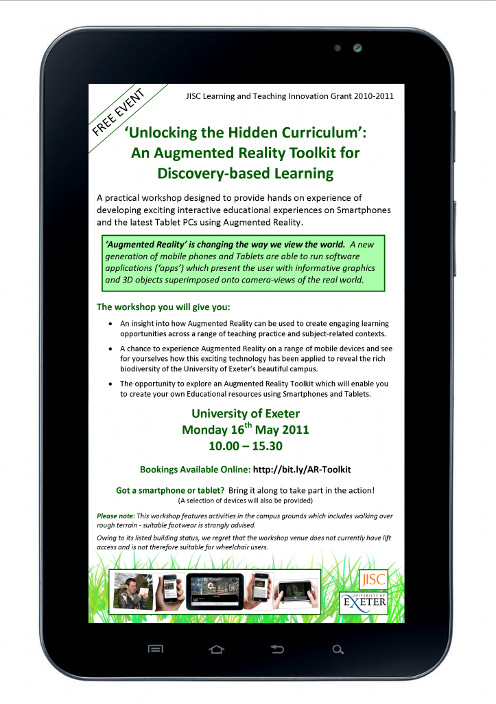
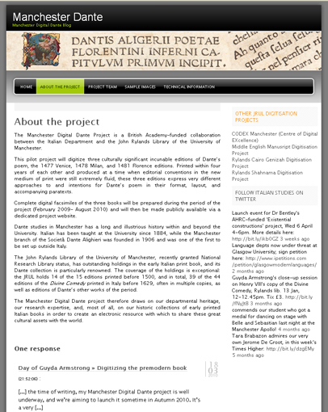
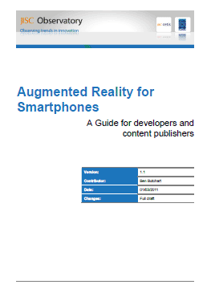
Synergies with existing projects

Slide 4
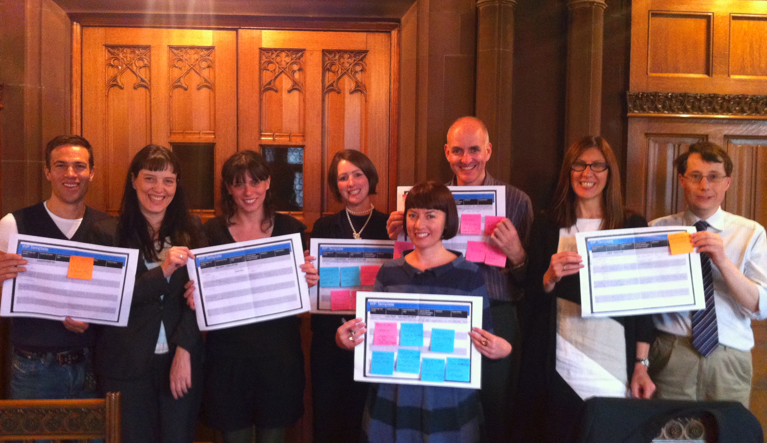
Team SCARLET

Slide 5


SCARLET Content

Slide 6
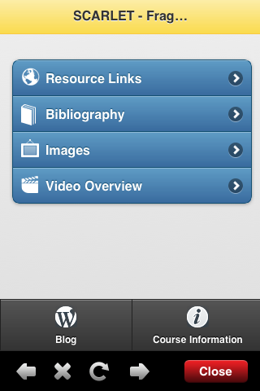
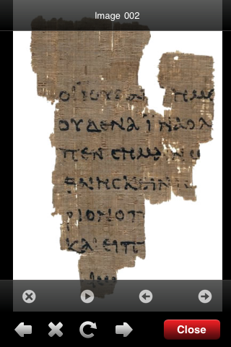
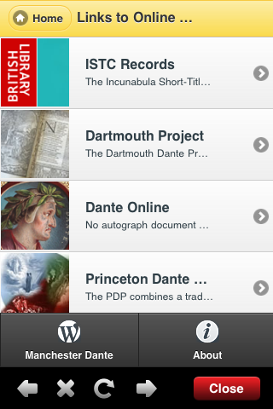
Student Learning Experience

Slide 7

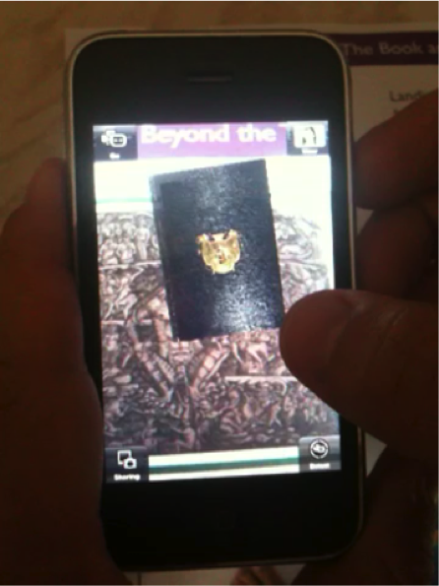
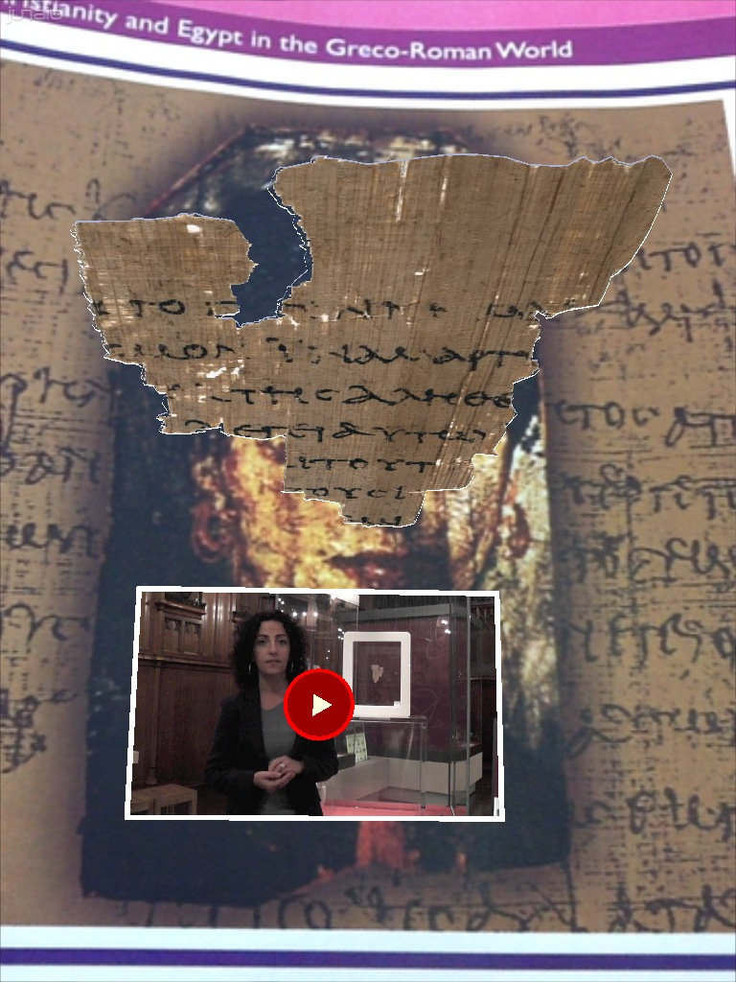
SCARLET Technology

Slide 8
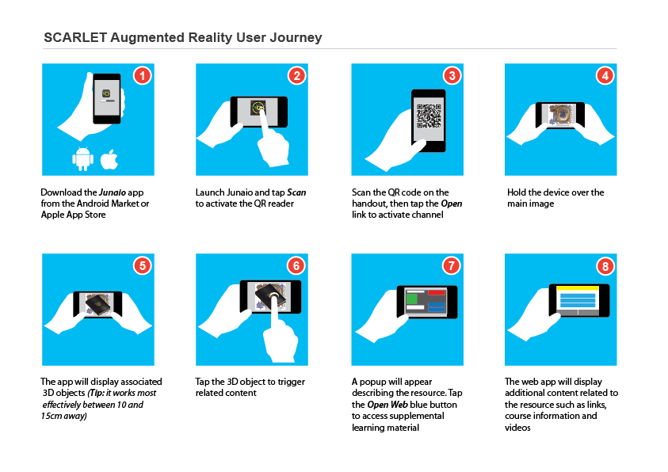
SCARLET User Journey

Slide 9

Evaluation
http://www.flickr.com/photos/svenreed/5258522555/

Slide 10

A methodology that can be replicated
http://www.flickr.com/photos/carbonnyc/3063453222/

Slide 11
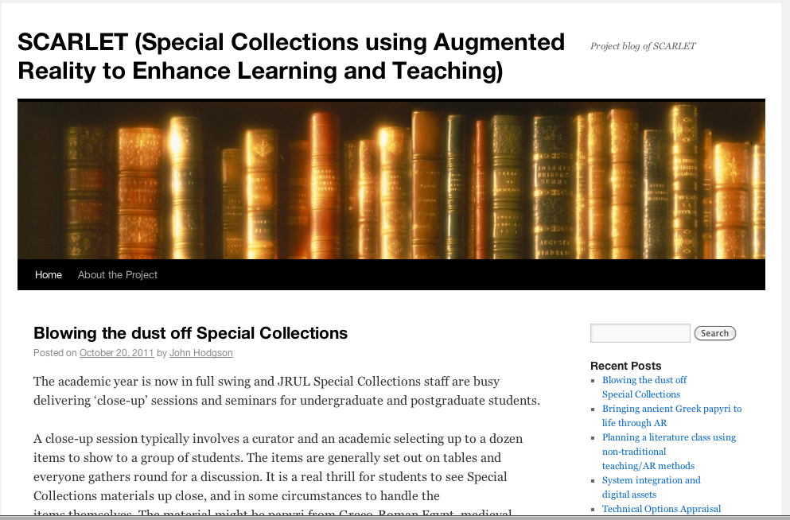
SCARLET Blog

Slide 12
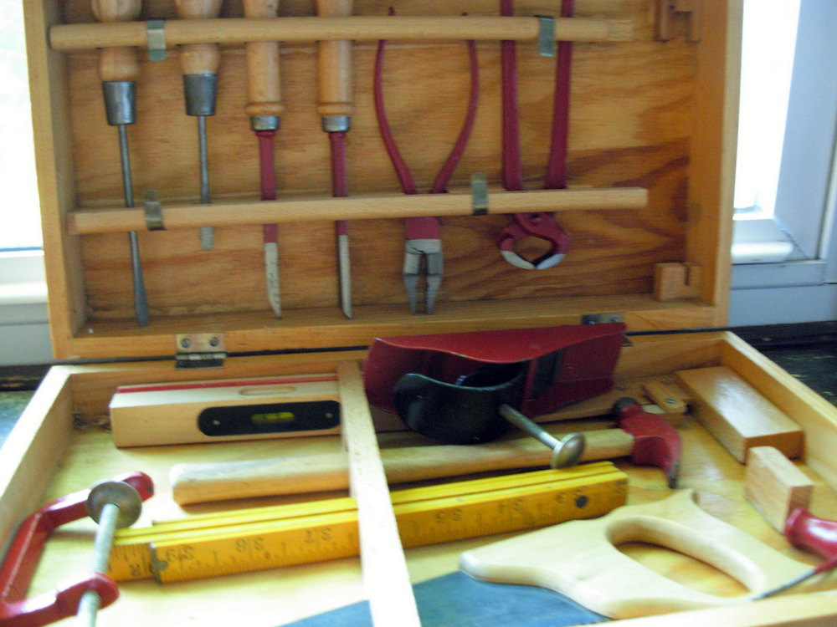
Toolkit
http://www.flickr.com/photos/nutmegdesigns/6094933598/

Slide 13

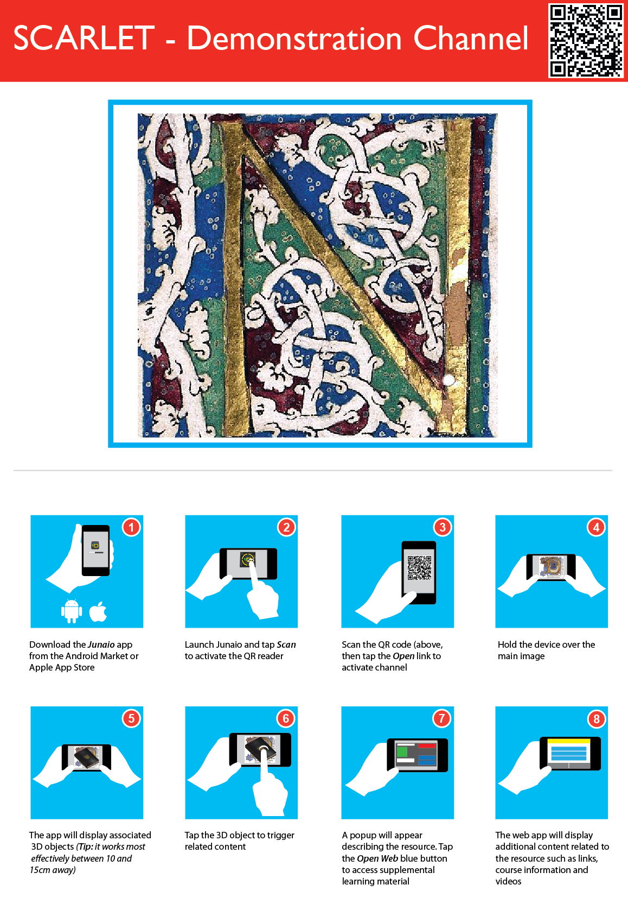
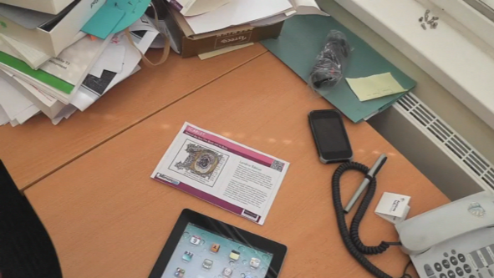
Find out more
Twitter @team_scarlet
Blog - http://teamscarlet.wordpress.com
Demo Content http://teamscarlet.wordpress.com/2011/11/14/demonstration-content/
User journey Video
http://youtu.be/UzI1dtSQ7ac

