Slide 1


Open practice across sectors
Anna Gruszczynska, Suzanne Hardy, Helen Richardson,
facilitated by Terry McAndrew

Slide 2




Presenters
Anna Gruszczynska is Project Officer at C-SAP (Higher Education Academy Subject Centre for Sociology, Anthropology and Politics) where for the past two years she has provided research and project management support to projects taking place within the JISC/HEA supported UK Open Educational Resources [UKOER] programme.
Suzanne Hardy joined the Subject Centre for Medicine, Dentistry and Veterinary Medicine in July 2000 and is responsible for overseeing the development and management of the website and its associated databases. Her primary brief is to support the information dissemination and publication activities of the Centre facilitated by the appropriate use of new technologies, and to encourage the novel use of new technologies in learning and teaching in the centre's three subject areas.
Helen Richardson is Business Manager at FusedWorks, Doncaster College's 3D visualisation studio (www.fusedworks.com). The College is a general further education college based in South Yorkshire. Through University Centre Doncaster it is one of the largest providers of Higher Education in the FE sector and currently has over 1000 FTEs on HE programmes..
Facilitator
Terry McAndrew is an advisor at JISC TechDis (since 2010) and the C&IT manager at the UK Centre for Bioscience Subject Centre (since 2000).

Slide 3
Session practice
Text-chatting
Elluminate layout
Audio
Whiteboard
Technical problems
Use the text-chat to engage with other delegates, presenter and moderators about the content of the session.
You can send private text-chat messages e.g. to moderators or to individuals.
You can change your Elluminate layout to “Wide layout” to make it easier to follow the text-chat (select “View … Layouts…Wide layout”).
If you are distracted by the text-chat, you can “unlock” the Elluminate layout to enable you to adjust the size and position of the text-chat sub-window (uncheck “View…Layouts …Layout locked”)
It is best to run the Audio Set-up Wizard to test your audio set-up each time you enter an Elluminate room (select “Tools…Audio… Audio setup wizard).
You must use a headset/microphone if you want to ask a question in audio.
Only use your microphone when guided by a moderator – click on the mic icon (bottom-left of screen) to turn it on and click on it again to turn it off.
Only draw on the whiteboard if guided by a moderator.
Send a private text-chat message to “moderators” and they will try to help.

Slide 4
JISCEL11
Open Practice Across Sectors
Notes:
JISCEL11
Open Practice Across Sectors

Slide 5
What do we mean by Open Practice?
Collaborative and Competitive
  Solutions are open for development but compete for attention
  More than OERs, but OER is a key initiative
Discoverable
  Published by mechanisms that assist teachers and learners
  Methodologies are shared through publications and events
  Resources shared online in a structured environment
Seeking to optimise the T&L experience
  What is the natural organisation for a connected world?
Examples from across sectors present their challenges and issues
Notes:
What do we mean by Open Practice?
Collaborative and Competitive
Solutions are open for development but compete for attention
More than OERs, but OER is a key initiative
Discoverable
Published by mechanisms that assist teachers and learners
Methodologies are shared through publications and events
Resources shared online in a structured environment
Seeking to optimise the T&L experience
What is the natural organisation for a connected world?
Examples from across sectors present their challenges and issues

Slide 6
Open Practice Across Sectors
FE & HE

Slide 7
Existing Culture - General
Limited open practice across the sector
Open practise more likely within departments
FE less hierarchical and more practical based which can lend itself more to open resources
FE resources can also be used within HE
Institutional structure that supports open practice

Slide 8
Existing Culture – Working Practice
Collaborative approach to way of working within curriculum – learner and employer involvement.
OER that works for a wider range of college curriculums (FE & HE) as tutors tailor resources to a students level.
Early steps taken to share knowledge of open practice through internal task groups and training days.

Slide 9
Challenges of Culture
Limited staff time to re-purpose open resources
Limited skill set to re-purpose open resources
Lack of infrastructure/policy to support open practice
Lack of confidence/knowledge with regards to licensing issues
Uncertainty around where to upload and find open resources
Limited sharing of resources between departments
Lack of awareness that creation of open resource is recognised as form of scholarship

Slide 10
Moving Forward...
Increase awareness!
Start with encouraging a culture of re-use
  Where can resources be found.
  How do you re-use (clear institutional policy).
CPD sessions for staff covering open resource availability, searching, re-purposing, licensing and curriculum planning.
Include market research phase to ensure open resources are appropriate, aligned to curriculum and employer needs.
Involve key stakeholders i.e. students and lecturers wherever possible to encourage wider use once released.

Slide 11

Open practice across sectors:
HE in FE issues
Anna Gruszczynska,
C-SAP/ Sheffield Hallam University
(HEA Subject Centre for Sociology, Anthropology and Politics)
Image source FreeFoto
(CC BY-NC-ND 3.0)

Slide 12
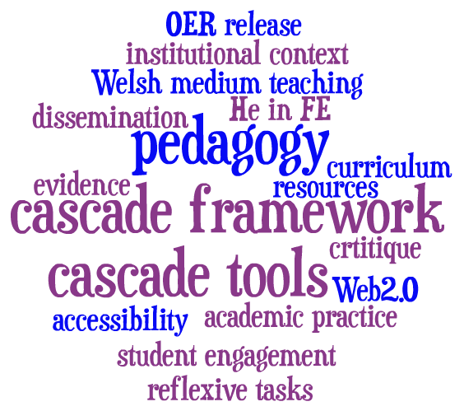
C-SAP cascade project: creating spaces for open practice
Cascade framework: Model of release, discovery and reuse of OERs
Emphasis on the broader context (cultural/institutional) in which OERs are created and (re)used and any resulting issues and/or tensions
Focus on the “why” rather than the “how” of Open Educational Resources [OERs]

Slide 13
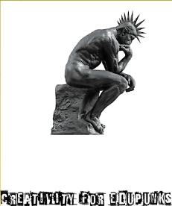
Opening up pedagogical practice: Creativity for edupunks (C4E)
A wiki-based resource and space to develop OER literacy and consider the potential impact of the OERs on approaches to teaching and learning
11 three-hour long sessions to fit within the 33-hour allocation for research activity (“selling point” for senior management)
Inspiration for C4E: connections with Blackburn’s past history of engagement with punk/DIY culture
Image source Phil Johnson (CC BY-NC-SA 2.0).

Slide 14
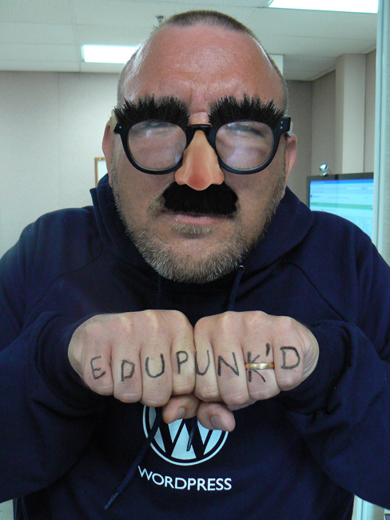
Ideas for going forward:
Need for a paradigm shift?
Edupunk is an approach to teaching and learning practices that result from a do it yourself (DIY) attitude (Downes, 2008).
Anarchogogy: the idea and the possibility of an approach to democratically disseminating, and openly creating “new” knowledge, where facilitators and learners collaborate, and the emerging ‘learning events’ serve to “lead without ruling” (from C4E wiki).
Image source @flickr Serenae
(CC BY-NC-SA 2.0)

Slide 15
What could open practice mean? (1)
For me learning has to be memorable, experiential and collaborative. For me open educational resources are a great addition and an extension to the learning that's taking place in the classroom amongst learners who are connected to the subject, the teacher and their peers. Participating in (Creativity for) Edupunk confirms it too: I have watched videos, browsed websites and posted on this wiki but there's no response, no sense of connection, until Phil wandered into my office the other day and for ten minutes we had a really good discussion about this stuff. (from Creativity for Edupunks wiki)

Slide 16
What could open practice mean? (2)
This is exactly what Phil and I have encountered on our "adventures" with this stuff; it is amazing in itself, but, explorations of the 'potential' for this stuff only becomes meaningful when it is discussed and deliberated ... in conversation and debate with real/empassioned [sic!] collaborators. (from Creativity for Edupunks wiki)
Our best hope is to get better at empowering individuals to find answers for themselves. (…) forget about giving the guy a fish, or teaching him how to fish, either. Teach him how to teach himself, and he’ll always be able to acquire the skills he needs to find food, skills you haven’t even thought of yet for things you didn’t know you could eat (from Kamenetz, 2010 – DIY U).

Slide 17

Open conclusions
(a big thank you to colleagues from University Centre at Blackburn College!)
Engage with the “why” of OERs in addition to technical aspects of OER production
Local context is crucial and reflection is key to challenging academic practice and sustaining these changes
Explore not just the differences between HE/HE in FE but possible synergies and similarities
Challenge some of assumptions and highlight the strengths of the sector
Embrace the potential of OERs to improve the visibility of HE in FE
Image source Phil Johnson (CC BY-NC-SA 2.0).

Slide 18


Open practice across sectors: human and animal healthcare. Lessons from ACTOR and PORSCHE
Suzanne Hardy
School of Medical Sciences Education Development, Newcastle University

Slide 19
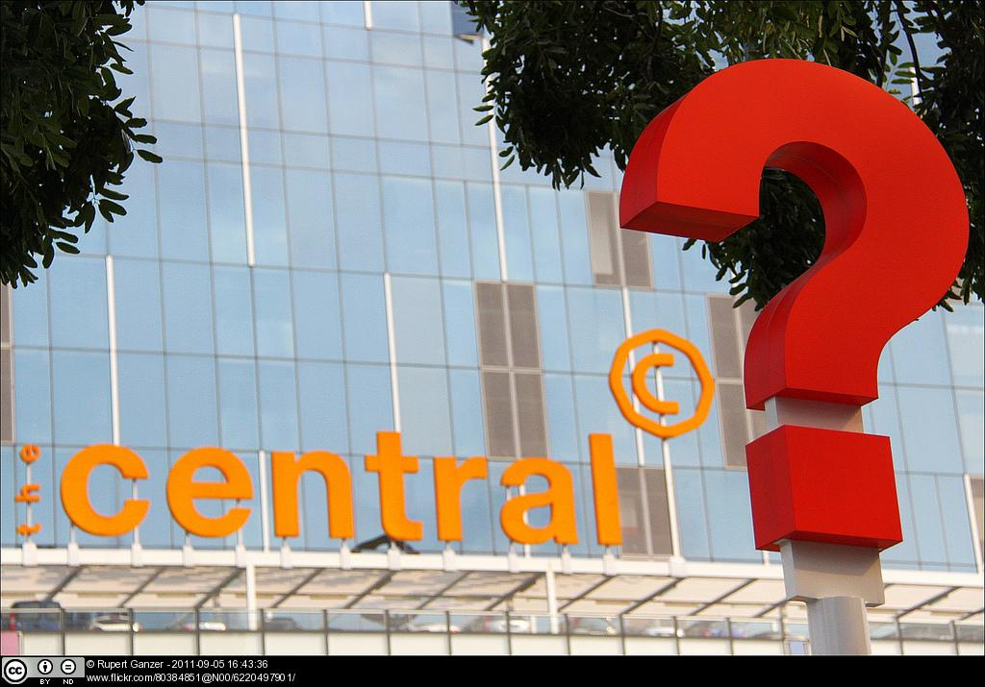
Existing culture

Slide 20
Which of these can be accessed from nhs.net?
YouTube
Facebook
Twitter
Slideshare
Jorum

Slide 21

Challenges

Slide 22

Ideas

Slide 23


suzanne@medev.ac.uk
twitter.com/hea_medev
twitter.com/glittrgirl
skype: glitt3rgirl
www.medev.ac.uk/ourwork/oer/
Notes:
On the website you can find full reports, a beginners guide to OER, and the Risk-Kit. You can find information about OER2, PORSCHE and ACTOR projects, and find an increasing number of case studies.

Slide 24
Discussion
We have approximately 25 mins to discuss the key issues
  How is Open Practice more than social tactics and trading?
  The importance of accessible Open Practice
  Keynote:
    Courage for transformative change?
    Thinking globally
    Incentives and gains to inform stakeholders and management – “Political wisdom”
    Dangers of non-engagement
Notes:
Discussion
We have approximately 25 mins to discuss the key issues
How is Open Practice more than social tactics and trading?
The importance of accessible Open Practice
Keynote issues:
Courage for transformative change?
Thinking globally
Incentives and gains to inform stakeholders and management – “Political wisdom”
Dangers of non-engagement

Slide 25


Follow-on activities
Asynchronous discussions
You can continue the discussions in the asynchronous discussion area: http://www.online-conference.co.uk/WebX?230@@.eedd499
Thinking Space
Sally Graham and Joy Jarvis will chart the developing story of the conference, creating a virtual thinking space to visually present ideas, common themes, connections, views, issues and questions that arise from the conference.
You can access the online Thinking Space at http://bit.ly/tieV01.
As Sally and Joy develop the Thinking Space during each day of the conference, please contribute towards the Thinking Space by tweeting your ideas and feedback using the tag #jiscel11space.
Sally Graham
Joy Jarvis

