Slide 1



STUDENTS AS
AGENTS OF CHANGE
Elisabeth Dunne, Dale Potter and Derfel Owen
JISC Innovating e-Learning Conference
November 2011

Slide 2
Derfel Owen
Part I:
Student Engagement:
The National Picture

Slide 3
Part II:
Students as Change Agents at the University of Exeter
Liz Dunne

Slide 4


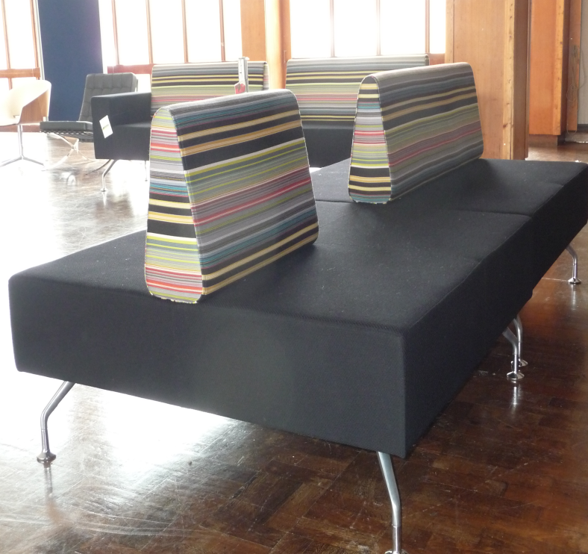

EXAMPLES OF STUDENT-LED RESEARCH PROJECTS on …
The LEARNING and TEACHING ENVIRONMENT
Over 1000 students, with the support of the Students’ Guild, gave opinions about the multi-million new ‘heart’ for the Exeter campus – The Forum. And tested furniture!

Slide 5

Archaeology
Student-led Research Findings: Students consider that there is not enough information available for careers in archaeology. 82% of students want a careers fair specifically designed for this subject area.
EMPLOYABILITY
Student-led Outcomes: Careers fair, updated website and monthly bulletins for jobs, work experience and funding availability.

Slide 6
Biosciences Student-led Research Findings: Students struggle with scientific essay writing. 89% of students wanted more essay practice and many feel unprepared for essay examinations. Student-led Outcomes: Essay skills guide, written by students, for students; more tutorial style essay sessions for first years.
PEDAGOGY

Slide 7
STUDENTS AS CHANGE AGENTS –
SHIFTING RESPONSIBILITY/ EMPOWERING STUDENTS
EMPHASIS ON THE STUDENT VOICE
EMPHASIS ON
THE UNIVERSITY AS DRIVER
Integrating students into educational change
EMPHASIS ON
THE STUDENT
AS DRIVER
EMPHASIS ON
STUDENT ACTION

Slide 8
STUDENT ENGAGEMENT
Engineering,
Maths,
Physical
Sciences
Life and Environmental Sciences
Volunteering
Student
Engagement
Strategy
Student Engagement
and Participation
Development
Manager
Sport
Change Agents
2008/9 to 2010/11
30 projects in all
The
Business
School
Humanities
Students’
Guild
Joint funding from the Students’ Guild and University central services
Social
Sciences,
International
Studies
2011/12
6 change agents projects per College
6 centrally-run projects
= 35 projects

Slide 9
Questions so far!
(strictly 5 minutes only!!)

Slide 10
Where can students make the most effective contribution as change agents:
A developing technology?
B study skills?
C employability?
D teaching methods?
E other? (give details in chat window)
Click on the letter below the participant window to respond

Slide 11
Where can students have most impact:
A at subject level practice?
B through institutional policy?
C in professional services?
D other? (give details in chat window)
Click on the letter below the participant window to respond

Slide 12
How should we reward and recognise the work that students are doing:
A financially?
B with academic credit?
C through an informal award scheme?
D reward is not necessary?
E other? (give details in chat window)
Click on the letter below the participant window to respond

Slide 13
Part III:
Technology & Change Agents
Dale Potter, Chris Harper, Ryan Thompson

Slide 14

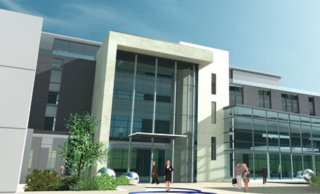

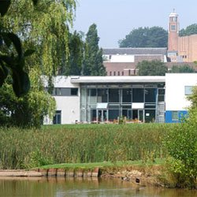

Students as Change Agents thread to
JISC-funded, Integrative technologies project.
Notes:
Top NSS ratings for past 4 years
All subjects top 10 (The Times)
1,685 UG students, 1,100 PG students
33% international students from 82 countries
Integrative Technologies Project
Expanding student numbers (1000+ now in 1st year)
International diversification (33% international students)

Slide 15
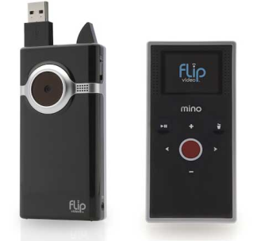



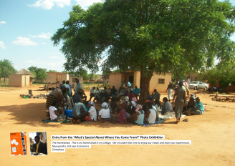


Student Projects 2008-10
Clickers
Using Video in Tutorials
Podcasts
Sustainability
Photo Competition

Slide 16
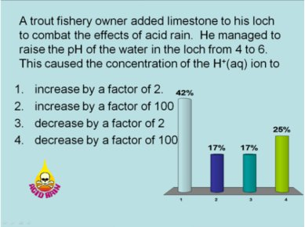


Clickers
Video in Tutorials
Podcasts
Sustainability
Photo competition
‘Ask the Audience’
interact
Turning Point response system
Easy to use
Convenient
Student focus enhanced
Peer review
Feedback
Instant
2010-11 pilot study
Engagement!
Notes:
Tim Lowe: http://www.youtube.com/watch?v=YbSC4k7XJ3E
ENGAGEMENT AND CROSS-SECTORAL COLLABORATION!!
1) Introduce
Guild President Johnnie Bedall on BBC Spotlight news outlined a core part of the student experience is engagement. Hence the title, hence our study.
2) What have we done with the clickers?
We've looked into the capability, usage of, and potential of the devices. This includes modules, student and staff views and more understanding of the potential of devices
3) Capability
Engagement
Wide ranging data capture
Instant response
Student and teacher understanding where knoweldge is not satisfactory
4) Usage
5) Potential for registration and attendance monitoring

Slide 17

Clickers
Video in Tutorials
Podcasts
Sustainability
Photo competition
Real Change!
4,000 audience response handsets now issued across undergraduate and Masters’ students.

Slide 18



Clickers
Video in Tutorials
Podcasts
Sustainability
Photo competition
Introduction + Process
Benefits of technology:
- Peer review process
- Review and catch up
- Self reflection
Conclusion – benefits everyone!

Slide 19
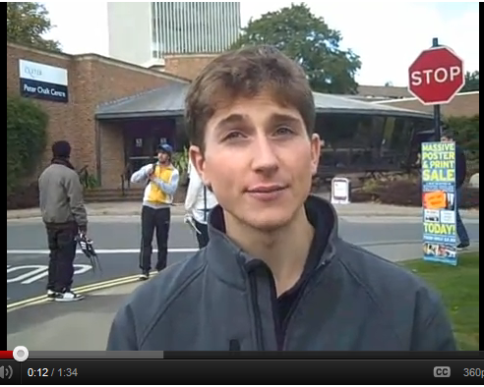
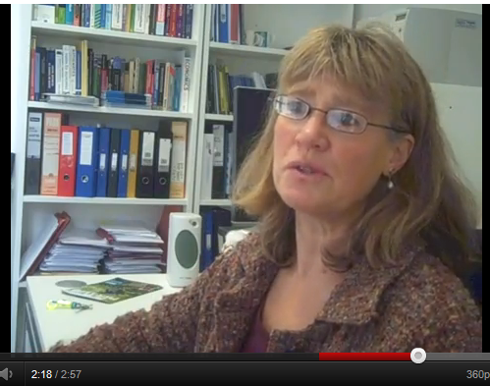
The value of student engagement in learning & teaching technologies
Clickers
Video in Tutorials
Podcasts
Sustainability
Photo competition
http://www.youtube.com/watch?v=YbSC4k7XJ3E
http://www.youtube.com/watch?v=Yy15o_CuzJ4

Slide 20
Clickers
Video in Tutorials
Podcasts
Sustainability
Photo competition
Students given dictaphone to record lectures
Students upload content to VLE
Low-cost, high impact proposal

Slide 21
Clickers
Video in Tutorials
Podcasts
Sustainability
Photo competition
Why did this project fail?
Naivety of the change process
Scalability of technology
Creating agile institutions in the post-Browne environment

Slide 22


Students as Change Agents: The Benefits
Students play key part in making great innovations happen
Experience organisational change in practice
Recognition & Employability skills
Institutions can stretch the top 10%
Harness the passion, vision and creativity of tomorrow’s leaders
World-class institutions, world-leading concepts

Slide 23


Employability
Recognised as part of Exeter
Award & Exeter Leaders Award
Entrepreneurial example for applications
Test-bed for future creativity

Slide 24
Everyone Benefits!

Slide 25
Find out more...
Question time
Students as Change Agents:
www.exeter.ac.uk/changeagents
JISC Integrative Technologies Project:
http://projects.exeter.ac.uk/integrate/saca.html

