Slide 1
Mobile devices in the classroom
Piloting Mobile Resources & Mobile Access at College of North West London
Tony Delahunty

Slide 2


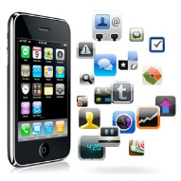

THE INSTITUTIONAL CHALLENGE
Strategy + Economics
THE CLASSROOM EXPERIENCE
Using Devices, Viewing Content
MOBILE RESOURCES
Developing materials Screencasting Apps
MOBILE ACCESS
Deploying Wifi Mobile versions of Web Services, VLE

Slide 3
The institutional challenge

Slide 4
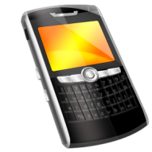
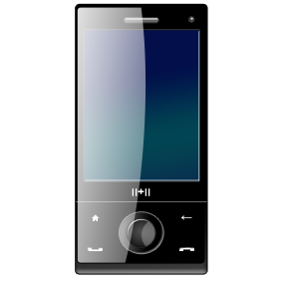

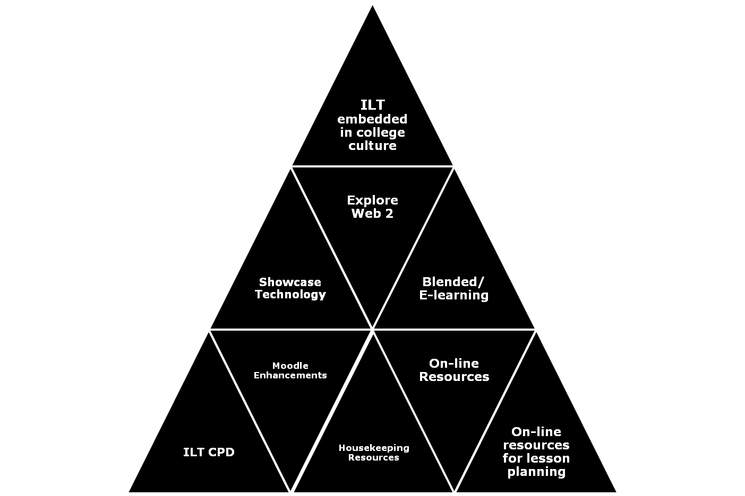
Strategic Priority
  Excellent electronic solutions
  Embracing the ‘Digital Age’
Economic Climate
  Exploit devices students carry in their pockets
  Enhance profile of College, in competing for students, partners
Challenges
  Inspiring staff and students
  Exploiting apps and resources
  Invigorating the curriculum
  Producing an efficient solution
  Changing a culture

Slide 5
The Classroom Experience

Slide 6
Perspective Check…
Is Mobile learning primarily something that goes on
  in the classroom?
  or beyond it?

Slide 7
Perspective Check…
Is Mobile learning a mode of delivery…
  that can be teacher/provider-led?
  or is it inherently user-led?

Slide 8
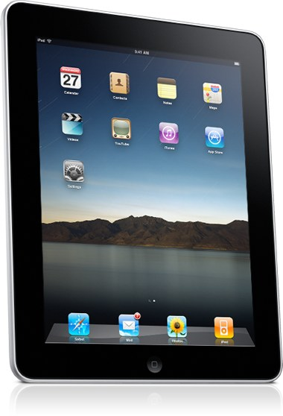

Slide 9
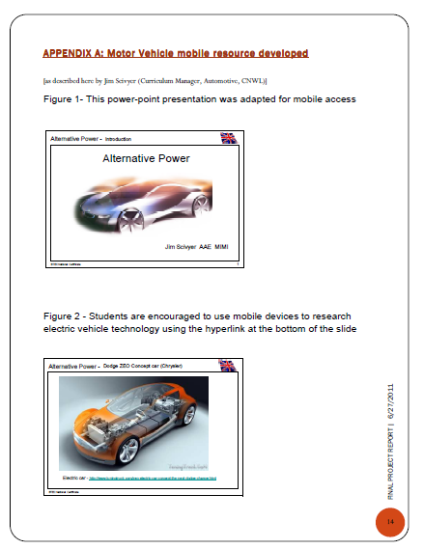
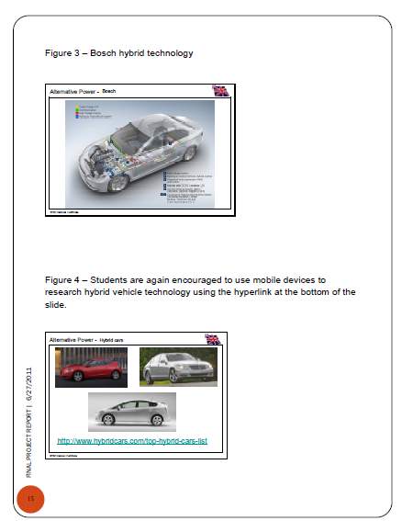

Slide 10
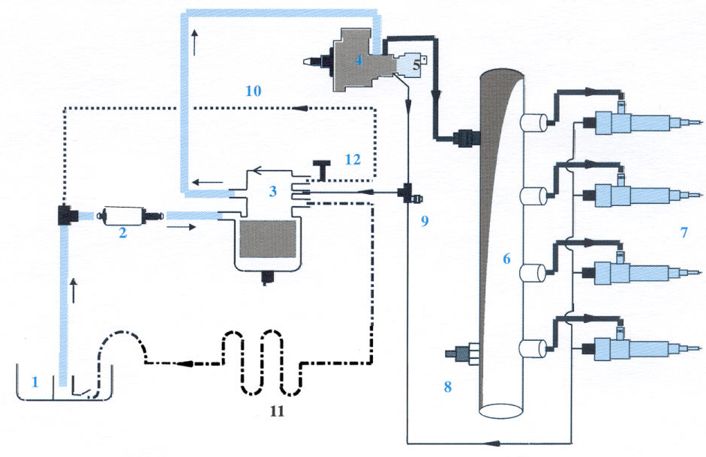
Can you see the diagram clearly?

Slide 11
Better now…?

Slide 12
Powerpoints converted for mobile access & viewing:
  http://www.slideshare.net/iltatcnwl/cnwllevel-3autoadvancedchassistechnologyintro

Slide 13
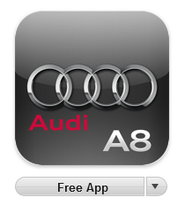
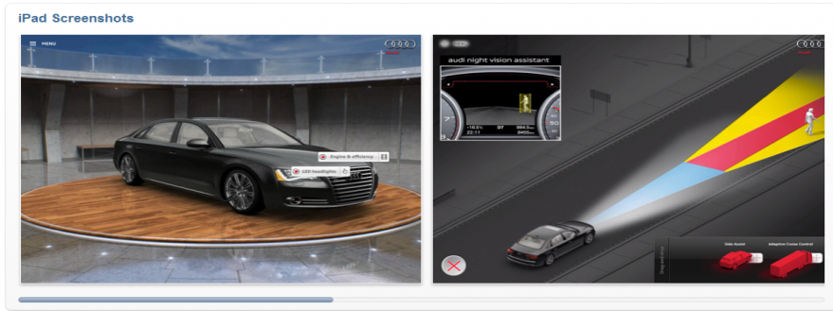
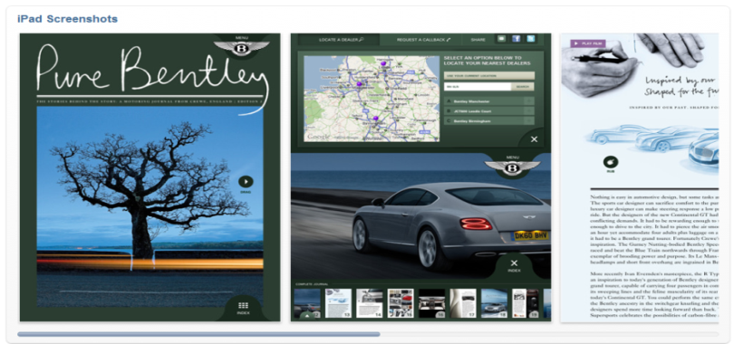

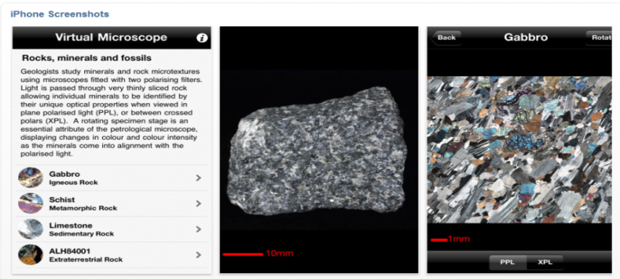
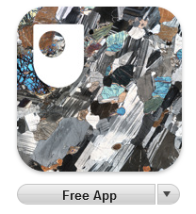
Learning Apps from the iTunes Store

Slide 14
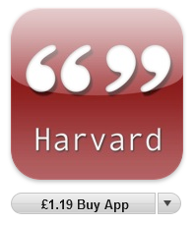
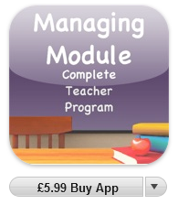

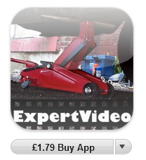
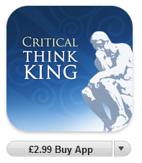
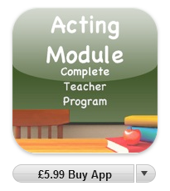
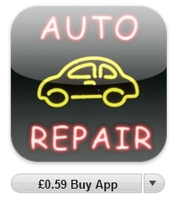
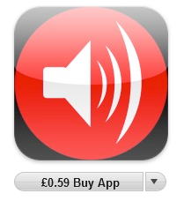
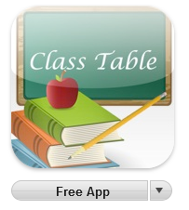
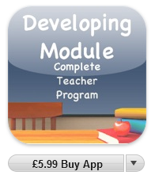
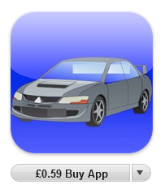
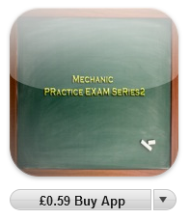
Learning Apps from the iTunes Store
Number 2 is good

Slide 15
Developing Resources

Slide 16
Perspective Check…
Which of the following mobile learning resource creation methods do you favour? …
  GLO Maker/ Xerte
  Articulate
  Lectora Inspire
  Mobile apps (iPhone etc or other platforms)
  Molesys/MoleDev

Slide 17
Perspective Check…
Which of the following mobile learning resource hosting methods do you favour? …
  Screenr
  Jing, Camtasia
  PowerPoint
  YouTube, etc, Video sharing sites
  Slideshare

Slide 18
Resource Creation Methods…. (1)
RLOs (Reusable Learning Objects)
  GLO Maker
  Articulate
  Xerte
  Hot Lava Mobile
  Lectora Inspire
  iPhone /iPad/iPod apps
  Molesys/MoleDev
Details in “Mobile Learning Resource Creation Specification Grid”

Slide 19
Resource Creation Methods…. (2)
Video/Audio
  Screencasting
    Screenr, Jing, Camtasia, PowerPoint
  Video sharing sites
    YouTube, etc, Slideshare

Slide 20
Screencasting

Slide 21
A screencast is a digital recording of computer screen output, also known as a video screen capture, often containing audio narration
Wide range of potential uses:
  Providing a voice-over to a PowerPoint presentation
  How-to’s: contextualised instructional guides, showing the user how to do something online
  Feedback on assignments, or other personalised messages
  Can be set for students to create, for them to demonstrate or practice a particular task
.

Slide 22
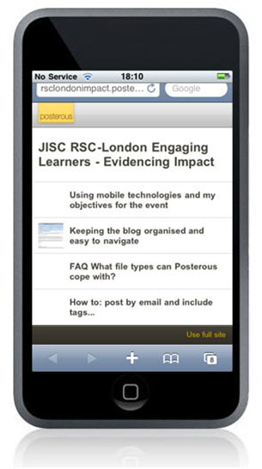
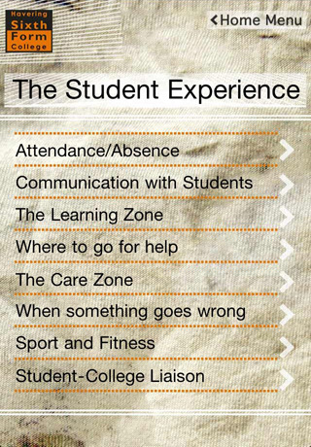
Resource Creation Methods….
Apps for Mobile Platforms
Interfaces to College systems, or Marketing Info
  Havering, Northampton, etc.
  Many more under development
Complex development, time-consuming. No uniform platform or paradigm as yet. Diversity of handheld devices

Slide 23
Mobile Access

Slide 24
Perspective Check…
How extensive is wifi?
  Students can and do use it
  Staff can and do use it
  Guests can and do use it
  Anyone in range (i.e random visitors) can and do use it

Slide 25
Perspective Check…
How vital is Wifi: which causes most upset and disruption to your institution when unavailable or down?
  Wifi
  Wired Network
  VLE
  Coffee Shop
  EMail

Slide 26
Enabling and Extending WiFi
Flexible access to resources and College systems has been a long-standing aim
Widespread mobile platforms make this more critical, and more appealing
Demand for WiFi for student use
Requires investment in infrastructure , and some technical/ cultural challenges
Projected eventual benefit: reduced support costs, as users use and maintain their own devices

Slide 27
Infrastructure Issues
Ensuring Web Services are mobile-friendly (e.g. VLE)
Coping with the multi-platform challenge (including ‘legacy’ platforms, e.g. PC browser)
Compatibility/cost/ease of use issues: led us to favour video/audio/’standard’ html
Developing an iPhone app for College information and functions. Other platforms to follow?
Increased acquisition of eBooks and use of eBook readers
Using SMS texting services for contact and marketing. Some trials with students’ crowd-sourced comments on College events

Slide 28
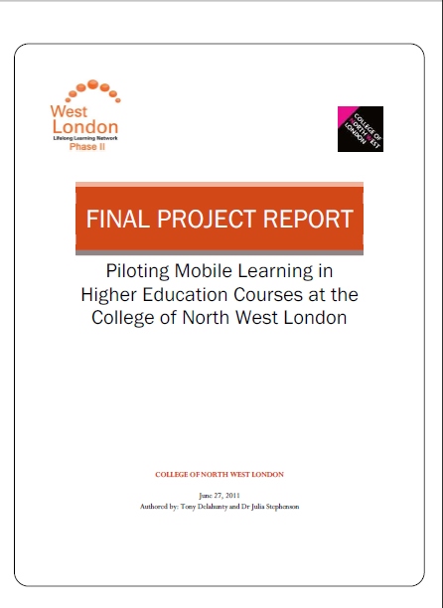
Available on the MobileLearn2011
Symposium Website:
www.cnwl.ac.uk/MobileLearn

Slide 29
Mobile devices in the classroom
Piloting Mobile Resources & Mobile Access at College of North West London
Thank-you for your attention!
Tony Delahunty

