Slide 1
Socio-technical ramifications of a new technology-supported approach to course design and approval
Paul Bartholomew
Jim Everett

Slide 2
JISC Curriculum Design Programme
The programme
T-SPARC
PiP
How this session came about
How it links to the main conference session: S4: What needs to change in curriculum design? (Simon Cross, Alan Masson, Jim Everett, Paul Bartholomew)

Slide 3
Overarching JISC Initiative
Institutional Approaches to Curriculum Design
  12 project funded @ £400 000 per project
  Project length: 3 years, 9 months
  First 6 - 9 months had to be spent in ‘review’
Parallel Initiative:
  Transforming Curriculum Delivery Through Technology

Slide 4
JISC’s anticipated outcomes for the programme
Improved understanding of effective curriculum design and how design processes can be supported with technology.
Reusable models of processes and practice.
Enhanced institutional processes in place which support educational innovation .
The stimulation of positive and informed change in curriculum design processes in the sector.

Slide 5
Institutional Contexts
Birmingham City University and T-SPARC
University of Strathclyde and PiP

Slide 6
Two Institutions
Shared conceptualisation of the problems surrounding course design and approval
Then exploring different routes

Slide 7
Poll
What are the main issues with the process of course design and approval in your institution?
Design is just about producing documentation
There’s no time to do a good design job
Programmes aren’t designed – modules are
Conservative approval processes discourage innovative solutions to design issues.

Slide 8
Methods for eliciting problems
T-SPARC approaches
PiP approaches

Slide 9
T-SPARC elicitation methods
Multimedia review:
  A set of interviews undertaken with programme directors to explore the ‘lived experience’ of curriculum design.
Process mapping:
  Mapping of all of the institutional processes that cascade from curriculum design and approval
Critiquing the maps:
  Staff annotated the process maps and identified strengths, weaknesses and frustrations.

Slide 10


Elicitation Methods
Principles in Patterns (PiP)
Focus Groups
  Cross-functional groups
  Process stage owners
Business process analysis
  The power of model making
  The to-be state

Slide 11
The common problem set
Problems with process flow
Problems with process tools and methods
Problems with people
Poll: Which of these problems most affects your institution?

Slide 12
T-SPARC problems / issues?
Design = preparing documentation for an approval event
Stakeholder engagement was sometimes tokenistic
Teams took a distributed rather than holistic approach to programme design

Slide 13
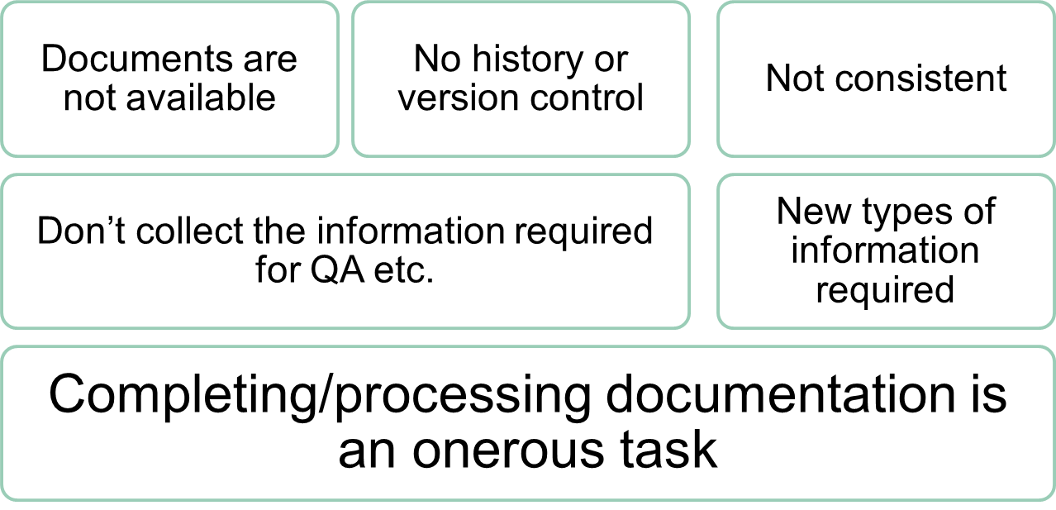
Principles in Patterns (PiP)
Issues and bottlenecks
Completing forms creates a teachable moment

Slide 14
Different approaches to the same problems
T-SPARC: change the processes
PiP: work within the processes

Slide 15
T-SPARC Story
Why change the process?
  The benefits of ‘real’ approval panels were perceived as being few and far between
  New appetites for curriculum design as an activity
  New emphasis on stakeholder engagement meant changes needed to happen to fully exploit the potential of rejuvenated values

Slide 16
T-SPARC
Technology Supported Process for Agile and Responsive Curricula
Our emergent solution to the issues uncovered.

Slide 17
Findings of the Multimedia review
Much of the work related to curriculum design is in the service of the production of definitive documentation.
This documentation is primarily written for an approval panel audience and programme teams feel that much of their investment in producing such documentation has limited value outside of the specific context of programme approval.

Slide 18
Findings of the Review
Programme teams report that this focus on the products of curriculum design rather than the process of curriculum design distracts activity away from rich team discourse and innovative solutions to curriculum design challenges.
In summary, our approval practices are perceived to tend to stifle innovation and require a documentary overhead that is seen by staff as being disproportionate to its value.

Slide 19
The T-SPARC expectation
Programme teams are ‘wide’ and include all stakeholders
Stakeholder engagement is non-tokenistic – informed by our model ( on next slide)
Technology assists programme teams in their engagement activity AND provides a way to ‘evidence’ this engagement

Slide 20
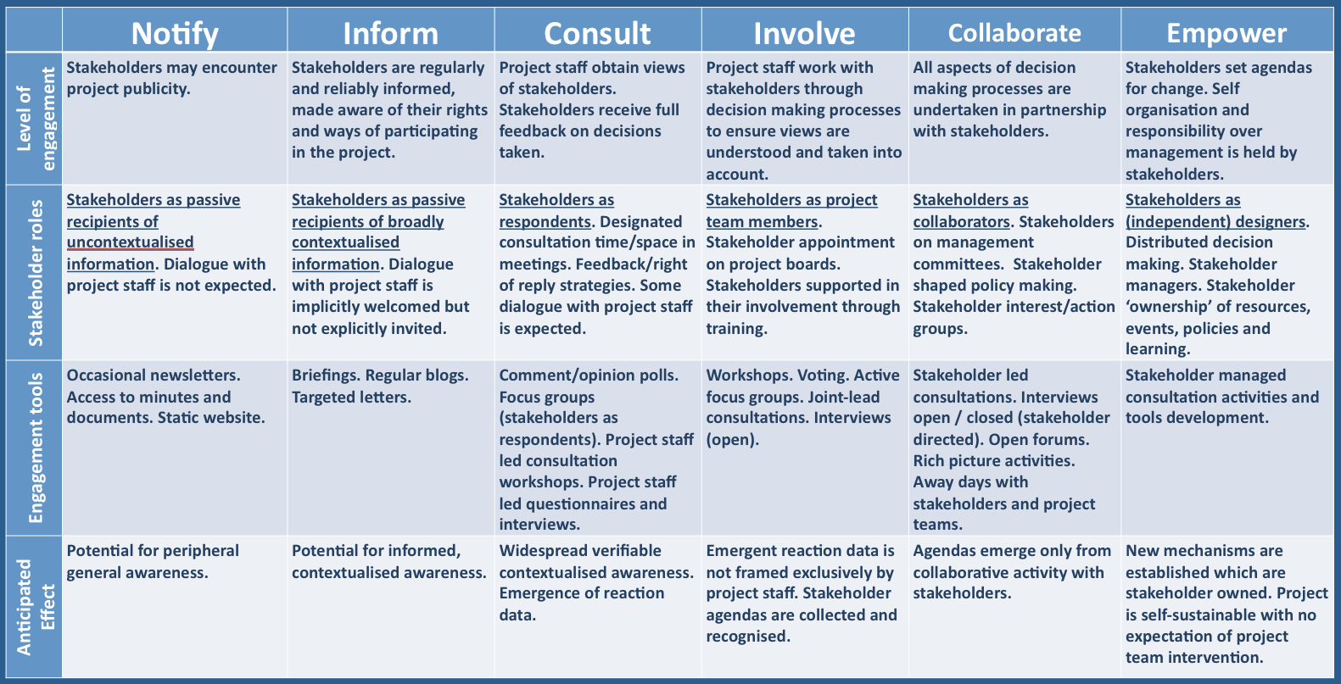

Slide 21

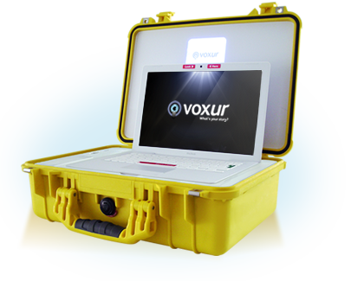
Bits of kit
Flip Cameras
MP3 recorders
Voxur Units
Borrow them / Use them

Slide 22
How do people react?
We’ve found that some (but not many) students don’t like being videoed
  They are young and female
Other stakeholders use their opportunity for having a ‘persistent’ voice to get more involved

Slide 23
Our (original) intentions
Some have changed…!

Slide 24
1. Informing programme design activity through the enhanced provision of pertinent information
Course specific statistical information – retention, progression
Market analysis information
Curriculum planning tools

Slide 25
2. Redesign of the ICT infrastructure which underpins the workflow of the curriculum design and programme approval processes
Definitive documentation – via SharePoint and InfoPath documents
‘Evidence’ of Process – via Mahara and/or Moodle
Anticipation that evidence of process will include multimedia artefacts

Slide 26
3. Electronic support for course team dialogue during their programme design activity
Holistic design approaches vs. distributed design processes
Time and space for discussion
To (part) address limited engagement of other stakeholders in curriculum design

Slide 27
4. Electronic representation of programmes and underpinning evidence at (and leading up to) the point of approval
The most important facet of the project
One of the most influential factors to impact on the ‘lived experience’ of curriculum design
Very closely linked to review and approval mechanisms

Slide 28
How can technology help?

Slide 29
Mahara
BCU’s e-portfolio system of choice
Can be used as a virtual ‘scrapbook’
Stick any type of media in there
Programme teams can record curriculum design / stakeholder engagement meetings – any way they like. Putting the ‘evidence’ up there for later reference.

Slide 30
Mahara
BCU’s e-portfolio system of choice
Can be used as a virtual ‘scrapbook’
Stick any type of media in there
Start recording you curriculum design / stakeholder engagement meetings – any way you like. Put the ‘evidence’ up there for later reference.

Slide 31
Moodle
Have a pre-populated space with suggestions and design support materials for programme teams to discuss as a team.
Use the forums to create a form of time and space to have team discussions or to involve a wider ranger of stakeholders.
Make more use of external experts

Slide 32
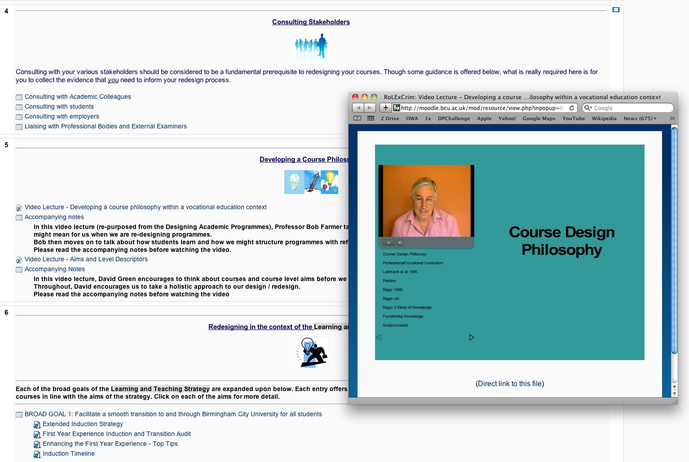

Slide 33
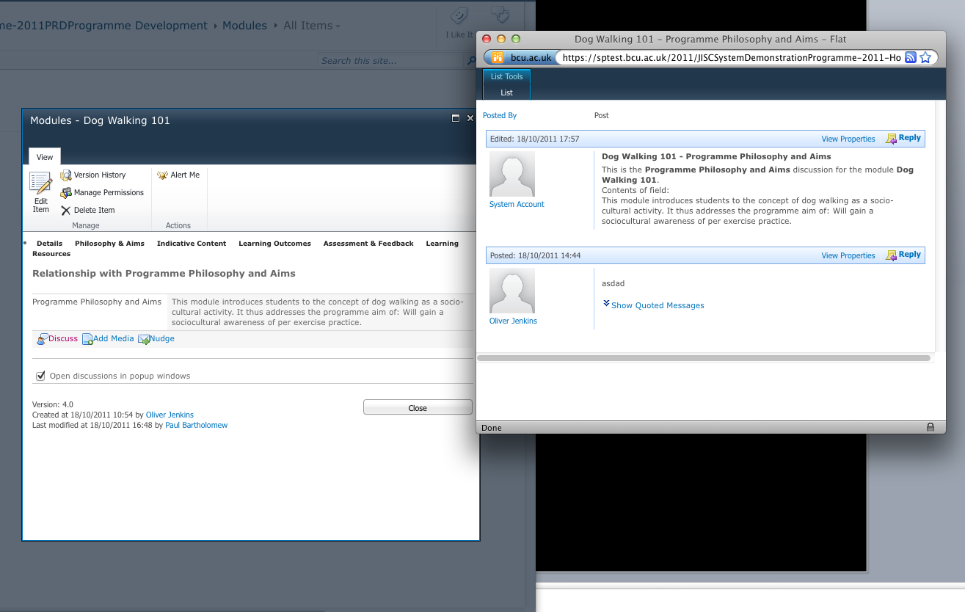
SharePoint
Does much, much more than we thought!
We’ve bespoked SharePoint 2010 a bit

Slide 34
The new approval process:
No panel events
Formative focus
Rich in discussion
Automatic generation of documentation

Slide 35
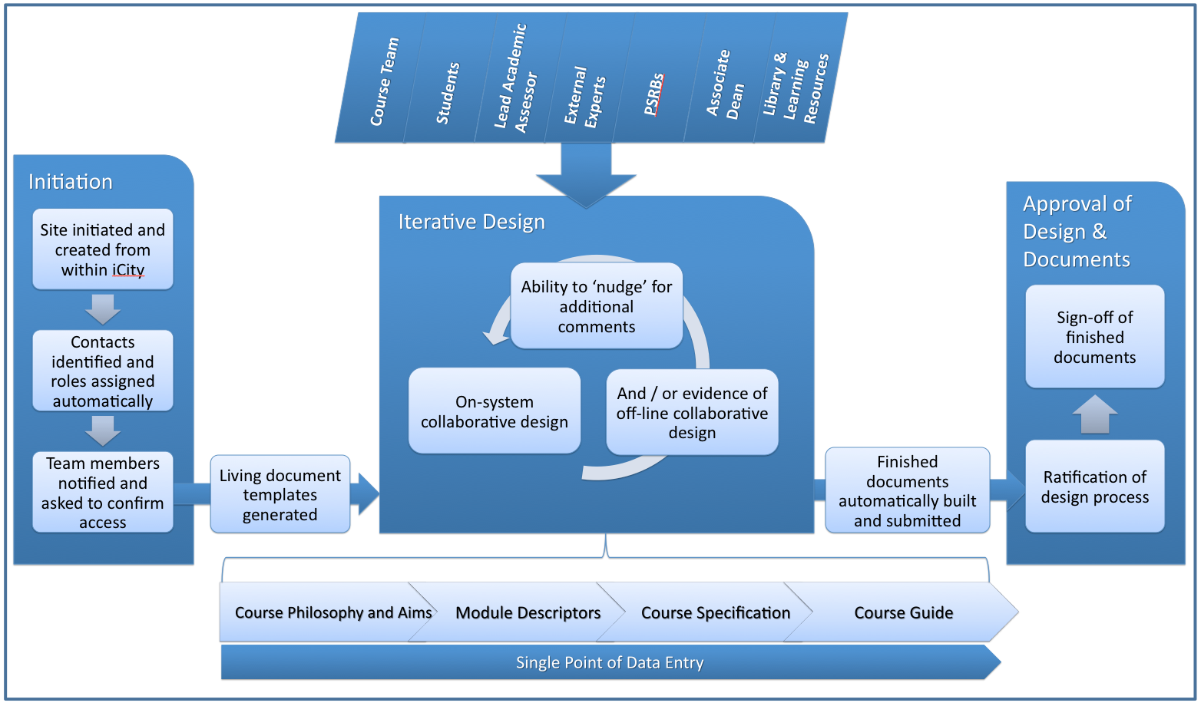

Slide 36
Web 2.0 tools
Google Docs; Twitter; Word Press; YouTube
Anything else programme teams like
Open up the opportunities for richer engagement with stakeholders

Slide 37
I took the first pilot programme through this approval process over the summer
An online approval system ‘robs’ you of your ability to put a verbal ‘spin’ on things – much more evidence-based.
The fact that evidence of a design process is required means that good design takes place
The formative nature of ‘longitudinal’ approval means that suggestions from ‘panel’ members can be incorporated into the design stage.

Slide 38
Why live with the process?
Principles in Patterns (PiP)
Institutional factors
Problem conceptualisation and perception
“Fix what can be fixed” and “Low hanging fruit”
What is this process we are living with anyway?

Slide 39
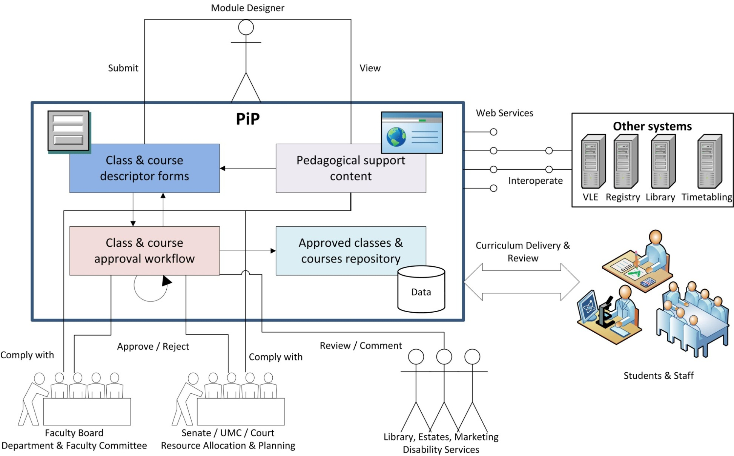
Enhancing with technology
Principles in Patterns (PiP)

Slide 40
But were compromises required?
PiP compromises
T-SPARC compromises

Slide 41
Compromises
Principles in Patterns (PiP)
Balancing scope and impact
Subversive technology, or Can processes remain the same when enhanced with technology?
Processes are organic and developing all the time

Slide 42
Compromises
No system is perfect – need to live with the foibles of the technology long enough to iron them out.
The process IS different – people need to adjust their mind set to new ways of working.
We are simultaneously piloting two things – a new approval process and new ICT infrastructure – this introduces some tensions around ownership

Slide 43
Similarities and Differences
How the T-SPARC and PiP approaches might diverge
How the T-SPARC and PiP approaches might converge
Lessons learned or “Would we do it the same way again?”

Slide 44
Discussion
When would the different approaches be most appropriate in cross-institutional projects?
Are these really different approaches, or different ways of presenting technology enabled solutions?
Opportunity to continue discussion online

Slide 45
Finding out more about T-SPARC
http://blogs.test.bcu.ac.uk/tsparc/
Oliver will drop a live link into the chat window

Slide 46
Finding out more about PiP
Principles in Patterns (PiP)
http://www.principlesinpatterns.ac.uk/

