Slide 1
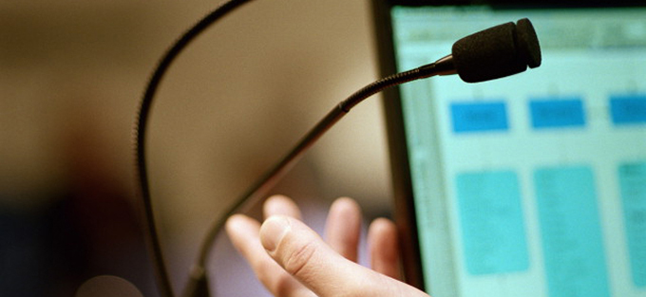
How to get your innovations adopted (and change the world)
Anne Miller, facilitated by Peter Bullen
Joint Information Systems Committee
Supporting education and research

Slide 2
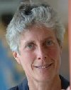
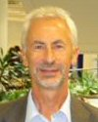
Presenter
Anne Miller is an authority on creativity and innovation and one of the world's most prolific female inventors, with 39 patents for a diverse range of products. Her inventions range from power tools for Bosch to the manufacturing system for the Femidom (the female condom). In 1988 she was a co-founder of The Technology Partnership (now one of Europe's leading technology innovation organizations) and in 2000 she founded The Creativity Partnership, where she provides consulting and training for some of Europe’s most successful organizations. Her acclaimed book "How to get your ideas adopted (and change the world)" is now available in paperback.
Facilitator
Peter Bullen is an Emeritus Professor at the University of Hertfordshire and a Critical Friend to a number of Universities involved in JISC and HEA supported projects.
Joint Information Systems Committee

Slide 3
Session practice
Text-chatting
Elluminate layout
Audio
Whiteboard
Technical problems
Use the text-chat to engage with other delegates, presenter and moderators.
You can send private text-chat messages e.g. to moderators or to individuals.
You can change your Elluminate layout to “Wide layout” to make it easier to follow the text-chat (select “View … Layouts…Wide layout”).
If you are distracted by the text-chat, you can “unlock” the Elluminate layout to enable you to adjust the size and position of the text-chat sub-window (uncheck “View…Layouts …Layout locked”)
It is best to run the Audio Set-up Wizard to test your audio set-up each time you enter an Elluminate room (select “Tools…Audio… Audio setup wizard).
You must use a headset/microphone if you want to ask a question in audio.
Only use your microphone when guided by a moderator – click on the mic icon (bottom-left of screen) to turn it on and click on it again to turn it off.
Only draw on the whiteboard if guided by a moderator.
Send a private text-chat message to “moderators” and they will try to help.
Joint Information Systems Committee

Slide 4
How to get your innovations adopted
JISC Innovating e-learning 2010 conference
Theme 2: realising the value
25 Nov 2010
Anne Miller

Slide 5
Who’s here?
A: Academic
B: Support staff (e.g. e-learning, ICT, library)
C: Senior manager
D: Member of agency staff (e.g. JISC, HE Academy)
E: Other (type into textchat)
We’ll be picking out some questions and examples from the textchat to discuss at intervals during the session and asynchronously afterwards.

Slide 6
Innovations are always resisted
The Telephone
“This so called telephone has far too many shortcomings to be seriously considered as a means of communication. The device is inherently of no value to us”
Western Union internal memo 1876
Open University
“I had heard about [the idea] but regarded it as a political gimmick unlikely ever to be put into practice”
Walter Perry, 1st Vice Chancellor of the Open University

Slide 7
What might be some particular problems in academia?
Academics
Often think the job’s done when they’ve written the paper
University management
Used to think “Funding”, now think “Return on Investment” (RoI)
Atmosphere
Was “growth”, now “cuts”

Slide 8
The resistance to innovation
Resistance is normal
Don’t get demoralised, get smart
Dealing with the 4 stages
Blindness :
“What idea?”
Frozen :
“Its not worth it”
Interested :
“Tell me about it ”
Integration :
“We’ve always done it this way”
Usual (ineffective) starting and finishing point
Notes:
Frozen
“The data’s unconvincing”
Its someone else’s responsibility”

Slide 9
“But we’re not blind!”

Slide 10
Exercise: Attention
What clues can you spot?

Slide 11
How many changes did you spot?
A none
B 1
C 2-4
D 5-9
E more than 10
Please abstain from voting if you’ve seen the video before, or were unable to see it this time (eg due to technical problems)

Slide 12
How many of you
Had a sneaking suspicion something was wrong but ignored it?
Yes?
No?
√
X

Slide 13
Exercise: Attention
Filtered out
because
it wasn’t relevant
What clues can you spot?

Slide 14
What do you hear?
Stairway to heaven forwards
Stairway to heaven
backwards
If there’s a bustle in your hedgerow, don’t be alarmed now, its just a spring clean for the May Queen. Yes there are two paths you can go by, but in the long run there’s still time to change the road you’re on.
From www.jeffmilner.com/backmasking.htm

Slide 15
Were you convinced?
√
Yes?
No?
X

Slide 16
What do you hear?
Stairway to heaven forwards
Stairway to heaven
backwards
If there’s a bustle in your hedgerow, don’t be alarmed now, its just a spring clean for the May Queen. Yes there are two paths you can go by, but in the long run there’s still time to change the road you’re on.
Oh here’s to my sweet satan. The one who’s little path would make me sad, whose power is Satan. He’ll give those with him 666, there was a little toolshed where he made us suffer, sad satan.
From www.jeffmilner.com/backmasking.htm

Slide 17
Did you hear them?!
√
Yes?
No?
X

Slide 18
What do you hear?
Force-fitted
to our
expectations
Stairway to heaven forwards
Stairway to heaven
backwards
If there’s a bustle in your hedgerow, don’t be alarmed now, its just a spring clean for the May Queen. Yes there are two paths you can go by, but in the long run there’s still time to change the road you’re on.
Oh here’s to my sweet satan. The one who’s little path would make me sad, whose power is Satan. He’ll give those with him 666, there was a little toolshed where he made us suffer, sad satan.
From www.jeffmilner.com/backmasking.htm

Slide 19
When are the first known records of sunspots?
Were they written….
A Since 1900?
B 1501-1900?
C 1 AD -1500?
D 1500BC - 0 AD?
E Before 1500BC?
Notes:
Mental models:
“God gave Man dominion over nature: Climate change can’t possibly be our fault and dangerous”
“We’re bringing peace and democracy to Iraq: There can’t possibly be a civil war”
“Unions and management are on opposite sides: Mgt’s offer can’t possibly be genuine”
“We’re in telecoms. Why on earth do we need to pay attention to what the ISP’s are doing?

Slide 20
The first known records of sunspots
First sunspots recorded
Chinese : 28 BC Europeans :1612
Notes:
Mental models:
“God gave Man dominion over nature: Climate change can’t possibly be our fault and dangerous”
“We’re bringing peace and democracy to Iraq: There can’t possibly be a civil war”
“Unions and management are on opposite sides: Mgt’s offer can’t possibly be genuine”
“We’re in telecoms. Why on earth do we need to pay attention to what the ISP’s are doing?

Slide 21
The first known records of sunspots
Ignored because
they didn’t fit with
the view of the
world
First sunspots recorded
Chinese : 28 BC Europeans :1612
Notes:
Mental models:
“God gave Man dominion over nature: Climate change can’t possibly be our fault and dangerous”
“We’re bringing peace and democracy to Iraq: There can’t possibly be a civil war”
“Unions and management are on opposite sides: Mgt’s offer can’t possibly be genuine”
“We’re in telecoms. Why on earth do we need to pay attention to what the ISP’s are doing?

Slide 22
3 Common causes of “blindness”:
“What idea?”
Filtering
If it doesn’t fit with what we’re paying attention to, we just filter it out
Force-fitting
If we possibly can, we force-fit things into pre-existing pigeon holes
Mismatched mental models
Ideas that don’t fit our mental models are ignored.
“That’s just like my idea”
“We tried that years ago and it didn’t work”
“Great, this shows I’m right”
“What idea?”

Slide 23
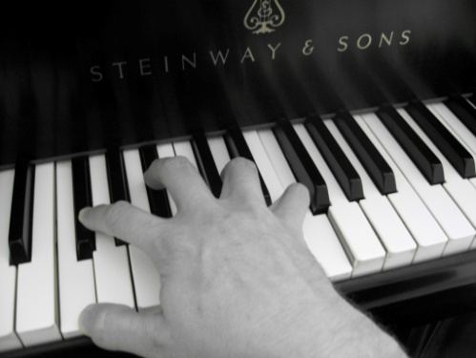
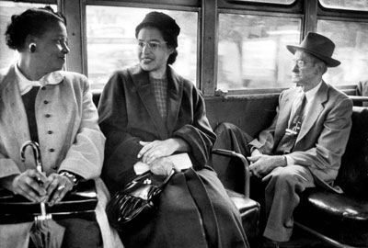
Opening their eyes
Shouting louder doesn’t work
Easiest
Fit in
.. with their interests, beliefs, concerns
Trigger
..them to use more useful mental models
Stimulate
..them to develop new mental models
Dumb blonde.. or….
..boffin?
Hardest
Notes:
Friend who teaches the piano to adults finds interesting patterns in her students preferences, according to their profession. Eg Accountants love working systematically through all the exams, but teachers hate them. So, just as any good teacher, she adapts how she teaches to where they’re at
Rosa parks 1955 got on the Montgomery bus

Slide 24
Any questions from the textchat?

Slide 25
Stage 2: Frozen
“Its not my priority”
“It’s too expensive”
“It’s too risky”
Aware, but insufficiently motivated to act

Slide 26
Where are you getting “frozen” reactions?
Share with text chat and we’ll discuss some a few slides further on
Here are some examples from other workshops..
A field full of unused new, taxed ambulances
Creating a better workspace for the test engineers
A bright idea to improve a jet engine
A reorganisation that’s increased customer complaints
An IT upgrade
Persuading people to act on climate change

Slide 27
Schein’s unfreezing technique
“The data’s unconvincing”
“Its someone else’s responsibility”
“It’s too risky”
“Why should I bother?”
Pressure for change
Resistance to change
3 things to provide simultaneously
Evidence that the status quo is not OK
Connection with things they care about
A sense of psychological safety
Notes:
Example telling off

Slide 28
Schein’s unfreezing technique
“The data’s unconvincing”
“Its someone else’s responsibility”
“It’s too risky”
“Why should I bother?”
Resistance to change
Pressure for change
3 things to provide simultaneously
Evidence that the status quo is not OK
Connection with things they care about
A sense of psychological safety
Notes:
Example telling off

Slide 29
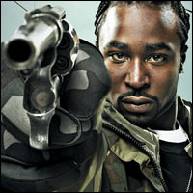
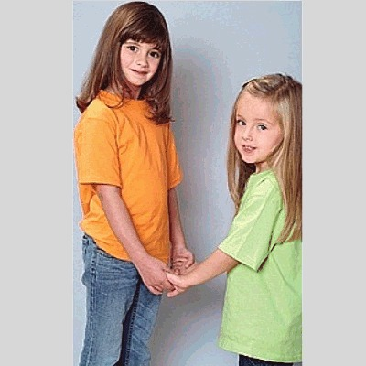
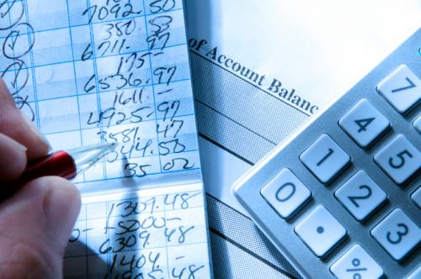
Example
What gave Vandy the courage to leave South Africa?
shock
connection
safety
Being robbed at gunpoint.
Fear her kids would think violence was normal.
Calculating they could afford one year.
Notes:
Plus whe she and husband realised that they’d prefer to try and fail, rather than never try

Slide 30
Some things to try…
Often the key missing element
shock
connection
safety
The status quo’s not OK
Evidence
Physical evidence
Scientific evidence
Financial/legal threat
Moral threat
Political threat
Try
Clear messages
Powerful experiences
Sticky questions
I care about this…
Relevance to me
+
Motivations, eg
Anxiety/guilt
(Opportunity/fun)
Outrage
Values, eg
Creativity/knowledge
Status/competition
Security/comfort
It’s safe to try…
Reduce risk
Safe “practice” grounds
“Permission to fail”
Training
Clear first steps
Reduce defences
Creative involvement
Saving face
Recognising emotions
Provide support
Inspiring vision
Encouragement
Supportive environment

Slide 31
Lets discuss some of your examples

Slide 32
Stage 3: Interested
“Tell me about it”
Be concise and clear
Aim for no more than 10 words
“high-quality distance learning for all”
“drop the unpayable 3rd world debt”
“a vacuum cleaner that sucks better because there’s no bag”

Slide 33
Stage 3: Interested
“Tell me about it”
Be concise and clear
Aim for no more than 10 words
Make sure your evidence clearly supports your message

Slide 34
Challenger disaster
Jan 28th 1986

Slide 35
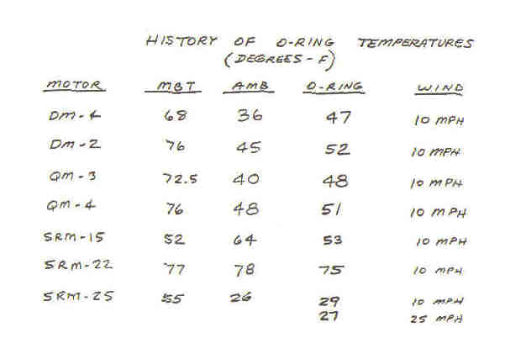
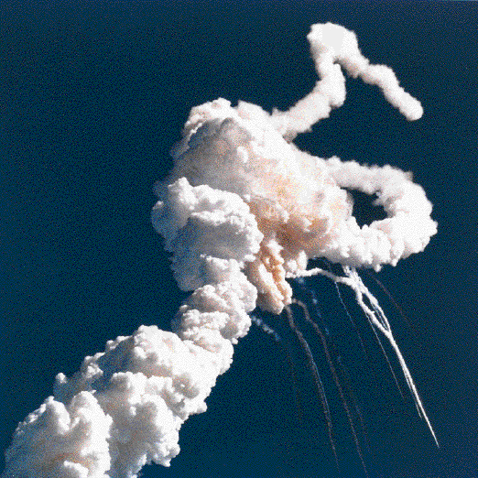
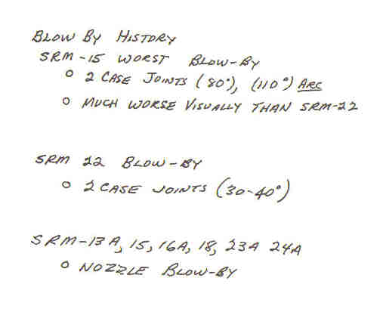
Clear evidence to support your message
Predicted launch temperature
Chart they could have sent
Charts sent to NASA
Notes:
1986

Slide 36
Stage 4: Embedded
Will they say “Sorry we forgot about it” or “We’ve always done it this way”
Reinforcement
Support
Feedback/ sanctions
Notes:
follow up call, First photocopiers, if someone suggests an improvement, say so. If they start distorting and misusing the idea, act.

Slide 37
Any outstanding questions?

Slide 38
For more see
“How to get your ideas adopted (and change the world)
By Anne Miller
Published by Marshall Cavendish 2009
www.annemiller.info
Thecreativitypartnership
Consulting, workshops, training
www.tcp-uk.co.uk
anne.miller@tcp-uk.co.uk
01223 513821
© the creativity partnership 2010

Slide 39
Some techniques
shock
The status quo’s not OK
Evidence
Physical evidence
Scientific evidence
Financial/legal threat
Moral threat
Political threat
Try
Clear messages
Powerful experiences
Sticky questions

Slide 40
Some techniques
connection
I care about this…
Relevance to me, now
+ Motivations, eg
Anxiety/guilt
(Opportunity/fun)
Outrage
+ Fit to Values, eg
Creativity/knowledge
Status/competition
Security/comfort
UK/GB Surveys
0.5
0.45
0.4
0.35
0.3
0.25
Outer directed (Prospector)
Position, power, visible success.
Inner directed (Pioneer)
Self expression, variety, knowledge, creativity.
Sustenance driven (Settler)
Security, comfort, belonging, routine.
0.2
0.15
0.1
0.05
0
1988
1990
1992
1994
1996
1998
2000
2002
2004
2006
Inner Directed
Outer Directed

Slide 41
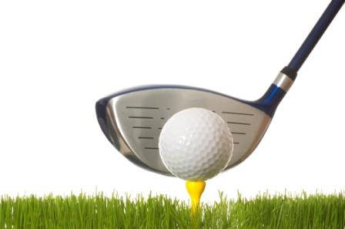
safety
Some techniques
It’s safe to try…
Reduce risk
Safe “practice” grounds
“Permission to fail”
Training
Clear first steps
Reduce defences
Creative involvement
Saving face
Recognising emotions
Provide support
Inspiring vision
Encouragement
Supportive environment

