Slide 1
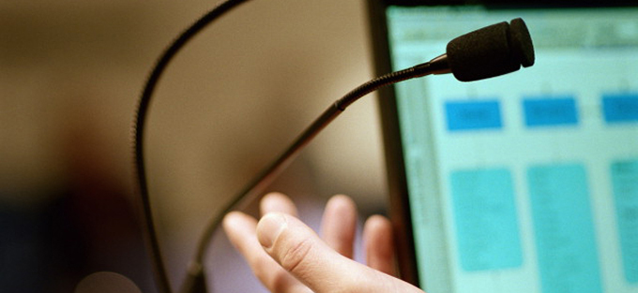
Learning to live in interesting times – what are educational institutions for?
Keri Facer, facilitated by Helen Beetham
Joint Information Systems Committee
Supporting education and research

Slide 2
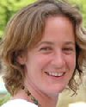
Presenter
Keri Facer is Professor of Education at the Education and Social Research Institute, Manchester Metropolitan University. She leads the Create Research Group in digital cultures, informal learning and educational change.
Facilitator
Helen Beetham is a Consultant to JISC, in which role she supports JISC work on learning literacies for a digital age, curriculum design and Open Educational Resources, as well as other aspects of e-Learning development and strategy.
Joint Information Systems Committee

Slide 3
Session practice
Text-chatting
Elluminate layout
Audio
Whiteboard
Technical problems
Use the text-chat to engage with other delegates, presenter and moderators.
You can send private text-chat messages e.g. to moderators or to individuals.
You can change your Elluminate layout to “Wide layout” to make it easier to follow the text-chat (select “View … Layouts…Wide layout”).
If you are distracted by the text-chat, you can “unlock” the Elluminate layout to enable you to adjust the size and position of the text-chat sub-window (uncheck “View…Layouts …Layout locked”)
It is best to run the Audio Set-up Wizard to test your audio set-up each time you enter an Elluminate room (select “Tools…Audio… Audio setup wizard).
You must use a headset/microphone if you want to ask a question in audio.
Only use your microphone when guided by a moderator – click on the mic icon (bottom-left of screen) to turn it on and click on it again to turn it off.
Only draw on the whiteboard if guided by a moderator.
Send a private text-chat message to “moderators” and they will try to help.
Joint Information Systems Committee

Slide 4
Learning to live in interesting times: what are educational institutions for?
Professor Keri Facer, Education and Social Research Institute, MMU
@kerileef, k.facer@mmu.ac.uk

Slide 5
Interesting times
Education makes a deal with students and with society – invest in education now and build a better future tomorrow –
There is declining confidence in that deal
Students, communities and the public are asking – does education really build better futures?

Slide 6
We work and we borrow in order to work and to borrow. And the jobs we work toward are the jobs we already have. Close to three quarters of students work while in school [college], many full-time; for most, the level of employment we obtain while students is the same that awaits after graduation. Meanwhile, what we acquire isn’t education; it’s debt. We work to make money we have already spent, and our future labor has already been sold on the worst market around. [...] What we learn is the choreography of credit: you can’t walk to class without being offered another piece of plastic charging 20 percent interest. Yesterday’s finance majors buy their summer homes with the bleak futures of today’s humanities majors. This is the prospect for which we have been preparing since grade-school.
Wewanteverything (2009: US Student)
Will the education they are getting really help the individual in future?

Slide 7
Well then invest in education yourself then, why taxpayer's money need to invest YOUR education? Will you pay back to the coffer after you graduate? Where your family's money going? Why you guys always ask for aid? Don't you have any savings?
(comment on YouTube in response to film about university students paying fees)
Will the education we’re offering really help all of society in future?

Slide 8
America’s high schools are obsolete. By obsolete, I don’t just mean that our high schools are broken, flawed, and under-funded – though a case could be made for every one of those points. By obsolete, I mean that our high schools – even when they’re working exactly as designed – cannot teach our kids what they need to know today. Training the workforce of tomorrow with the high schools of today is like trying to teach kids about today’s computers on a 50-year-old mainframe. It’s the wrong tool for the times. Until we design them to meet the needs of the 21st century, we will keep limiting – even ruining – the lives of millions of Americans every year.
Gates (2005)
Are we preparing people for the right futures?

Slide 9
What sorts of educational institutions would rebuild confidence that they are a sound investment for students’ and for society’s futures?

Slide 10
To answer that question we need to ask another one first - what sorts of futures do we think we are preparing for?

Slide 11
Overview
Thinking about ‘the future’ in education
What futures do we imagine?
Some socio-technical trends for the next two decades
Will the physical university still exist?
Some complicating factors
Breakdown or transition?
Getting beyond ‘future-proofing’
Democratic institutions for interesting times…

Slide 12
Before we start…
How old will you be in 2025?
A under 40
B 41- 50
C 51- 60
D 61- 70
E You can’t ask me that at this time in the morning…

Slide 13
Testing our dominant assumptions
The next twenty years will be characterised by a shift towards a global knowledge economy of international trade, digital networks and free movement of people, goods and services
Yes but…
No but…

Slide 14
Thinking about possible futures
What do you think the world will be like in 2025?
The pre-conference discussion thread will continue throughout the conference on this topic
What ideas are coming up out there?

Slide 15
THINKING ABOUT THE FUTURE IN EDUCATION

Slide 16
Thinking about ‘the future’ in education is too often…
Tricky
… I haven’t got time to think about the future, I’m just trying to get through today
Tacit & invisible
‘this is what happened in the past, this is what we’re doing now’
Tokenistic & rhetorical
‘tomorrow’s children will need X so we must do [whatever I wanted us to do anyway]…’
Taken for granted
‘the future knowledge economy of the 21st century’
Technologically determinist
‘futuristic schools’
(building on Noel Gough, 1990)

Slide 17
Problems with these approaches to the future
Disempowerment of educators and young people
These approaches do not give anyone a purchase on how change might come about and what they might do about it
Vulnerability to fads
we haven’t tested the multiple possibilities, and so we have to change each time new ‘futures’ come along
Lack of awareness of ‘special interests’
e.g. dominance of ‘technological’ accounts, dominance of commercial perspectives
No accountability to future generations
there is no mechanism for examining how decisions now might shape the future and who will benefit from these decisions (e.g. PFI?)
No mechanism for assessing how current provision will meet young people’s future needs

Slide 18
What’s the most important source of your beliefs about the future?
A Magazines/news reports
B Research evidence/reports from practice & industry
C History
D Government
E Other (ideas in chat...)

Slide 19
What’s the most important source of your institution’s beliefs about the future?
A Magazines/news reports
B Research evidence/ Reports from practice & industry
C History
D Government
E Other (comment in chat)

Slide 20
The beyond current horizons programme
www.beyondcurrenthorizons.org.uk

Slide 21
BCH Programme Aim
To build a set of long term future scenarios for education in the context of social & technological change 2025 and beyond
Funded by DCSF 2007-2009
Team: Richard Sandford, Steve Sayers, Mary Ulicsak, Dan Sutch, Joanne O’Hagan, Helen Beetham, Helen Haste, Carey Jewitt, Sarah Harper, Rob Wilson, Jessica Pykett, Clara Lemon, Duncan Thompson, Cecilia Thirlway, Lacia Ashman, Graham Hopkins and many others…

Slide 22
The process 2007-2009
Probable futures : exploring potential future inter-relationships between existing social forces and technological developments
commissioning 84 scientific and social-scientific reviews
Possible futures: exploring potential inter-relationships between emergent social forces and technological developments
conducting interviews, events and discussions with over 150 leading thinkers, researchers and organisations. Building a set of potential future scenarios for education.
Preferable futures: exploring the future developments individuals and groups want to see emerge and which they are already working to make happen
running online and face to face engagement activities with over 500 education stakeholders

Slide 23
Socio-technical futures to 2025

Slide 24
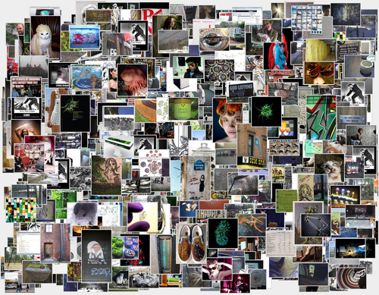
1. We will have the capacity to ‘know more stuff about more stuff’
Social trends toward accountability and security,
The decreasing cost and increasing availability of digital storage capacity,
The development of new forms of bio- and genetic information,
The ability to digitally tag almost any physical object, space or person,
The ability to represent information in more diverse media;
Image by Noah Sussman Tumbollage (Creative Commons License applies)

Slide 25
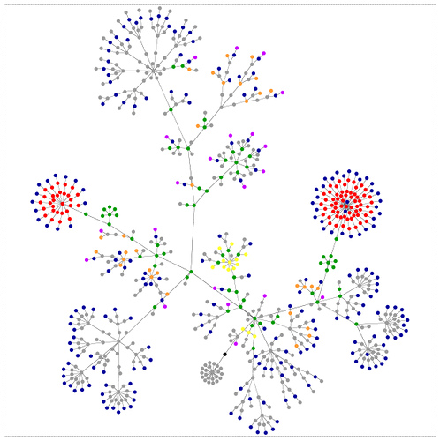
2. The personal ‘cloud’
The capacity to connect to a network, and be constantly connected to knowledge, resources, people and tools
Expectations of ‘perpetual contact’ with diverse networks and communities, both physical and virtual.
Mobile/distributed families creating new notions of ‘absent presence’
My filter systems/friends – shaping what information I get
My systems shaping what information I get
Image by Noah Sussman – Creative Commons License Applies

Slide 26
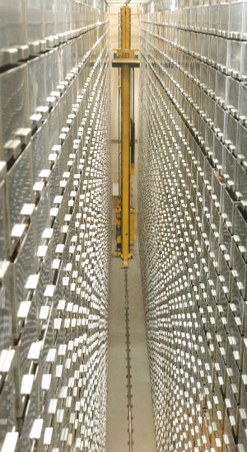
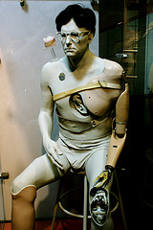
3. Working and living alongside machines becomes increasingly normal
Devolving responsibility to machines: simple manual tasks or outsourcing the management of complex systems
Cosmetic Pharmacology & Intelligent Prostheses (Brain-computer interfaces)
Different generations with different degrees of comfort in delegating power and responsibility to machines.
Growing computers – ethics?
Image from Andrew Harrison, DEGW
Patterned (Flickr): Creative Commons License

Slide 27
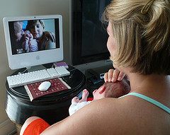
4. Changing organisation of space
Distance matters less:
Access information, people and resources anywhere
Familiarity & social etiquette of working at a distance
Increased international migration & decreased ease of frequent travel
Geography still counts:
Place plays a role as identity marker & shapes regulatory/legal issues. Place shapes cultures of innovation, economies and exchange
Lars Plougmann: creative commons license applies

Slide 28
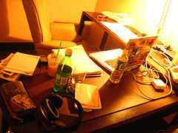
5 Weakening institutional boundaries
Cultural shifts: younger age groups merging working and leisure practices
Demographic shifts: adults needing to balance caring, working, learning, relationships
Remote working, freelance working, a ‘cloud’ of labour around a core
Shift towards networked institutional models
Cindy47452 (flickr): Creative Commons License applies
Brande Jackson: Creative Commons License applies
SJ Photography: Creative Commons License applies

Slide 29
The rise of the ‘knowledge worker’ ?
Crowdsourcing
Collaborating
Building personal reputations and brands
Managing multiple roles
Working with data, working on data, reworking data

Slide 30
Education for knowledge workers …?
Just-in-time, work based learning, 2400 ‘corporate universities’ by 2004
Wholly online, personalised, organised around the learners’ schedule
Phoenix university, graduated over 30,000 students since it started, no frills
24 states in the US have state-wide virtual schools by 2005, the UK has three wholly online schools
The reorientation of education around the individual not the institution

Slide 31
Is there a future for the physical university in 20 years in this knowledge economy?
Vote:
Yes, but…
No, but…
Your comments in chat..

Slide 32
‘complicating factors’

Slide 33
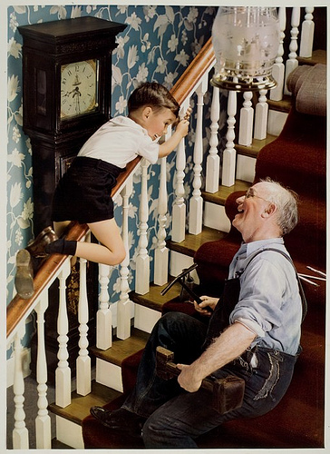
Aging Populations
Over 50% of the population of Western Europe aged over 50 by 2030 with a further 40 year life expectancy.
Over 25 % aged over 65.
Population ageing a global phenomena, not just restricted to Europe/US
Lifelong learning…
Or the beginnings of Intergenerational conflict?

Slide 34
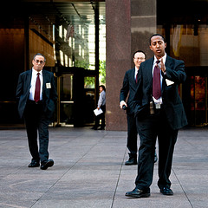
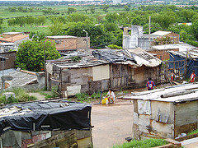
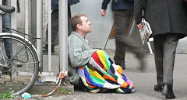
Declining confidence in the knowledge economy future
Polarisation of workforces:
Rise of elites in major organisations
Increased positional competition in middle classes
Digital Taylorism & ‘ordinary’/low paid work – caring, agriculture, services
Displacement of many jobs by socio-tech systems
High Skills Low Wage Future?
Troy Holden: CC license applies
Fiona L Cooper: CC license applies
Jessica Mulley: CC license applies

Slide 35
Other futures?
Environmental and materials critique
Dependent upon energy and materials sources in short supply – fixable? Waste mining, alt. energy?
2 degree temperature rise built in – species loss, radical adaptation, loss of habitat
Economic critique of the ‘knowledge economy’
Premised upon enclosing core economy goods of time, family life, public space – economically unsustainable
Premised upon ensuring a significant % are dispossessed/excluded to continue to drive wages lower

Slide 36
Other futures?
Breakdown
Radical polarisation, environmental constraints and demographic change lead to significant civil unrest, leading to crackdown and control. The emergence of ‘green zones’ for the wealthy and declining or loss of quality of life for the remainder
Transition
Social and environmental value become central goal and measure of policy making and public investment; increased localisation and commitment to sustainable economies; Transition towns
See Global Scenarios Group/Tellus Institute

Slide 37
Which way do you think it’s going to go?
A – Business as usual – same values, no constraints
B – Exert discipline to limit risks – same values, more control/tweaks
C – Collapse/breakdown
D – Transformation/Transition – new values, rethink

Slide 38
Which way do you want it to go?
A – Business as usual – same values, no constraints
B – Exert discipline to limit risks – same values, more control/tweaks
C – Collapse/breakdown
D – Transformation/Transition – new values, rethink

Slide 39
Discussion Thread
What would education look like that sought to prepare young people and societies for these different possible futures?
Discussion thread set up on this in the conference

Slide 40
In defense of a future-building education institution

Slide 41
From future-proofing to future-building
Future-proofing is
Being on the back foot, protecting individuals and institutions against change
It is thinking that building flexibility, adaptability and responsiveness to change is sufficient
It is assuming someone else is in charge of what will happen
Future-building is
looking clearly at possible futures in development; and
asking ‘how can we work together to tip the balance in favour of futures that offer real wellbeing for our students’

Slide 42
Rebuilding the educational contract
Tipping the balance in favour of futures that offer real wellbeing for our students
Developing students’ capacities to shape their futures
Building societies that are fair, democratic and sustainable
Developing students’ capacities to create fair, democratic and sustainable futures
A student with a first class degree entering an impoverished world in breakdown is not guaranteed a great future
A student with a first class degree who treats the world and the people in it as their playthings is not building a future in which others should invest

Slide 43
Principles for a future-building university
A curriculum for interdependence
With other people/ with our socio-technical systems/ with the material world
A pedagogy of engagement
Learning to contribute to the world, not simply inherit it
Democratising research, design, production – tools for developing knowledge for survival
Valuing the local
The local and institutional matters as a site for change
The local as a public space to bring people together and encounter difference. Beyond the university a ‘spaceship’
Connected
Learning from and contributing to the other organisations/sectors trying to build the same futures

Slide 44
The role of TEL in this agenda
A curriculum for interdependence
Tools & practices to make visible our interdependence
A pedagogy of engagement
Powerful tools& practices for building, sharing, critiquing and creating knowledge
Valuing the local
Tools & practices to map the local, develop community knowledge commons, build accountability and transparency
Connected
Tools & practices for connectivity beyond the institution, the local and the national

Slide 45
There are other people asking these questions
Democratic education movements
Co-operative education movements
International democratic research movements
The Education Justice Collective
Open Education Resources
Wellcome Beacons for public engagement

Slide 46
Living in interesting times

Slide 47
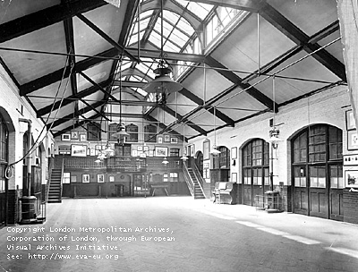
We have coped with change before
Industrialisation - Electric light, phonographs, wireless cinema, early globalisation, mass production
Invented playgrounds and new school spaces, universal primary education, widening access to higher education and laws banning child labour

Slide 48
Flourishing in interesting times
Pessimism is a luxury of good times. In difficult times, pessimism is a self-fulfilling, self-inflicted death sentence. (Evelin Lindner)
My aspiration for education:
Educational institutions that build sustainable, fair and democratic futures for their students and the societies that they depend upon
What is yours? Are you doing it already? And how are you going about it?

Slide 49
Thank you - join Helen and myself online for more discussion
k.facer@mmu.ac.uk @kerileef

Slide 50
Acknowledgements & Links
Thanks to the Create Research Group and Education and Social Research Institute, Manchester Metropolitan University, for their support and challenge in exploring these ideas.
The socio-technical trends described here are derived from the work of the Beyond Current Horizons project which I led from 2007-2009 while Research Director at Futurelab. The research team on this project included Richard Sandford, Dan Sutch, Steve Sayers and Mary Ulicsak. The implications for education presented here should be understood to be my personal views and do not reflect the views of participants of the BCH programme, its participants or its funders. All members of the advisory group, challenge leads and review authors along with the full text of the final report from the programme can be found at:
www.beyondcurrenthorizons.org.uk/outcomes/reports/final-report-2009/
Images/photographs are attributed to their author where possible. They are used under Creative Commons license which means that they can be displayed elsewhere, but only with attribution, and they should not be modified in any way or used for commercial purposes. They were (almost) all sourced from Flickr
The futures tools can be found as follows:
www.millionfutures.org.uk; www.visionmapper.org.uk; www.powerleague.org.uk;

Slide 51
Some ideas to follow-up
Henry Giroux – educated hope (always a good, challenging read on the importance of the critical in education)
Arjun Appadurai – democratic research (interesting international perspectives on why we need to support people to create strategic knowledge)
Erik Olin Wright – real utopias (the case for challenging inherited futures and the need to create viable alternatives)
Keri Facer – learning futures (book, due out 2011 published by Routledge, goes through many of the arguments from this talk in more detail)
Jean Anyon – radical possibilities (the potential for local educational institutions to act as hubs for social change)
Inayatullah, Slaughter, Dator – alternative educational futures (three of the big writers on educational futures)
Global Scenarios Group/Tellus Institute – the great transition (a very useful set of future scenairos and the basis for the international transition movement)
Danny Dorling – Inequality (v. interesting on myths underpinning justification for inequalities in education)
Wilkinson & Pickett – The spirit level (a book that makes the case that more equal societies benefit everyone in them)

