Slide 1

From Courses to Communities
Nigel Paine
Joint Information Systems Committee
Supporting education and research

Slide 2
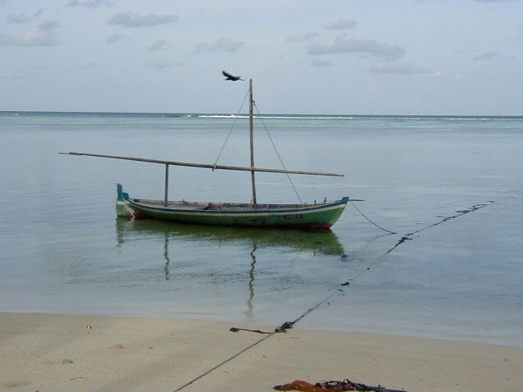

Slide 3
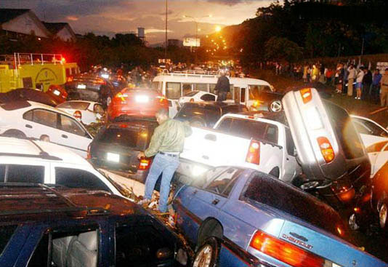

Slide 4

Open: what might work
Cull: what will work
Focus: energies on success
Share highlights
Donald Taylor

Slide 5
First Question
Do you prefer JISCEL09 as an online conference
To a face to face physical conference?
Y or N

Slide 6
One Insight

Slide 7
Not Just A People Issue
‘Can Do’
environment
High Performance
Creating Great
Environments
low calibre
retarded performance
Developing Great People
Strategic Dimensions

Slide 8
Not Just A People Issue
‘Can Do’
environment
High Performance
Creating Great
Environments
low calibre
retarded performance
Developing Great People
Strategic Dimensions

Slide 9
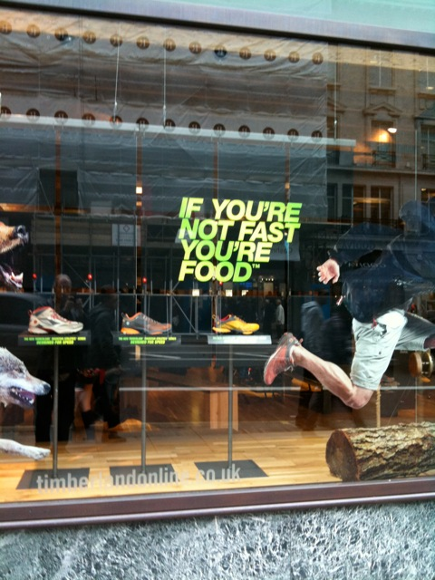

Slide 10
Do You Feel You Work in a Great Environment?
Y
Or
N

Slide 11
Patrick Dixon

Slide 12
Colleges/Universities who
Patrick Dixon

Slide 13
Max DuPree
"The first job of a leader is to define reality,…...”

Slide 14
For YOU and all Leaders
TO: Framing
FROM: Shaping

Slide 15
How Much Autonomy?
A: Loads, I can just get on with it.
B: Some, I can get away with it.
C: A bit, but difficult.
D: None at all, really.

Slide 16
We Have to Change Learning!
From courses TO environments
From knowledge TO knowledge delivered shared
From control TO free flow
From individuals TO communities
From skills TO values and attitude

Slide 17
Which is Most Important?
A: the learning environment
B: Two way sharing/ building of knowledge
C: More autonomy
D: Indiv to communities
E: Skills to values and attitudes

Slide 18
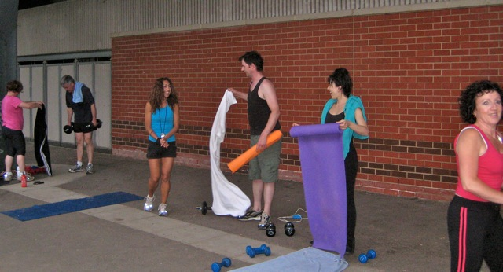
Learning to
Know
Learning to
be
Learning to do
Learning to
live

Slide 19
?
Radical New Models
Personal Resources and Archives
Peer Network selected by Learner
Learner
Personalised Information Feeds and Mobile Tools
Mentors inside and outside
Based on a slide from Martin Bean VC the OU

Slide 20
Drucker’s Definition of Innovation
“Change which creates a new
dimension of performance.”

Slide 21
These Are Some Things They Said
More talk; more sharing; more freedom
Great leaps forward
Fun environment, energetic
Motivating, competitive environment
Unpredictable, Challenging, Learning 24/7
Risk taking, no blame culture
Curiosity valued, sharing of ideas
A place where you beg forgiveness
not ask permission

Slide 22
QUESTIONS?

Slide 23

4 Stage Model for the
Learning Lifespan
(18) – 25
25 – 50
50 – 75
75+
3 Transition Points

Slide 25
The Networked Learner
‘It will become more difficult to distinguish the
individual learner from the networks of people
information and tools, with which they
are connected.’

Slide 27
Formal and Informal Learning
Participation in, and mobilisation of,
social networks will reinforce offline
and informal patterns of communication,
information and knowledge exchange.
Formal education will have to follow
that direction.

Slide 28
Frances Hesselbein
Imperatives of leadership 2010 – 2020
Move innovation right across the organisation.
Disperse the demands of leadership right through the organisation.
Build collaboration: leading outside the walls
Build: access for growth, development and participation

Slide 29
THINGS TO ADD?

Slide 31
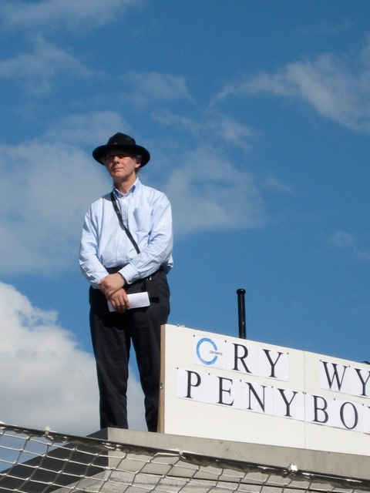
Venue is important for online and f2f

Slide 32
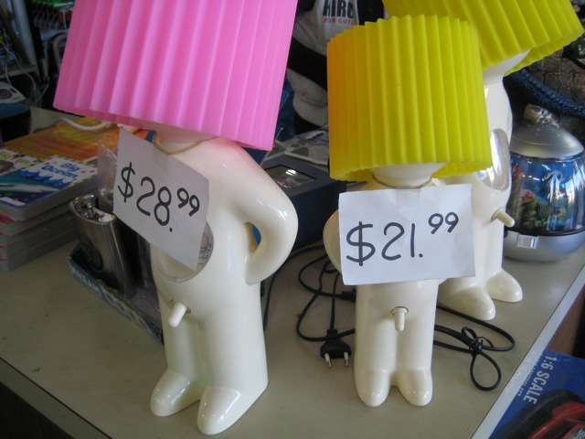
The key to learning success: FUN

Slide 33

Develop tools for communities
not communities for tools!

Slide 34
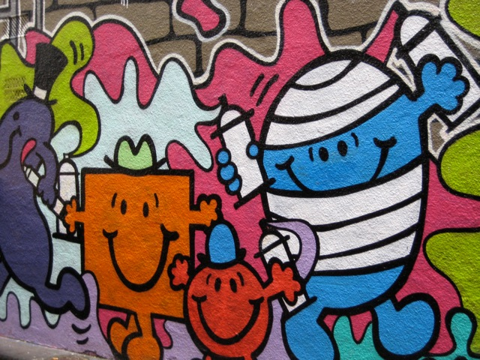
Make it easy to get started

Slide 35
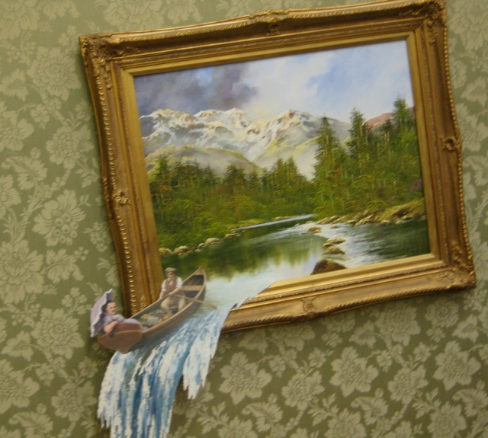
Be flexible
Be emotional

Slide 36
The Virtuous Learning Circle
Performance
Personal Growth and Organisational Success
Knowledge
Cohesion
Chris Yapp:

Slide 37
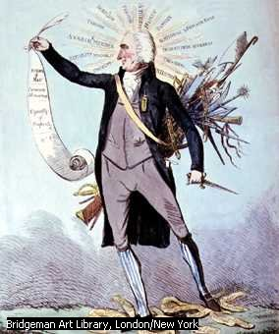
Not Everything is Equally Important

Slide 38
From Courses to Communities
Friday 27th November 2009
JISC Innovating e-learning 2009
Nigel Paine
nigel@nigelpaine.com
www.nigelpaine.com
Twitter - ebase

