Slide 1
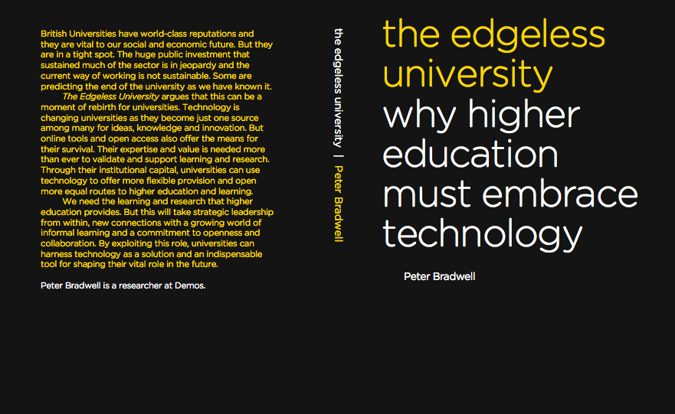

Notes:
About the pamphlet.
Based on interviews with a series of leading thinkers in the area followed by an expert roundtable.
It is written to provide a story about the strategic role of technology .

Slide 2
www.demos.co.uk
Notes:
About Demos and who we are / I am.

Slide 3
Questions for you
  What’s missing?
  What’s wrong?
  What’s useful?

Slide 4
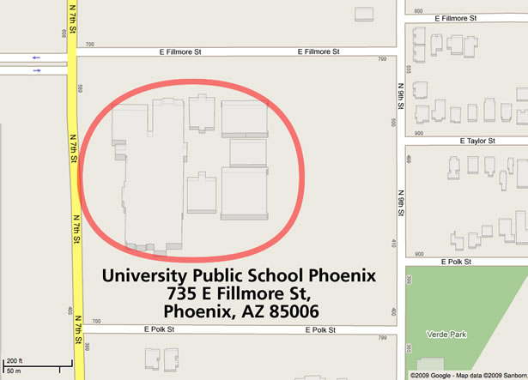
An ‘Edgeless’ University?
‘….in function, not in form…’
Notes:
Technology is helping change the way that learning and research happens.
And that can seem threatening to higher education institutions – to their expertise and to their business models.
But we argue in the Edgeless university that this doesn’t have to be the case.
Technological change opens up new possibilities.
‘Edgeless Universities’ are institutions who understand how to capitalise on their institutional value and role in this new environment. They are willing to provide teaching and learning in new ways to support the diverse needs of students; to help lecturers, academics and researchers adapt and take advantage of new connections; and appreciate the value and institutional capital they still hold.
They recognise that there are more points of intensity now - places where learning and research happens – that can lie outside their institutional walls. But their institutional status in this environment is not diminished and learning to operate in this edgeless world is really important.
This presentation will build on the findings of our pamphlet. It is designed to be participative, which basically means that we’d like you to do as much work as me. I’ll pause every so often to discuss what’s being said, and then a bit later we’ll have some more interactive work where we’ll be prioritising some of the possibilities, challenges and solutions.
The aim is less to just pimp out the Demos pamphlet – although I should point out that it is available to download free, like all our reports, at our website.

Slide 5
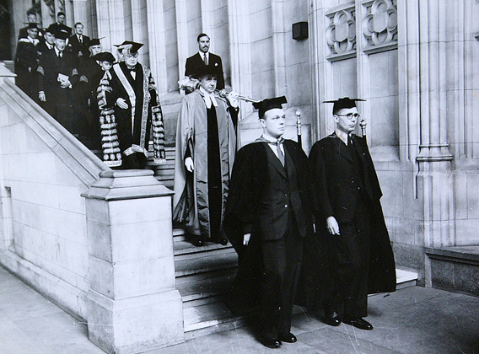
The status of universities
  Four British institutions among the top ten global universities
  Contribute £59bn to UK economy

Slide 6
The challenges for universities
  Maintaining standards
  Rising demand and widening participation
  Strained resources
Notes:
The number of people passing through UK universities is rising: between 1997 and 2007 the number of students in higher education grew from 1.8 million to 2.4 million.
Progress towards 50% target
Continued desire to pursue equality of aspiration and opportunity.
Moral and economic imperative.
Numbers vs equality
Funding shortfalls.
Likely fees increase, likely falls in state funding (of 5%).

Slide 7

The ‘perfect storm?’
  Global financial crisis
  How can universities maintain standards, continue to improve access, all with strained resources?
Notes:
The number of people passing through UK universities is rising: between 1997 and 2007 the number of students in higher education grew from 1.8 million to 2.4 million.
Progress towards 50% target
Continued desire to pursue equality of aspiration and opportunity.
Moral and economic imperative.
Numbers vs equality
Funding shortfalls.
Likely fees increase, likely falls in state funding (of 5%).

Slide 8

What can technology do?
  The age of knowledge, ideas and information.
Notes:
It is hard to imagine a topic for which you won’t easily find a range of instructional material, videos and openly available knowledge. And it is equally hard to avoid finding people who want to tell you more about a subject, or learn or research it with you.
Much of this would have been impossible ten years ago.

Slide 9
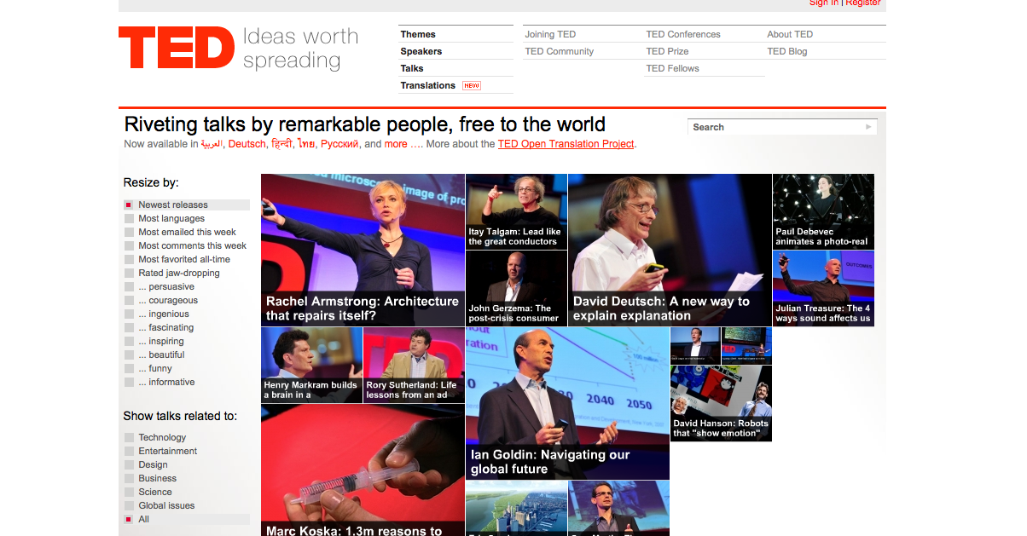

Slide 10
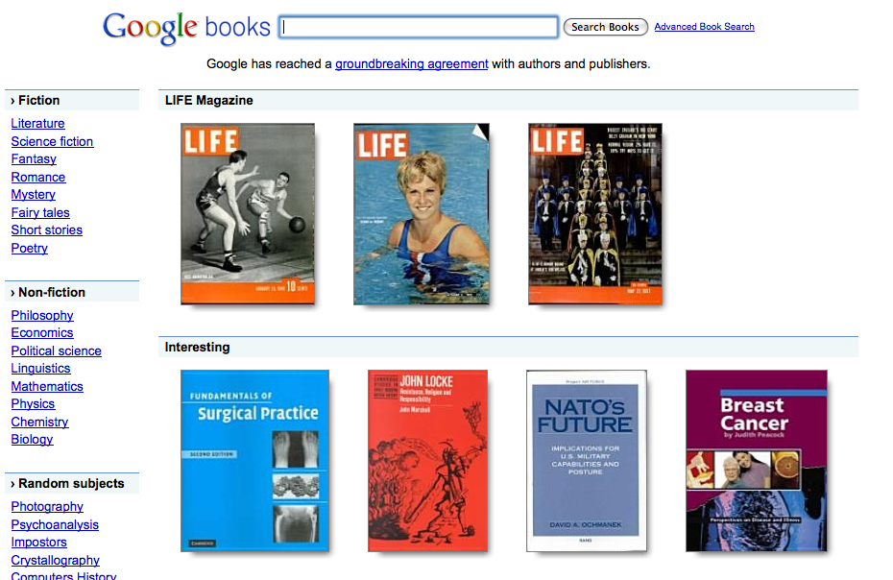

Slide 11
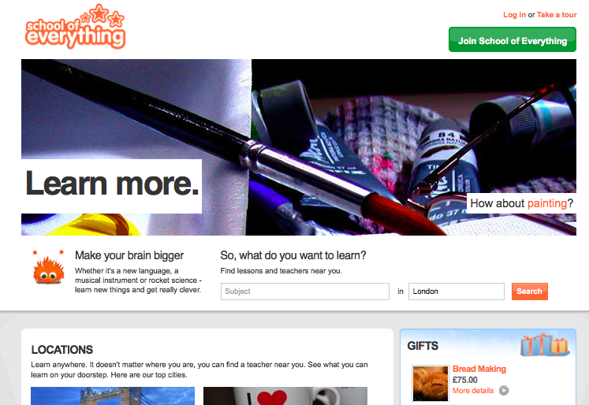

Slide 12
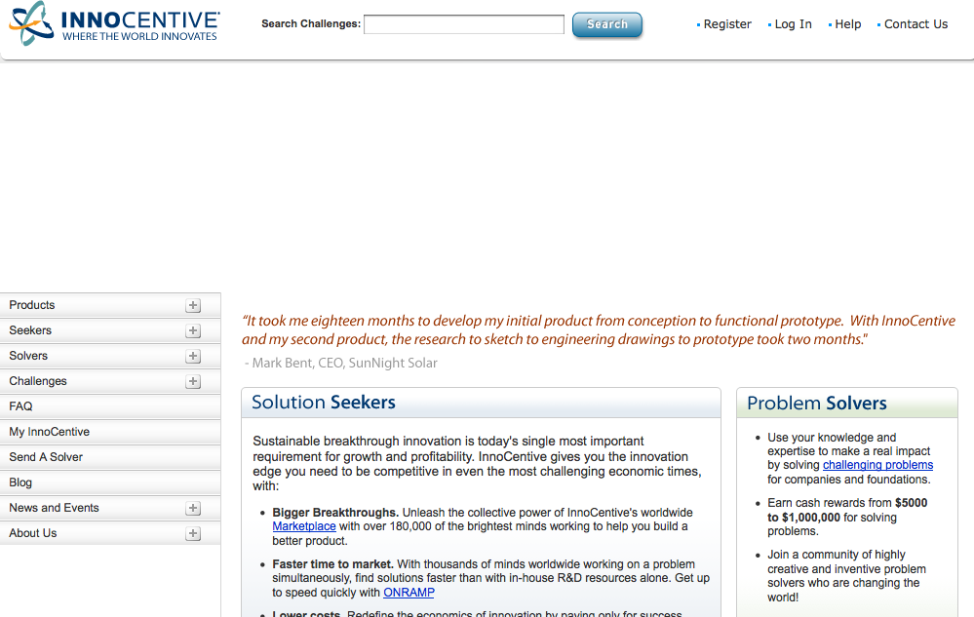

Slide 13
Why technology helps learning
  Collaboration
  Availability of information
  People
Notes:
It is hard to imagine a topic for which you won’t easily find a range of instructional material, videos and openly available knowledge. And it is equally hard to avoid finding people who want to tell you more about a subject, or learn or research it with you.
Much of this would have been impossible ten years ago.

Slide 14
Not just a threat
It’s not just a threat
  Emphasising value
Notes:
Could be seen as a threat.
Universities aren’t the only game in town any more. They have become one source among many for ideas, knowledge and learning.
But far from undermining them, this can serve to emphasise their value.

Slide 15
Not just a threat
It’s not just a threat
  Emphasising value
    Affiliation and status
    Accreditation
    Authority
Notes:
Could be seen as a threat.
Universities aren’t the only game in town any more. They have become one source among many for ideas, knowledge and learning.
But far from undermining them, this can serve to emphasise their value.

Slide 16
Questions for you
  What’s missing?
  What’s wrong?
  What’s useful?

Slide 17
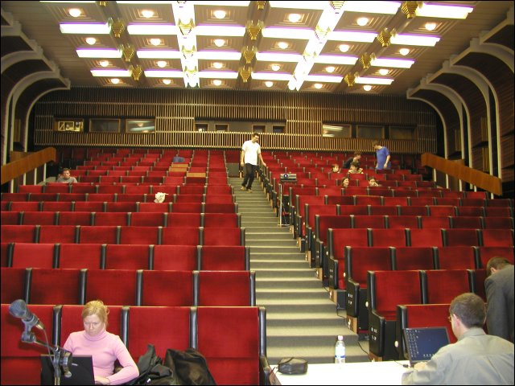
IMPROVING TEACHING
AND LEARNING

Slide 18
Priorities
Teaching students to analyse information and work collaboratively
Putting lecture notes, podcasts and videos online
Providing more interactive teaching
More online ‘contact’ with students
Training staff and academics
Notes:
CUT DOWN TO FIVE; INVITE DISCUSSION OVER EACH.

Slide 19
Inhibitors and challenges
Staff skills and awareness
Staff engagement and willingness to learn
There is a lack of institutional interest or leadership
A lack of resources to invest
It’s difficult to know when and what to change

Slide 20

COMMUNICATION AND
OPENNESS

Slide 21
Priorities
Making research more freely available
‘Curation’ of research data
Openness with institutions’ data
Promoting shared resources
Understanding researchers’ / academics’ needs

Slide 22
Inhibitors and challenges
Publishing business models are a problem
Lack of incentives for academics to be more open
Competition amongst institutions or academics
It’s hard to make the materials of a high enough quality
Dealing with feedback

Slide 23
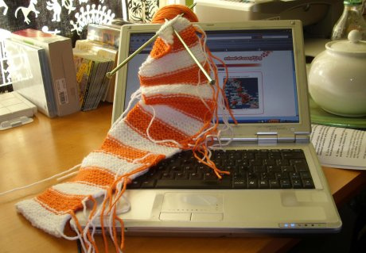
NEW KINDS OF
PROVISION

Slide 24
Priorities
New, more flexible degree courses
Links with alternative providers like School of Everything
More purely online provision
Collaboration between institutions
Staff training in supporting new kinds of learning

Slide 25
Inhibitors and challenges
The way formal higher education is funded mitigates against innovation
We don’t know enough about what learners want
It’s hard to balance online provision with face-to-face needs
Universities should retain the current models of teaching provision
Maintaining a pursuit of ‘widening participation’

Slide 26

CATALYSTS FOR
CHANGE

Slide 27
The catalysts
Staff training and support
Supporting collaborative research platforms
A greater recognition of and status for high quality teaching
Understanding the value and role of your university
More resources dedicated to improving the use of technology

Slide 28
peter.bradwell@demos.co.uk
Notes:
About the pamphlet.
Based on interviews with a series of leading thinkers in the area followed by an expert roundtable.
It is written to provide a story about the strategic role of technology .

